Slide 1
Practical Rootkit Detection with RAI
Christoph Csallner, University of Texas at Arlington http://ranger.uta.edu/~csallner/
Joint work with: Shabnam Aboughadareh
This material is based upon work supported by the National Science Foundation under Grants No. 1017305, 1117369, and 1527398. Any opinions, findings, and conclusions or recommendations expressed in this material are those of the author(s) and do not necessarily reflect the views of the National Science Foundation.

Slide 2
Practical Detection Challenges
C1: Malware detection app = Attack surface
Current AV very large
C2: Signature-based is slow
Deployment typically needs app restart
New attack signature not yet in black list
What if legacy app infected before white-listed?
C3: Can’t trust legacy platforms
No TPM, intel VT-x, etc.

Slide 3

Threat Model: Many machines like:
App#1
App#N
….
User
Kernel
Operating System
Kernel Module#1
….
Kernel Module#M

Slide 4
Threat Model
Monitored app / OS may be kernel- or user-mode
OS may be on hardware, container, VM
System may already be under attack
Adversary has full ongoing access to OS & apps
Inject code
Manipulate binaries on disk & in memory
Obtain higher privilege level: Root, ..
Hook sys call table, overwrite code & read-only data

Slide 5
RAI Setup
App 1
....
App N
App 1
....
App N
Operating system
Operating system
Kernel module 1
Kernel module 1
....
....
RAI kernel module
Hashes
RAI kernel module
Machine 1
RAI
Back-end
Machine 3
App 1
....
App N
App 1
....
App N
Operating system
Operating system
Kernel module 1
Kernel module 1
....
....
RAI kernel module
RAI kernel module
Machine 2
Machine 4

Slide 6
RAI Design
RAI component is tiny kernel module
Easier to install / test / port / hide
Small attack surface
No need for special hardware / virtualization
Offload almost everything to RAI server
On-demand (“real-time”) detection
No restart of monitored system / app needed
No need to disable current AV
No need to black / white list

Slide 7
RAI Design
Deploy on running applications
Get dynamic white / black list via voting scheme
Client: Periodically monitor (hash) physical memory
Server: Request & compare hashes in random intervals
If only minority of apps infected
Server voting scheme: Hash outliers are suspicious
Attack usually spreads relatively slowly across sites

Slide 8
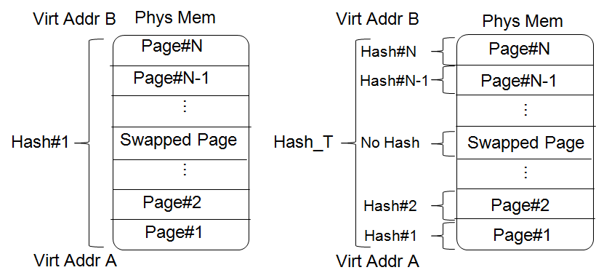
Implementation: Physical Memory (RAM) Hashing
Hash of pages’ hashes
Different machines may swap out different pages
If comparison fails: Compare page-level hashes

Slide 9
Monitoring Dynamically Loaded Code
Problem: Two instances of application can be in two different execution states
Example: A benign dynamic library is loaded into one instance but not into the other instance
Solution: Hashing each executable segment separately
benign_lib2.so
benign_lib1.so
benign_lib1.so
ld.so
Hash_T2
ld.so
Hash_T1
libc.so
libc.so
.text
.text
Application A in state S1
Application A in state S2

Slide 10
De-relocate Addresses
Virtual addresses of kernel module / app library may differ across executions: Load order, etc.
Position Dependent Code: In kernel module / legacy libraries
OS loader “relocates” relative with absolute virtual address
Different absolute address → Code hashes will differ
Don’t want to rely on disk contents to resolve problem
Heuristic Approach: Disassemble memory contents, find addresses and de-relocate them
Use Distorm disassembler: Provides convenient access to opcodes and operands

Slide 11
Evaluation: Two Setups
“Local” setup
All clients on same physical machine
40 VMware Ubuntu Linux instances
Two groups with the same kernel versions (2.6 and 3), 512 MB RAM, 32 and 64 bits processors
100 user-mode applications and 41 kernel modules
One VM dedicated server: Ubuntu 12.04 LTS, 64 bits
AWS setup
Sets of 6—60 clients equally distributed over 10 AWS regions
Similar setups to local experiment
90 user-mode applications
Ubuntu 12.04 LTS, 30 GB RAM server running in Oregon

Slide 12
RAI evaluation: Slowdown
Test-bed:
20 Ubuntu Linux VMWare virtual machines, kernel version 2.6, 3, 32-bit or 64-bit Intel processor, 512 MB RAM
Server: Debian Linux, 2.33 GHz Xeon, 64-bit, 32 GB RAM
100 user-mode applications and 41 kernel modules
RAI Activity | Target | Loc | Slowdown (%)
Hash | User-mode app | Client | 8
Hash | Kernel (OS) | Client | 3
Hash + de-relocate | Kernel module | Client | 20
Compare hashes | 20 VMS | Server | 15

Slide 13
RAI evaluation: False positives
- False positive rate for user-mode applications and OS: 0%
- False positive rate for kernel-mode modules: below %10
Reason: Disassembly errors for de-relocation of dynamic addresses.
Kernel Module | Number of Pages | False Hash | False Positive(%)
e1000 | 22 | 3 | 13.6
vmwgfx | 18 | 2 | 11.1
ttm | 11 | 1 | 9.0
drm | 33 | 1 | 3.0
bluetooth | 55 | 3 | 5.4
rfcomm | 9 | 1 | 11.1
psmouse | 16 | 2 | 12.5
All 41 modules | 314 | 13 | 4.1

Slide 14
RAI Evaluation
Example detected rootkits
Rootkit | Exec Mode | Kernel Version | CPU | Loc | Attack
LD_PRELOAD | User | 3, 2.6 | 32-bit, 64-bit | Memory | Exchange Libraries
Jynxkit | User | 2.6 | 32-bit | Memory | Exchange Libraries
Patch dynamic loader | User | 2.6 | 32-bit | Disk | Inject code
Attach to process | User | 2.6 | 32-bit | Memory | Divert Execution
System call hooking | Kernel | 3 | 64-bit | Memory | Change kernel data
Suterusu | Kernel | 3 | 64-bit | Memory | Change kernel code

