Slide 1

CyFuzz: A Differential Testing Framework
for Cyber-Physical System Development Environments
VeriVITAL - The Verification and Validation for Intelligent and Trustworthy Autonomy Laboratory
SERC - Software Engineering Research Center
Shafiul Azam Chowdhury
Dr. Taylor Johnson
Dr. Christoph Csallner
The University of Texas at Arlington
Available: http://shafiulazam.com/cyfuzz
Source Code: https://github.com/verivital/slsf_randgen
6th Workshop on Design, Modeling, and Evaluation of
Cyber Physical Systems (CyPhy), Oct. 2016. To appear.
This material is based upon work supported by the National Science Foundation under Grants No. 1117369, 1464311, and 1527398. Any opinions, findings, and conclusions or recommendations expressed in this material are those of the author(s) and do not necessarily reflect the views of the National Science Foundation.
This material is based upon work supported by the Air Force Office of Scientific Research (AFOSR) contract numbers FA9550-15-1-0258 and FA9550-16-1-0246, and by Air Force Research Lab (AFRL) contract number FA8750-15-1-0105. Any opinions, ndings, and conclusions or recommendations expressed in this publication are those of the authors and do not necessarily reflect the views of AFRL or AFOSR.
Project Homepage URL

Slide 2
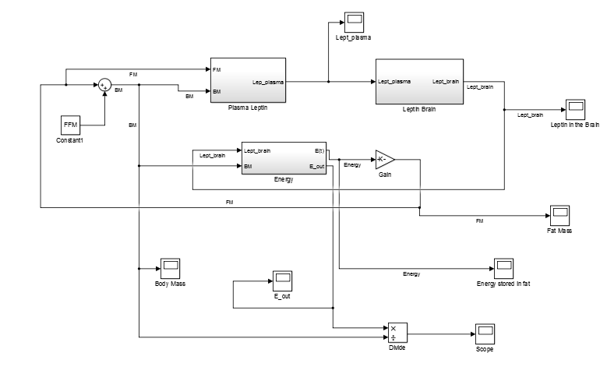


Engineering process of CPS
Model-based design
Development environments
Simulation & Code Generation
Image on the right: sample Simulink model. This image is licensed under the Creative Commons Attribution-Share Alike 4.0 International license. Media URL: https://commons.wikimedia.org/wiki/File:Simulink_lept.png
Notes:
Recently MBD methodology has become the preferred method for designing, modelling and simulating complex dynamic systems [1]

Slide 3
Defects in Development Environments
Typical assumptions:
Compilers
Code Generators
Simulators
Tools
Do not have bugs
Notes:
CC says: You only have full audience attention for the first ca. 5 minutes of your talk. If a speaker does not get to the point on slide 2, people start to zone out and check their email.

Slide 4
Defects in Development Environments
Typical assumptions:
Compilers
Code Generators
Simulators
Tools
Do not have bugs
MLOC Program
(CPS tool chain)
Without bugs?
Notes:
Csmith ref: [7, 8]
CC says: Keep left side, move right side to “Related Work” section at end of presentation

Slide 5
Defects in Development Environments
Typical assumptions:
Compilers
Code Generators
Simulators
Tools
Do not have bugs
MLOC Program
(CPS tool chain)
Without bugs?
What happens if CPS tool chain injects subtle bugs/security holes into CPS?
Notes:
Csmith ref: [7, 8]
CC says: Keep left side, move right side to “Related Work” section at end of presentation

Slide 6
Tools Improvement Approaches
Formally verifying components
[-] Currently Not feasible
Large codebase
Formal
Spec.
[-] No complete and/or updated specifications
Rapid release cycle of products
Notes:
[1, 11]

Slide 7
Background: Differential Testing
Test Generator
generate
Code, Model
Test Subjects
Compiler 1
Compiler 2
compile
Binary 1
Binary 2
execute
compare
Output 1
?
Output 2

Slide 8
E.g. Csmith: Yang et al. [2011]
Random Generator
generate
C
Varying compilers & optimization settings
gcc -o1
gcc -o2
llvm -o0
compile
compile
crash
Binary 1
Binary 2
execute
compare
Output 1
?
Output 2

Slide 9
Background: Differential Testing
[+] Don’t need full formal language specs to find bugs
[+] No false warnings if undefined behaviors are avoided
[+] Inexpensive
Random Generator
generate
Code, Model
Test Subjects
Compiler 1
Compiler 2
compile
Binary 1
Binary 2
execute
compare
Output 1
?
Output 2

Slide 10
Background: Differential Testing
[+] Don’t need full formal language specs to find bugs
[+] No false warnings if undefined behaviors are avoided
[+] Inexpensive
Random Generator
generate
Code, Model
Test Subjects
Compiler 1
Compiler 2
compile
Others found many bugs with this in production compilers / tools which are part of the CPS tool chain
Binary 1
Binary 2
execute
compare
Output 1
?
Output 2

Slide 11
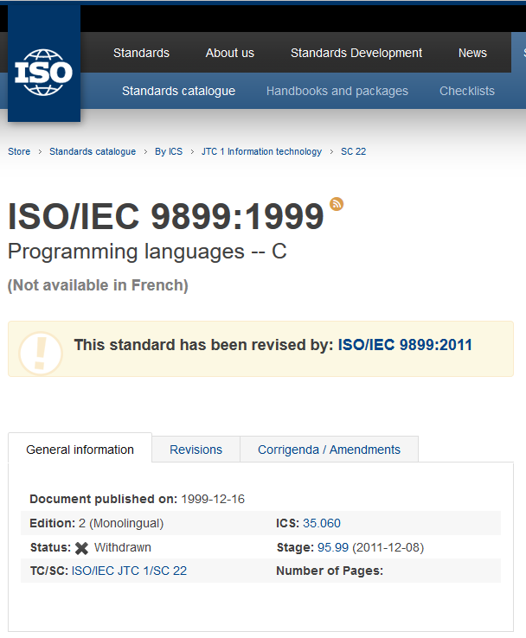
New Challenges for Fuzzing CPS tool chain
Having some spec. is useful:
Efficient generator (not generating many invalid tests)
E.g. Csmith generate tests following C99 specification
Image: The C99 standard, screen-captured from URL: http://www.iso.org/iso/iso_catalogue/catalogue_ics/catalogue_detail_ics.htm?csnumber=29237
Notes:
Modeling languages are different than Traditional programming languages
modeling language semantics often depend on subtle details, such as two-dimensional layout information, internal model component settings etc.
combination of programming paradigms (e.g., both graphical, data-flow language and textual imperative programming language in the same model

Slide 12

New Challenges for Fuzzing CPS tool chain
Not the case with Simulink:
Do not have publicly available complete, updated specs.
How to generate valid models which the CPS tool chain can accept without raising errors?
Feedback-driven model generation approach
Guide model generation via CPS tool chain errors/warnings
Notes:
[1, 15, 16]
Modeling languages are different than Traditional programming languages
modeling language semantics often depend on subtle details, such as two-dimensional layout information, internal model component settings etc.
combination of programming paradigms (e.g., both graphical, data-flow language and textual imperative programming language in the same model

Slide 13
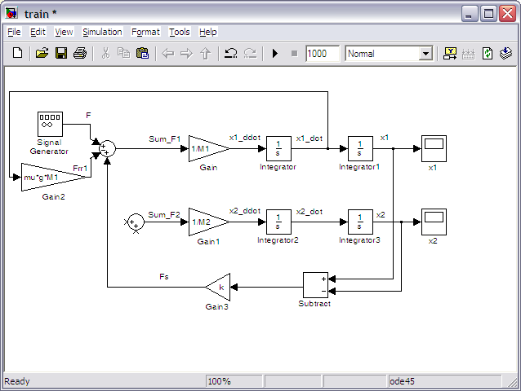

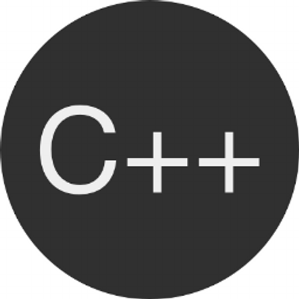
New Challenges for Fuzzing CPS tool chain
CPS model contains mix of language paradigms:
Dataflow (nodes, edges) and procedural (C code)
Previous work limited to single paradigm (mostly procedural)
Notes:
Modeling languages are different than Traditional programming languages
modeling language semantics often depend on subtle details, such as two-dimensional layout information, internal model component settings etc.
combination of programming paradigms (e.g., both graphical, data-flow language and textual imperative programming language in the same model

Slide 14
New Challenges for Fuzzing CPS tool chain
Vast search space
Industrial CPS design tools: Very complex modeling languages
Many, many configuration options, platforms, etc.
Notes:
Modeling languages are different than Traditional programming languages
modeling language semantics often depend on subtle details, such as two-dimensional layout information, internal model component settings etc.
combination of programming paradigms (e.g., both graphical, data-flow language and textual imperative programming language in the same model

Slide 15
Our Contributions
Study of publicly available Simulink bug reports
CyFuzz: A conceptual framework for arbitrary CPS environment
Prototype implementation for Matlab’s Simulink
Preliminary evaluation

Slide 16
A Study of Bugs
Bug reports published for Matlab/Simulink version 2015a on Simulink’s web site
Search for: incorrect code generation
17 Feb 2016: 50 bug reports, 47 fixed in subsequent releases
Example finding:
Over 50% of reports: Simulation result ≠ Output of generated code
➔ Differential testing seems promising
Our study results online:
https://docs.google.com/spreadsheets/d/1l0npmC7k906M5rECmLmfALXT-kLD3mRtX-3ylUXTmxc/pubhtml

Slide 17
A Study of Bugs
Classification Factor | Bug Reports [%]
Reproducing the bug involves a code generator | 60
Reproducing depends on block parameter values and/or port or function argument values and data-types | 56
Reproducing indicates mismatch between simulation result and generated code's output | 54
Reproducing depends on the way blocks are connected | 36
Reproducing depends on overall model configuration settings | 32

Slide 18
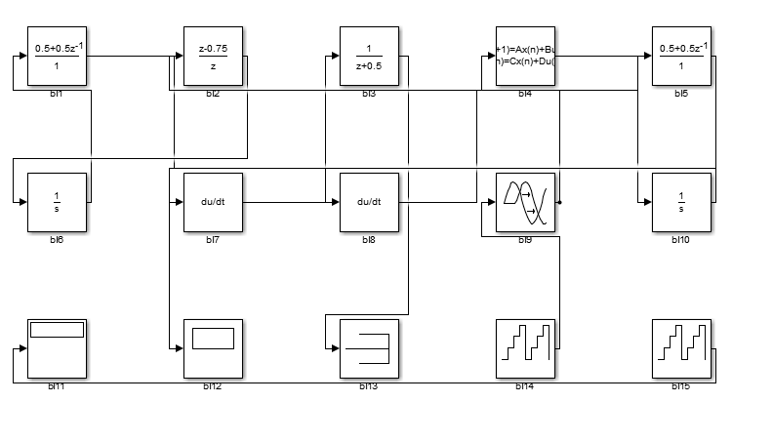
Review: CPS Models (e.g. Simulink Model)

Slide 19
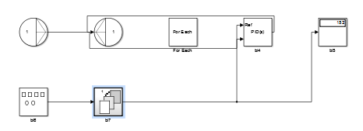
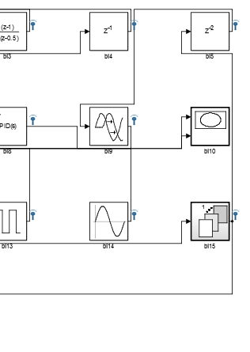
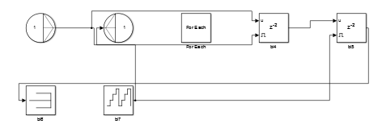
Hierarchical Model
1

Slide 20
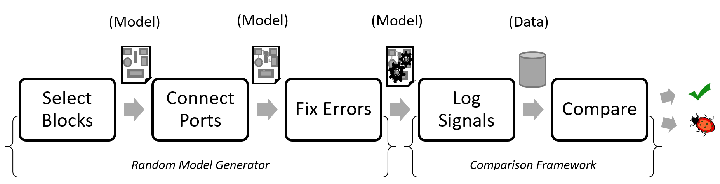
CyFuzz: Phases
Random Model Generator
Comparison Framework

Slide 21
CyFuzz: Phases

Slide 22
Select Blocks
Generate N blocks
N selected randomly from a range
Randomly from block libraries, according to customizable weights
Currently only from 4 libraries
Simulink libraries: 15 built-in plus more from toolboxes
Hierarchy up to configurable depth (more on hierarchy later)
Customize Csmith to generate C code, integrate via Simulink S-function

Slide 23
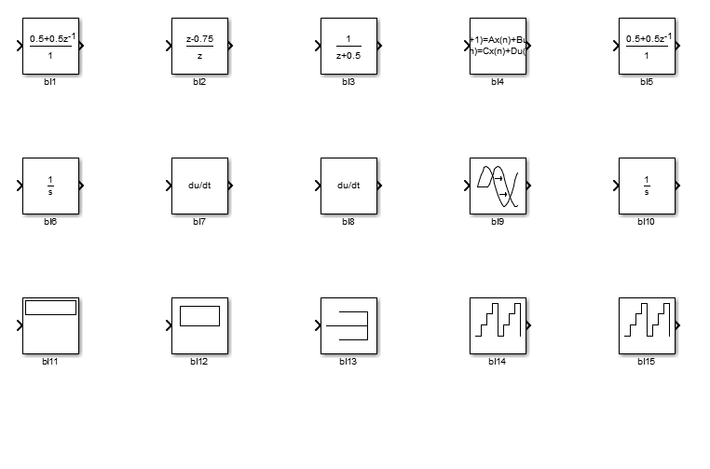
Select Blocks
n: 15
Library | Config. | Actual
Discrete | 35% | 33.33%
Concrete | 35% | 33.33%
Source | 15% | 20.00%
Sink | 15% | 13.33%

Slide 24
Hierarchical Model Creation
Calls Select Blocks method to create a child (aka sub) model
Child model can select parameters (number of blocks, block selection parameters etc.) on its own
Parent model does not reuse child model (but could)
Child’s own blacklist (and whitelist) of blocks (not all blocks can be used in a child model)

Slide 25
Configure Blocks
Parameter values currently fixed, but could be random
Configures some (whitelisted) parameters

Slide 26
Connect Blocks
Maximize number of connected blocks
Randomly choose input/output ports
Prioritize unconnected ports

Slide 27
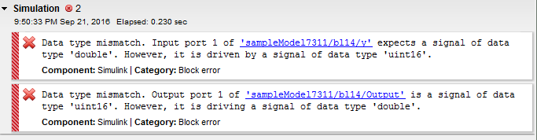
Fix Errors
Error in compiling the model

Slide 28
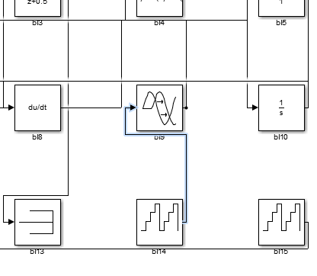
Fix Errors
Identify problematic components
Exploiting Matlab’s exception handling mechanism

Slide 29
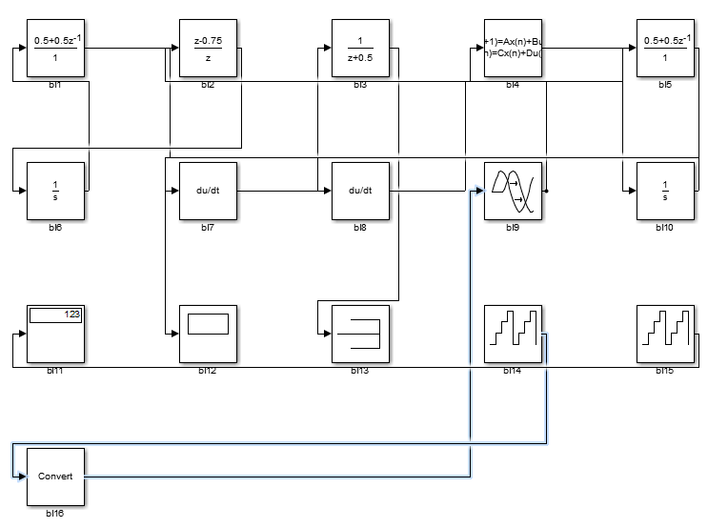
Fix Errors
Added a new block to fix data-type incompatibility

Slide 30
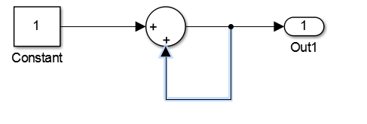
Fix Errors
For example:
Algebraic Loop elimination
Model with algebraic loop

Slide 31
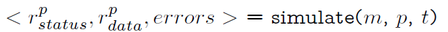
Compile and Simulate
timeout
model
Tool chain
configuration
Compilation is the first step of simulating a model.
simulate will stop immediately if a compilation error occurs.

Slide 32
Compile and Simulate
Error Messages
ENUM: {success,
Error,
Timed-out}
Logged Signals

Slide 33
Fix Errors
Simulink error messages are quite detailed
Use error message to drive repair action
Our repair may introduce new errors
Repeat R times
[+] Easy to implement
No knowledge of type rules needed
[+] Worked surprisingly well (in our evaluation)

Slide 34

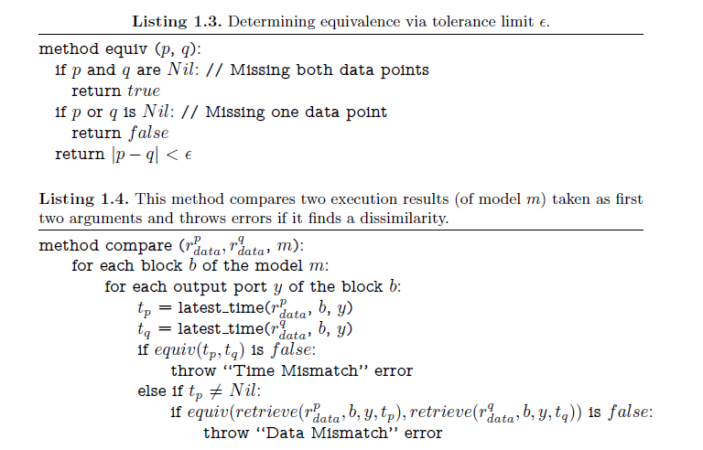
Log Signals and Compare
0.5 - 0.4 - 0.1 == 0
False!

Slide 35
Log Signals and Compare

Slide 36
Custom Blocks
Integrating procedural code (C/Matlab) in models
Implemented using S-Function interface of Matlab/Simulink

Slide 37
Custom Blocks (simplified example)
static void mdlOutputs(SimStruct *S, ...){
InputRealPtrsType uPtrs =
ssGetInputPortRealSignalPtrs(S,0);
real_T *y =
ssGetOutputPortRealSignal(S,0);
... ??? ...
}
Input
Output
*y = 2.0 *(*uPtrs[0]);
How to calculate output at each simulation step?

Slide 38
Custom Blocks
Plugging random C code as Simulink blocks
Harness Csmith to generate random code
High-level Issues:
  Csmith-generated functions can not be called safely multiple times after linking as Simulink blocks (re-initialize variables)
  Using data from other blocks in Csmith-generated functions (pass these values to Csmith-generated variables)
  Floating-point support in Csmith is still primitive (detect crash bugs only)

Slide 39
Prototype Implementation Details
Comparison Framework:
  Simulink’s Signal Logging API & sim command invocation
  Varies simulation modes
    E.g. “Normal Mode” vs. “Accelerated Mode with Optimization On”

Slide 40
Research Questions
RQ1. Is the random generator effective?
Which portion of the generated models can Simulink simulate?
RQ2. Can CyFuzz find Simulink bugs?
RQ3. What is the runtime of CyFuzz’s phases?
Not included in the evaluation:
Custom Blocks
Hierarchical Models

Slide 41
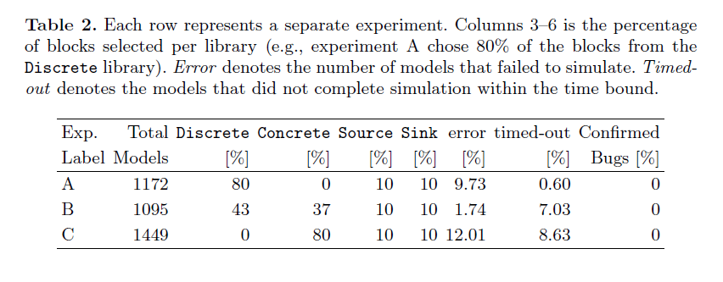
RQ1: Effectiveness of Random Generator
[+] Simulink successfully simulated some 80% of generated models
Errors and time-outs fluctuated with library weights

Slide 42
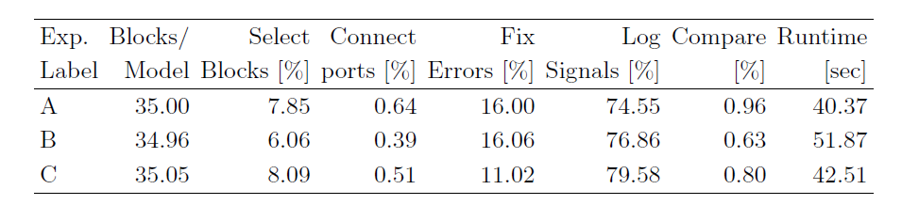
RQ3: Runtime
Average sum of all phases around 45s
Most expensive phase: Simulation & Signal logging

Slide 43
RQ3: Runtime
[+] Block Selection Algorithm has O(n) runtime
[+] Scales linearly with number of blocks
  Number of timed-out and error models also increase
  Addressing one type of error in Fix Errors phase reduce number of error models

Slide 44
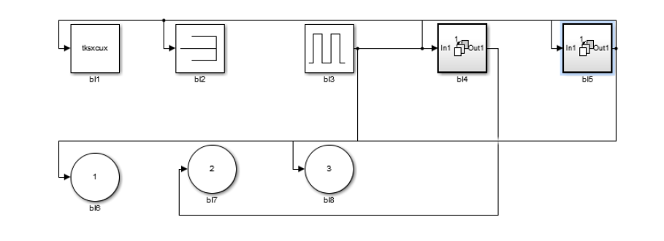
RQ2: Effectiveness of Comparison Framework
[+] Independently reproduced a known Simulink bug:
Hierarchical model
Output differ between Normal and Rapid Accelerator Modes
Bug confirmed and fixed in later releases
CyFuzz-generated model that triggers the bug:

Slide 45
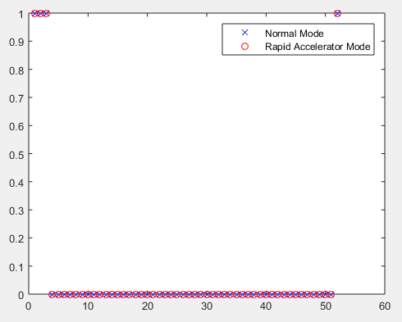
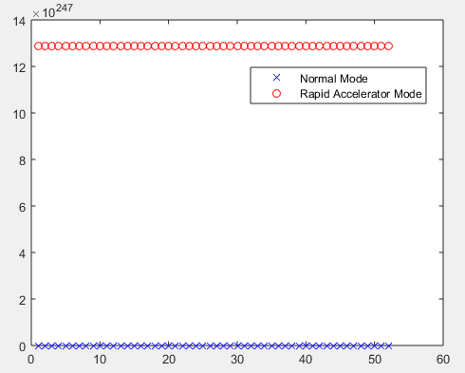
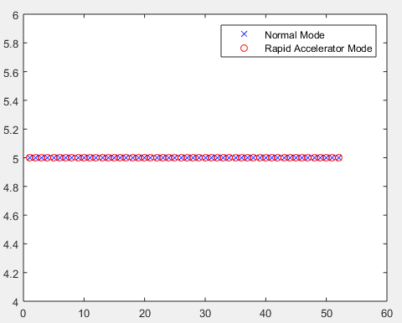
0 vs. 13E247
X Axes: Simulation Iterations
Y Axes: Block Outputs (numbers)

Slide 46

Future Work
Full-fledged fuzzer for Simulink
Incorporate more built-in libraries in the Random Generator
Having custom blocks in generated models (integrate Csmith)
Varying more configuration options in the Comparison Framework
Compare signals in multiple simulation steps
Contribute: https://github.com/verivital/slsf_randgen

Slide 47
Related Work
Notes:
Signal logging in Rapid Accelerator mode: http://www.mathworks.com/help/simulink/ug/exporting-signal-data-using-signal-logging.html#bt0cprf

Slide 48
Compilers and Type-checker Fuzzers
Jsfunfuzz
LangFuzz [27]
Csmith [10]
Rust Typechecker Fuzzer [11]
Jcrasher [28]
Rugrat [29]
Many core compiler fuzzer [13]
… and many others.

Slide 49
Testing components of CPS tool chain
Stürmer et al., TSE ‘07 [1]
Code generator testing
Identifies optimizers as most vulnerable
Generates models; needs spec in terms of graph grammar
Uses Reactis (second-order tests)
Sampath et al., RTAS ‘07 [31]
Model preprocessor tester
Requires semantic meta-model of the model preprocessor
Targets Stateflow (Simulink component)
Notes:
Sturmer et al cons:
Such specications for code generators might not be available
Whitebox testing in parts is undesirable
Sampath et al cons:
The approach does not scale
The complete specications it needs are not available.

Slide 50
Testing CPS Models
SimCoTest [17]
Test suite generator for SL/SF controllers
Mohaqeqi et al., TASE ‘16 [32]
Sound test suites for CPS
Conformance testing algorithm
Johnson et al., ICCPS ‘15 [8]
CPS specification mismatch identification
Dynamic analysis approach
Alur et al., CAV ‘09 [33]
Generate symbolic traces
Simulation and static analysis
Coverage improvement

Slide 51
Thank You!

Slide 52
References
Notes:
Sturmer et al cons:
Such specications for code generators might not be available
Whitebox testing in parts is undesirable
Sampath et al cons:
The approach does not scale
The complete specications it needs are not available.

Slide 53
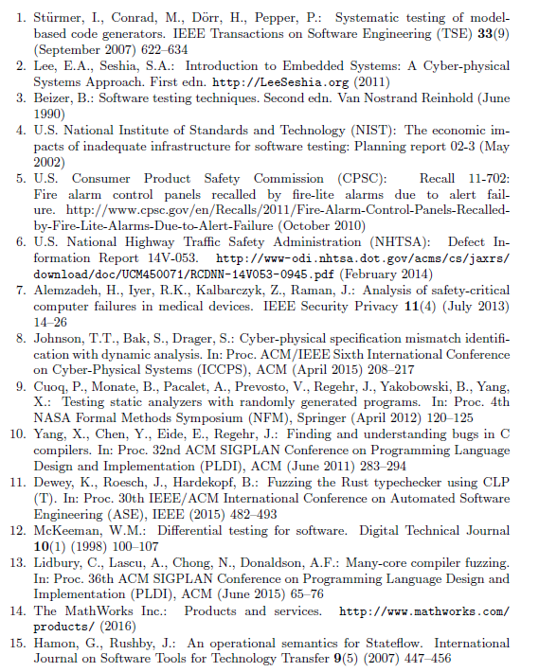
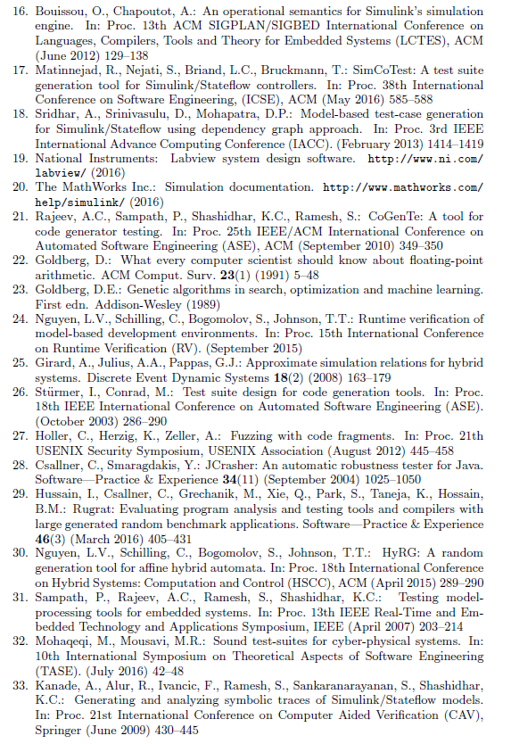

Slide 54
Supplementary Materials

Slide 55
Who uses Simulink/Stateflow?
Aerospace and defence
Airbus, BAE, Bell Helicopter, Boeing, Cessna, EADS, Honeywell, Lockheed Martin, NASA, The US Air Force and Navy
Automotive
Bosch, Daimler, Delphi, Ford, GM, Hyundai, Mazda, Nissan, Toyota, and Volvo
Energy and Industrial Automation
ABB, Alstom, Halliburton, Johnson Controls, and Schlumberger
Biotech and Medical devices
Cochlear, Genetech, Novartis, Pfizer, Philips Healthcare, Roche, and VisionCare
Communications and semiconductors
Alcatel-Lucent, Broadcom, Epson, Fujitsu, Realtek, Renesas, and Vodafone
Notes:
CC says: Move at very end (backup section)
Chose SLSF due to its market share as a development tool across CPS industries: Ref: [10]

Slide 56
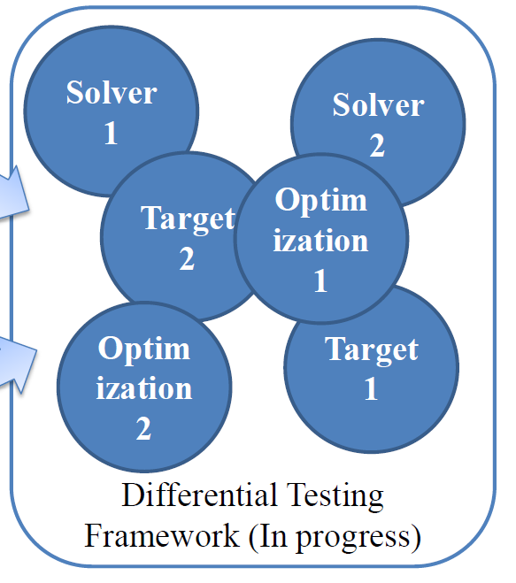
SUT Options to Vary
Simulation Modes
  Normal, Accelerated and Rapid Accelerated modes
Compilers
  MinGW/MS Visual C++/GCC
Compiler Optimization
  Various optimization levels/no optimization
Targets and platforms
Simulation solvers
(This is just a list of possibilities, our current setup uses handful of these options listed later)

Slide 57
Background: CPS model
Parameter: Influences model’s behavior
Block: Node, basic component of CPS model, represents a formula / code
Input port: accepts data for block’s processing
Connected to a single output port
Output port: emits data produced by block
Can be connected to multiple input ports
Parameter: Influences block’s behavior
Connection: Edge between blocks
Block library: Similar to a standard library of traditional programming language

Slide 58
Background: CPS model hierarchy
Very popular among industrial Simulink users
Model block: References a group of blocks
Child model: Referenced by a model block
Parent model: Contains a model block

Slide 59
Background: CPS development tool
Type-checker: Check if CPS model is syntactically well-formed
E.g.: Data type mismatch between connected output and input ports
Simulator: Numerically solve model’s formulas
Calculate blocks’ outputs
For N simulation steps
Mode: Interpreted vs. Compiled vs. Combinations
Simulink: “Accelerator”, “Rapid Accelerator”, etc.
Signal: Output of a block's port at a particular simulation step
Code generator: Generate native code for (embedded) target platform

