Slide 1
A Corpus of Simulink Models for Model-based Empirical Studies
Shafiul Azam Chowdhury
Lina Sera Varghese
Soumik Mohian
Dr. Taylor T. Johnson
Dr. Christoph Csallner
The University of Texas at Arlington
Vanderbilt University
github.com/verivital/slsf_randgen
This material is based upon work supported by the National Science Foundation under Grants No. 1117369, 1464311, and 1527398. Any opinions, findings, and conclusions or recommendations expressed in this material are those of the author(s) and do not necessarily reflect the views of the National Science Foundation.
This material is based upon work supported by the Air Force Office of Scientific Research (AFOSR) contract numbers FA9550-15-1-0258 and FA9550-16-1-0246, and by Air Force Research Lab (AFRL) contract number FA8750-15-1-0105. Any opinions, findings, and conclusions or recommendations expressed in this publication are those of the authors and do not necessarily reflect the views of AFRL or AFOSR.
Notes:
Welcome to the largest corpus of Simulink models
for…

Slide 2

Motivation
Model-based design
Increased use of CPS (e.g. Simulink) models
Increased interest in model-based empirical studies
Understanding model properties and software engineering research
Large-scale corpus of Simulink models
Unavailable: Studies use handful of (possibly proprietary) models
Adversely affects evaluation and replication of studies
Model collection: nontrivial overhead
Notes:
Due to the increased popularity of MBD thanks to sophisticated tools like Simulink, we see increased use of CPS models, and their studies.
E.g. many empirical studies investigate structural model properties (e.g. model size and layout)
And relate them to qualitative properties, like model complexity and comprehension.
We also see many model-based s/w research and tool development e.g. in refactoring, clone detection etc.
These studies need models to evaluate work.
Some need domain specific models e.g. automotive models
Some even need very large, complex models to compare scalability of their approach.
----------------
Unfortunately, large, curated collection (aka corpus) of Simulink models is unavailable.
and it has adverse consequences.
First, studies are confined to use limited number of models in evaluation
Next, many use proprietary models, thus affecting replication and comparison.
Finally, crafting a corpus is time consuming
and researchers should not be intimidated by the task of collecting models for their study.

Slide 3
Contributions
Largest corpus (to date) of ~1k publicly available Simulink Models
Corpus design choice
Models and their meta information: freely available
Study of Model Metrics
Structural properties and Complexity Metrics
Lightweight Evaluation
Tool for metrics study: freely available
Can benefit all future model-based empirical research
Notes:
Today, we present the *design* of the largest corpus of 1k public models.
Models and their useful meta information are freely available.
We also investigated interesting metrics including model structural properties and complexity attributes,
And evaluate its usage.
We hope our work would benefit all model-based empirical research

Slide 4
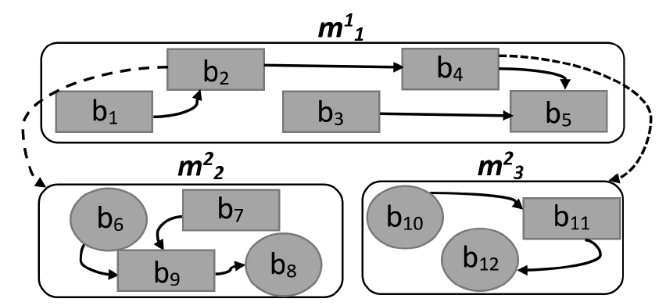
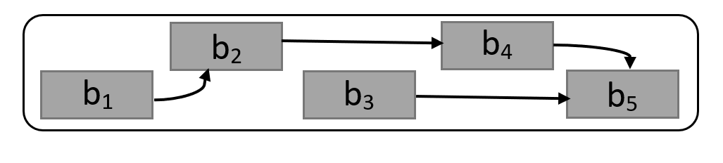
Background: CPS Model
Block: Node, basic component of CPS model, represents a formula / code
Connection: Edge between blocks
Block library: Similar to a standard library of traditional programming language
Custom Blocks: Native code using s-functions
Hierarchy: block representing a child model
Model References and Subsystems
Notes:
A CPS model contains of blocks, which accepts data using input port, performs calculations, and sends outputs to other blocks.
Using connection lines.
Instead of such explicit connections, there could be hidden connections using special From and Goto blocks.
We can choose vendor provided built-in blocks from libraries
Or even define custom block behavior using procedural code.
Instead of flat models, we can create them in hierarchies, where a block in a “parent” model is actually a placeholder for an ENTIRE “child” model.
Two ways to create hierarchy:

Slide 5
Corpus Design Choice
CPS Domain
From author-provided description and tags
Trivial Models
Manually identified
Model Sources
MathWorks’ tutorial models
Public Repositories: MathWorks’ FileExchange, GitHub, and SourceForge
Academic and Search Engine results
Notes:
What to expect:
For each model, what’s its CPS domain (automotive, avionics?)
Meta information like this are published in a CSV file
So that studies can easily filter out the model of their target domain.

Slide 6
Design Choice
Content Type
Only include projects with .mdl and .slx files
Keep other artifacts in the project
Test Harness and Libraries
Keep, identify and publish
Toolbox Requirement
Mandatory and optional requirements

Slide 7
Study of Model Metrics

Slide 8
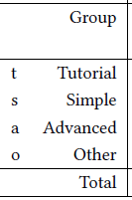
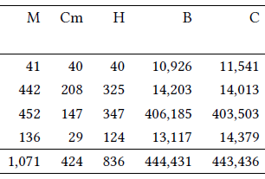
M: # models
Cm: # models compiled with University license
H: # models with hierarchy
B: # blocks
C: # connections

Slide 9
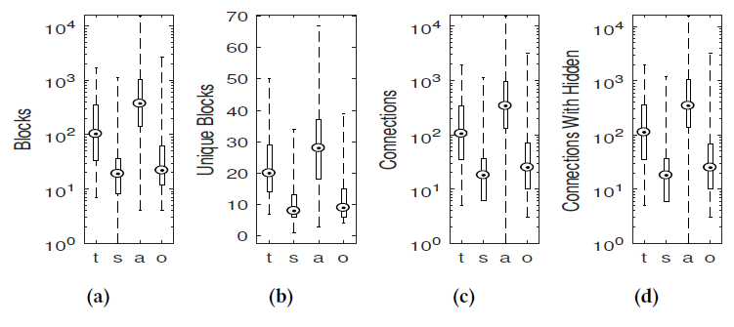
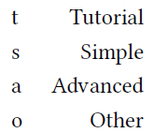
Blocks
Unique Blocks
Connections
(excluding hidden)
Connections
(including hidden)
Tool 1: sldiagnostics
Tool 2: https://blogs.mathworks.com/simulink/2009/08/11/how-many-blocks-are-in-that-model/
Notes:
Blocks and connections are common in the literature,
But many do not define explicitly what was count.

Slide 10
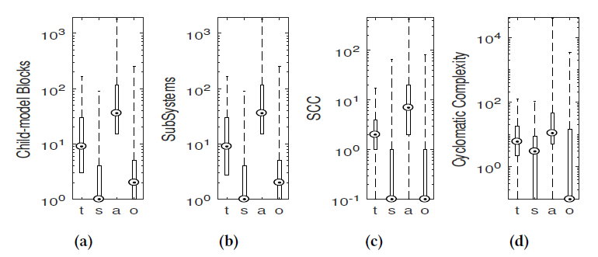
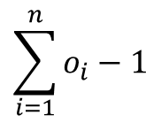
# Subsystems +
Model Reference
# Subsystems
Strongly
Connected
Components
Cyclomatic Complexity
$$\sum_{i=1}^{n}{o_{i}−1}$$
n: # of decision points
o: # of possible outcomes
Notes:
Model reference: not widely used

Slide 11
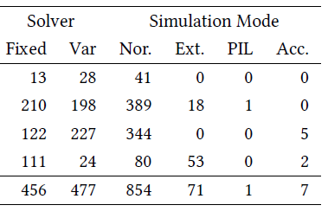
Fixed: Fixed-step solver
Var: Variable-step solver
Nor: Normal Mode
Ext: External Mode
PIL: Processor in the loop
Acc: Accelerator Mode

Slide 12
Pairwise Correlation Analysis of Metrics
Kendal’s 𝜏; (to compare with Olszewska et al. 2016)
Cyclomatic complexity
Number of blocks and connections
Number of child-model blocks
Number of subsystems (0.5297 – with cyclomatic complexity)
Maximum hierarchy depth (0.5509 – with cyclomatic complexity)
Compilation time
Number of strongly connected components

Slide 13
Conclusions
We present the largest corpus of public Simulink models
Explored interesting model properties and complexity metrics
Previously unknown findings in modeling practices
Benefits future model-based research
Reducing model-collection overhead
Aiding evaluation, replication and comparison of studies

Slide 14
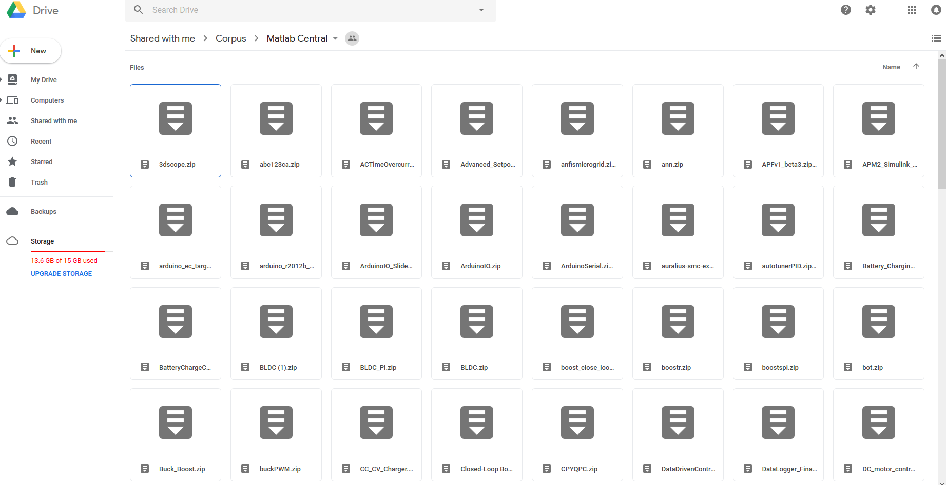
Corpus Available: github.com/verivital/slsf_randgen

Slide 15
Thank You!

