Slide 1


Automatically Finding Bugs in a Commercial Cyber-Physical System Development Tool Chain with SLforge
Christoph Csallner
University of Texas at Arlington
IEEE MetroCon 2019
November 6, 2019
Software and Systems Engineering Track
Hurst Conference Center
Hurst, TX 76054
www.ieee.org
www.MetroCon.org

Slide 2
1-slide Summary
Simulink by MathWorks widely used in industry
  Simulink = Popular Cyber Physical System (CPS) development tool chain
Found 10+ “compiler” bugs in Simulink
  We are looking for bugs in the Simulink tool itself
Simulink vendor MathWorks confirmed these as bugs
Other results
  USD 1M in grants from the National Science Foundation (NSF)
  USD 32k gift to UTA from MathWorks to continue research
  Source code available (BSD license) https://github.com/verivital/slsf_randgen

Slide 3

What Is The Problem?
Bugs in CPS Development Tools

Slide 4
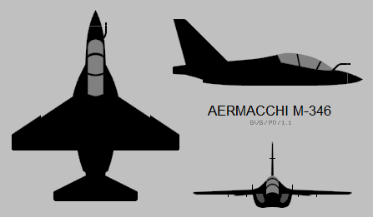



CPS
System Model as Block Diagram
Analyze,
Simulate
Engineer
Executable
Generate & Compile Code
CPS = Cyber-Physical System

Slide 5

CPS
System Model as Block Diagram
Deploy
Analyze,
Simulate
Executable
Generate & Compile Code
CPS = Cyber-Physical System

Slide 6
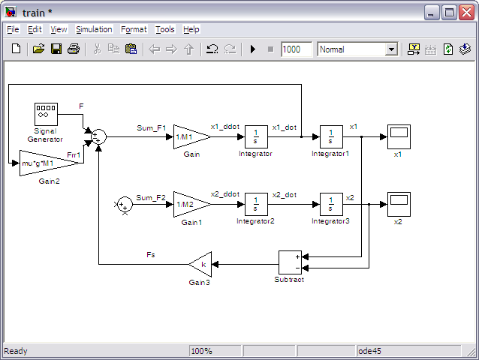

Typical CPS Development Tool Chain = MLOC+
Model-based design
Development environment
Analysis, simulation,
code generation, etc.

Slide 7
Common Assumptions
Million+ lines of code
(CPS development tool chain) without bugs?
Bug-free:
Compiler
Code Generator
Simulator, etc.
What happens if
CPS dev tool chain injects subtle bugs into production CPS?
Notes:
Anyone who has written 10 lines of code or more knows how hard bug-free code is :-)

Slide 8

CPS
System Model as Block Diagram
Deploy
Analyze,
Simulate
Engineer
Executable
Generate & Compile Code
CPS = Cyber-Physical System

Slide 9
Why Is This Problem Important?
These CPS Development Tools Are Used Widely

Slide 10
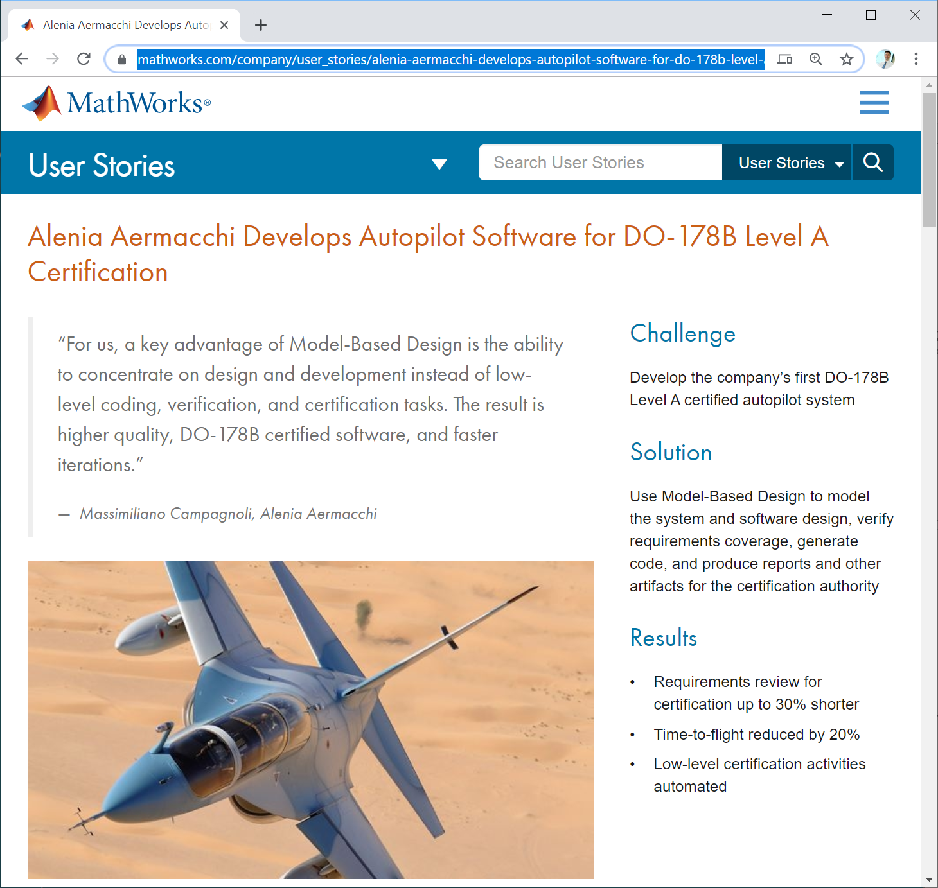
Example: M-346
“Our Simulink system model is executable, enabling early validation of requirements. That same model, updated to be compliant with DO-178B modeling standards, is used to generate flight code.”
  https://www.mathworks.com/company/user_stories/alenia-aermacchi-develops-autopilot-software-for-do-178b-level-a-certification.html

Slide 11

Space Flight
“[..] automatically generate code for [..] attitude control, power control, thermal control, and FDIR, [..] we plan to develop all onboard application software, nearly 95% of the full flight software, using Simulink and Embedded Coder.”
  https://www.mathworks.com/company/user_stories/esas-first-ever-lunar-mission-satellite-orbits-moon-with-automatically-generated-flight-code.html

Slide 12

Bell 525 Relentless
“[..] design and extensive simulations in Simulink,” [..] “The first time we generated code for the real flight control computers with Embedded Coder, we had no integration problems.”
  https://www.mathworks.com/company/user_stories/bell-helicopter-develops-worlds-first-commercial-fly-by-wire-helicopter.html

Slide 13
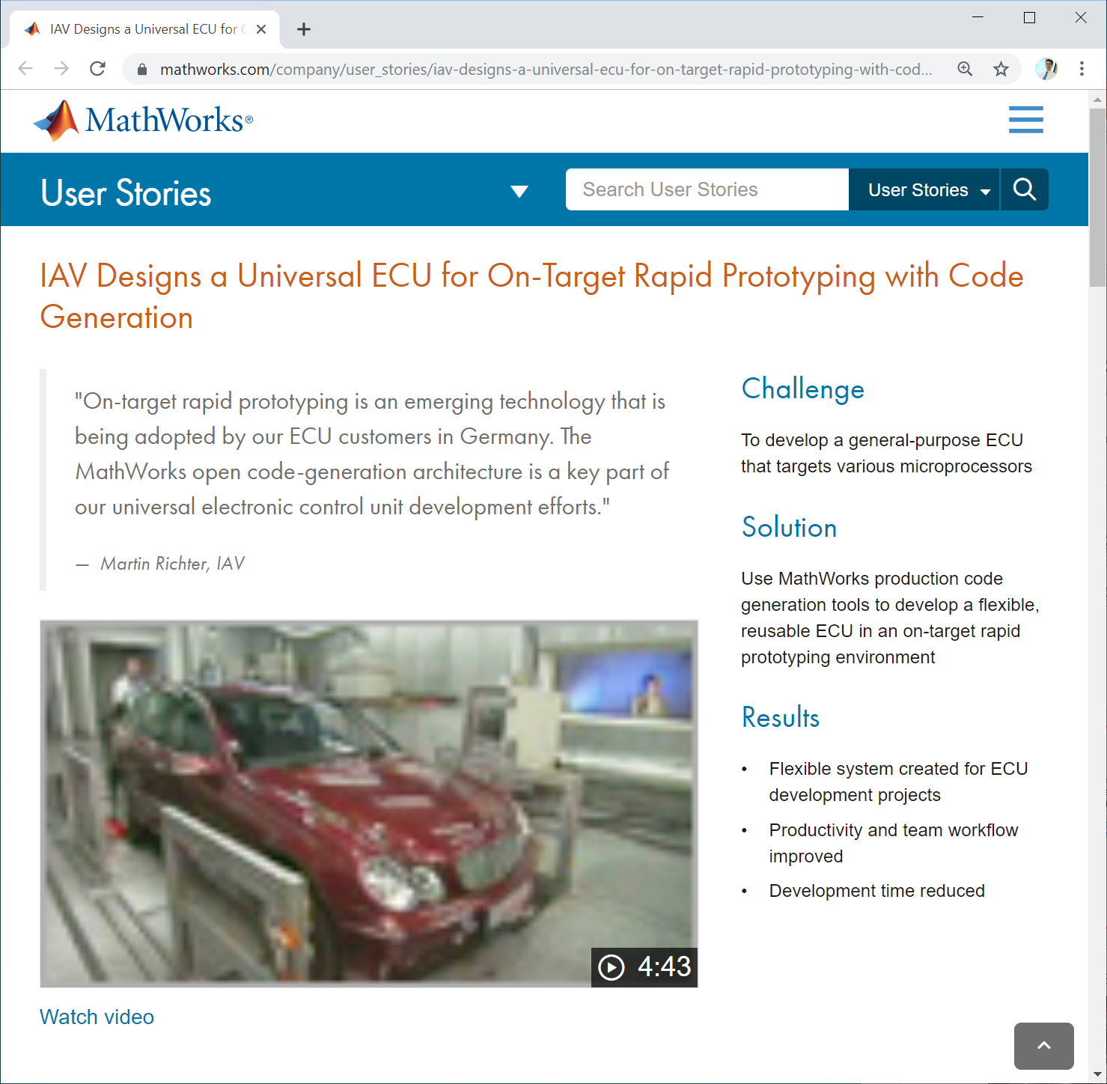
Electronic
Control Unit
“Using Simulink to develop the I/O drivers and Embedded Coder to generate embedded code saved IAV from hand coding and customizing the code for each microprocessor.”
  https://www.mathworks.com/company/user_stories/iav-designs-a-universal-ecu-for-on-target-rapid-prototyping-with-code-generation.html
Notes:
IAV = Automotive engineering firm Ingenieurgesellschaft Auto und Verkehr in Berlin, Germany

Slide 14
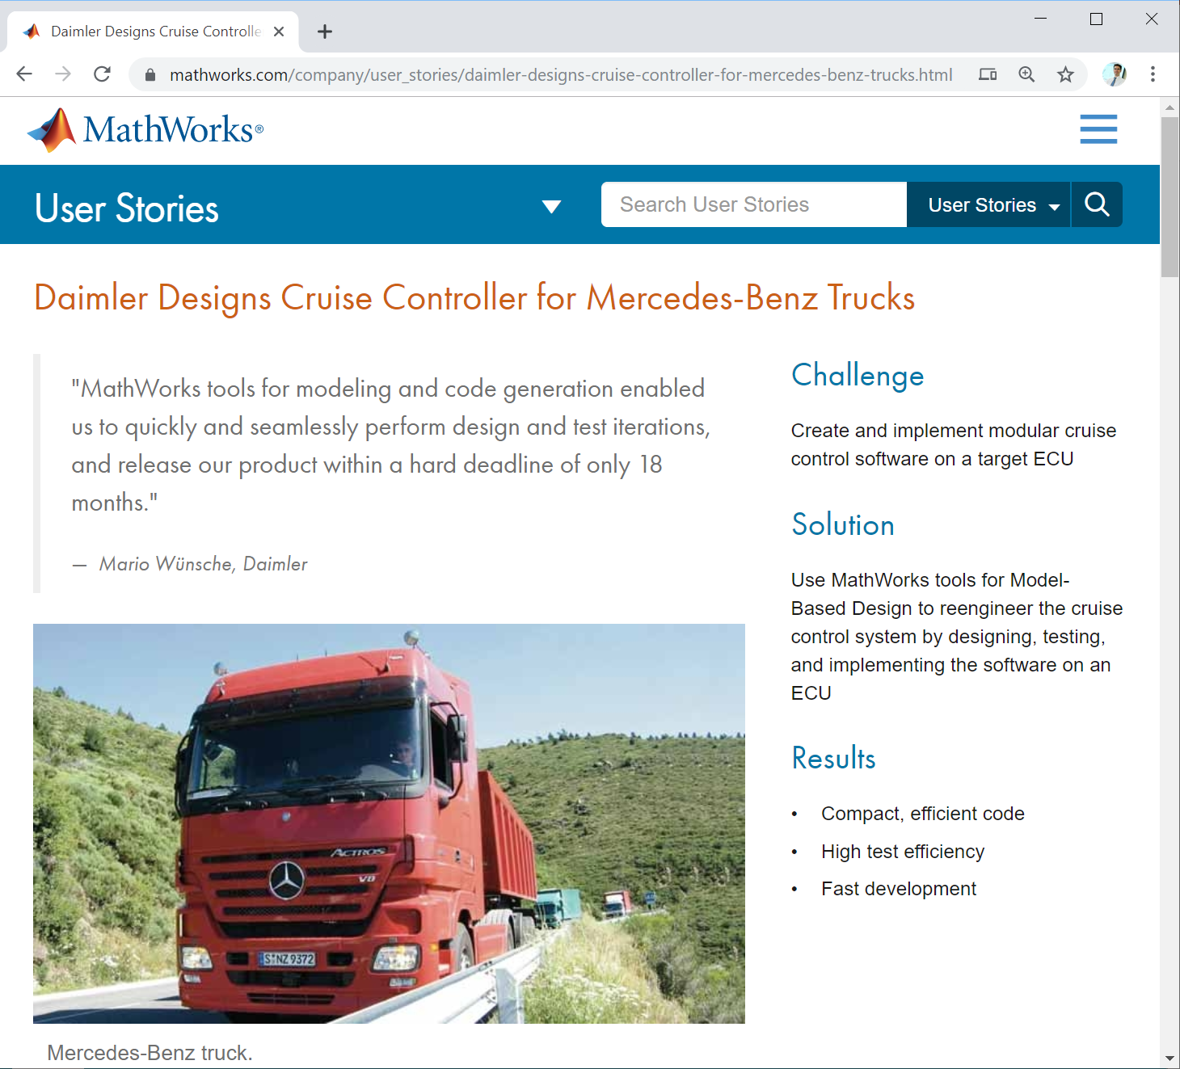
Cruise Controller
“It would have been nearly impossible to achieve this project deadline without the use of simulation, production code generation, and processor-in-the-loop capabilities offered by MathWorks.”
  https://www.mathworks.com/company/user_stories/daimler-designs-cruise-controller-for-mercedes-benz-trucks.html

Slide 15
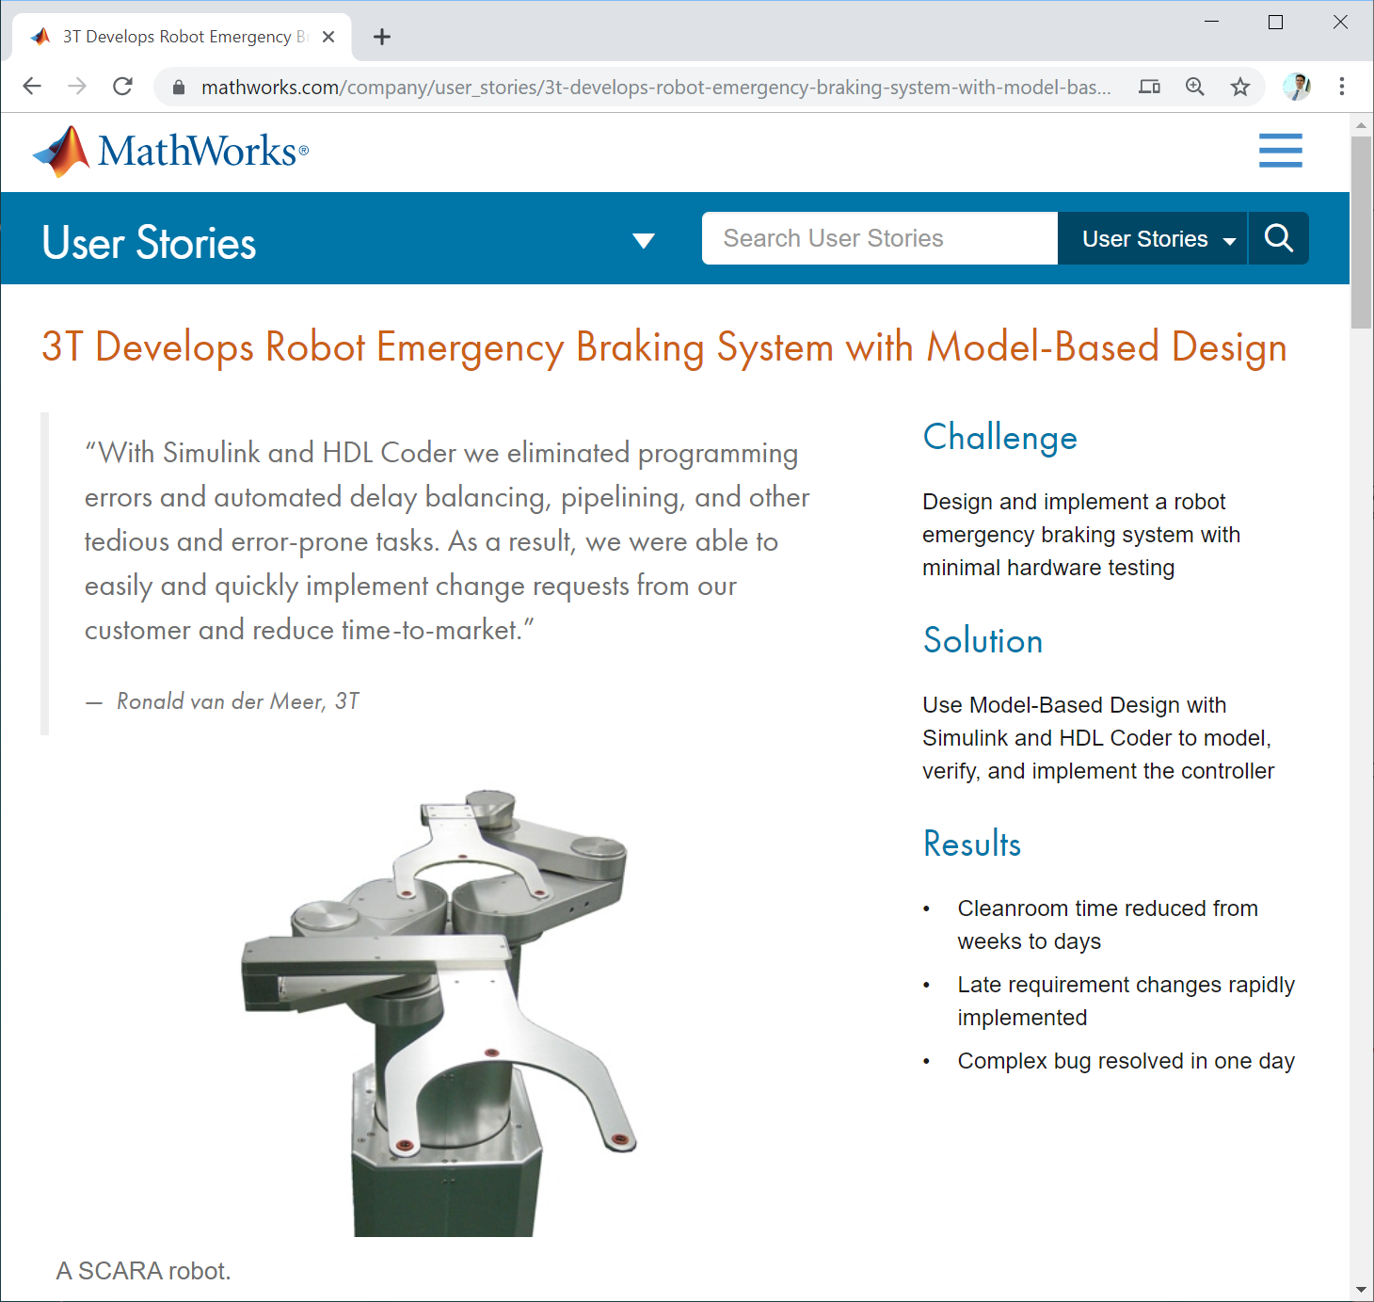
Robot Braking
System
“To minimize hardware testing and debugging in the cleanroom, we tested and refined our solution via simulation in Simulink and then used code generation with HDL Coder to implement it [..].”
  https://www.mathworks.com/company/user_stories/3t-develops-robot-emergency-braking-system-with-model-based-design.html

Slide 16
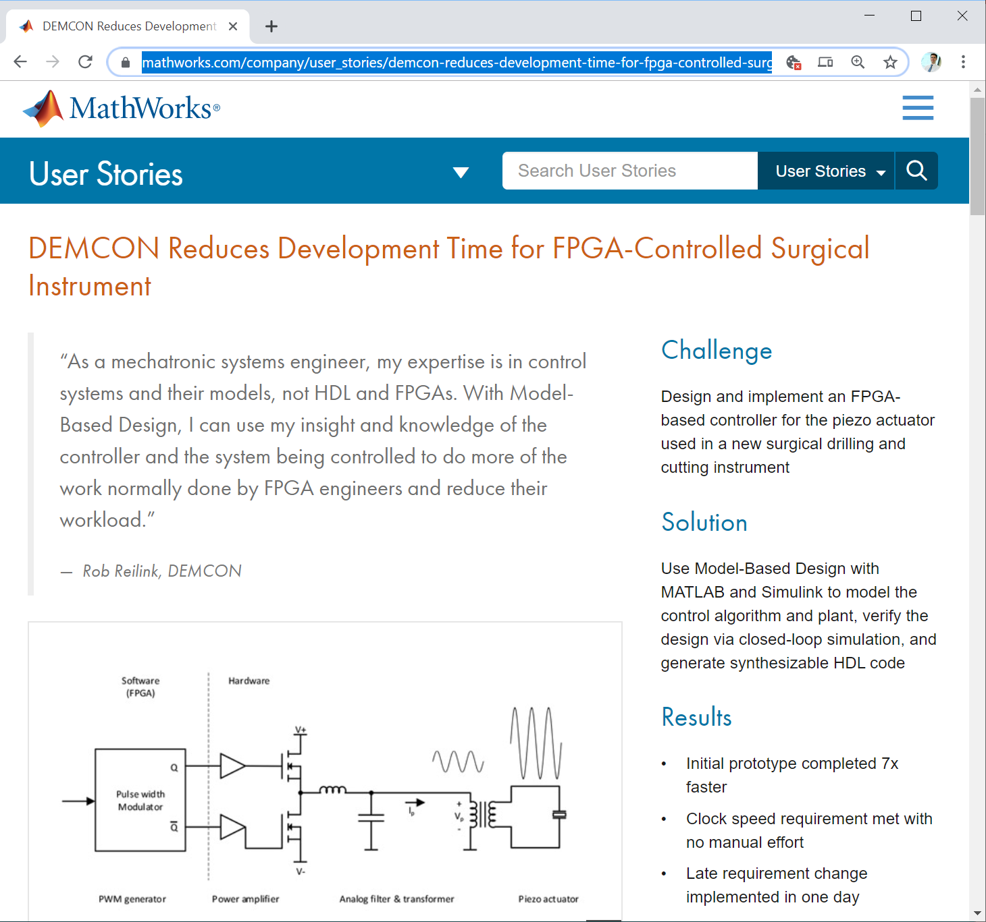
Surgical Instrument
“[..] it took weeks or more to hand-code in C for our target DSP,” [..]. “With Model-Based Design and native floating-point code generation [..], we had a prototype up and running in one day.”
  https://www.mathworks.com/company/user_stories/demcon-reduces-development-time-for-fpga-controlled-surgical-instrument.html

Slide 17

Retinal Prosthetics
“[..] uses Simulink and Computer Vision Toolbox to incorporate their algorithms into complete systems that process video streams from a camera affixed to eye glasses worn by implant recipients.”
  https://www.mathworks.com/company/user_stories/doheny-eye-institute-develops-next-generation-retinal-prosthesis.html

Slide 18
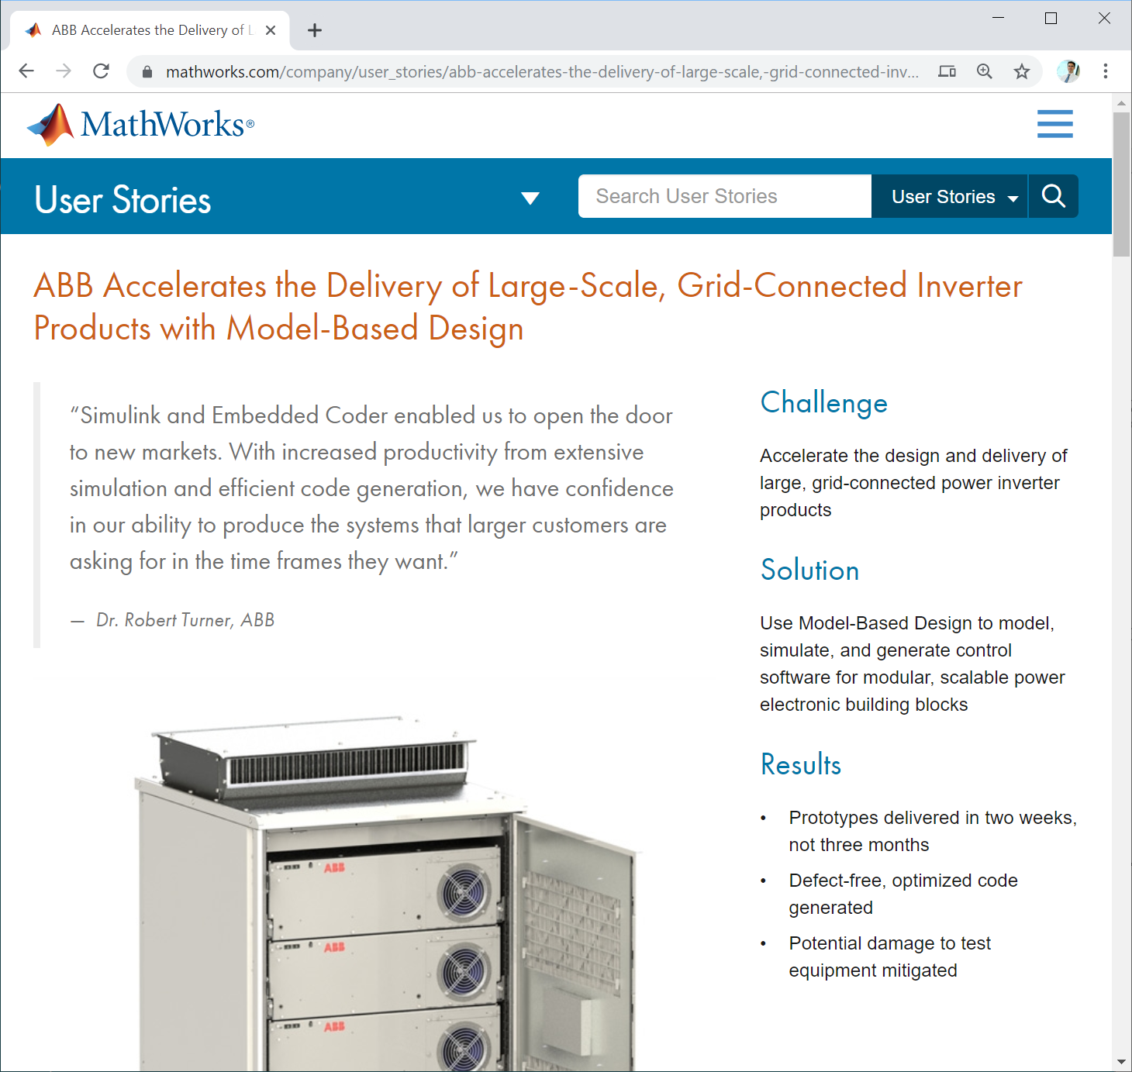
ABB Inverters
“[..] our developer productivity is easily increased tenfold,” [..]. “Simulation and code generation enable us to turn changes around quickly [..] we no longer waste a big part of our development cycle debugging code.”
  https://www.mathworks.com/company/user_stories/abb-accelerates-the-delivery-of-large-scale,-grid-connected-inverter-products-with-model-based-design.html

Slide 19
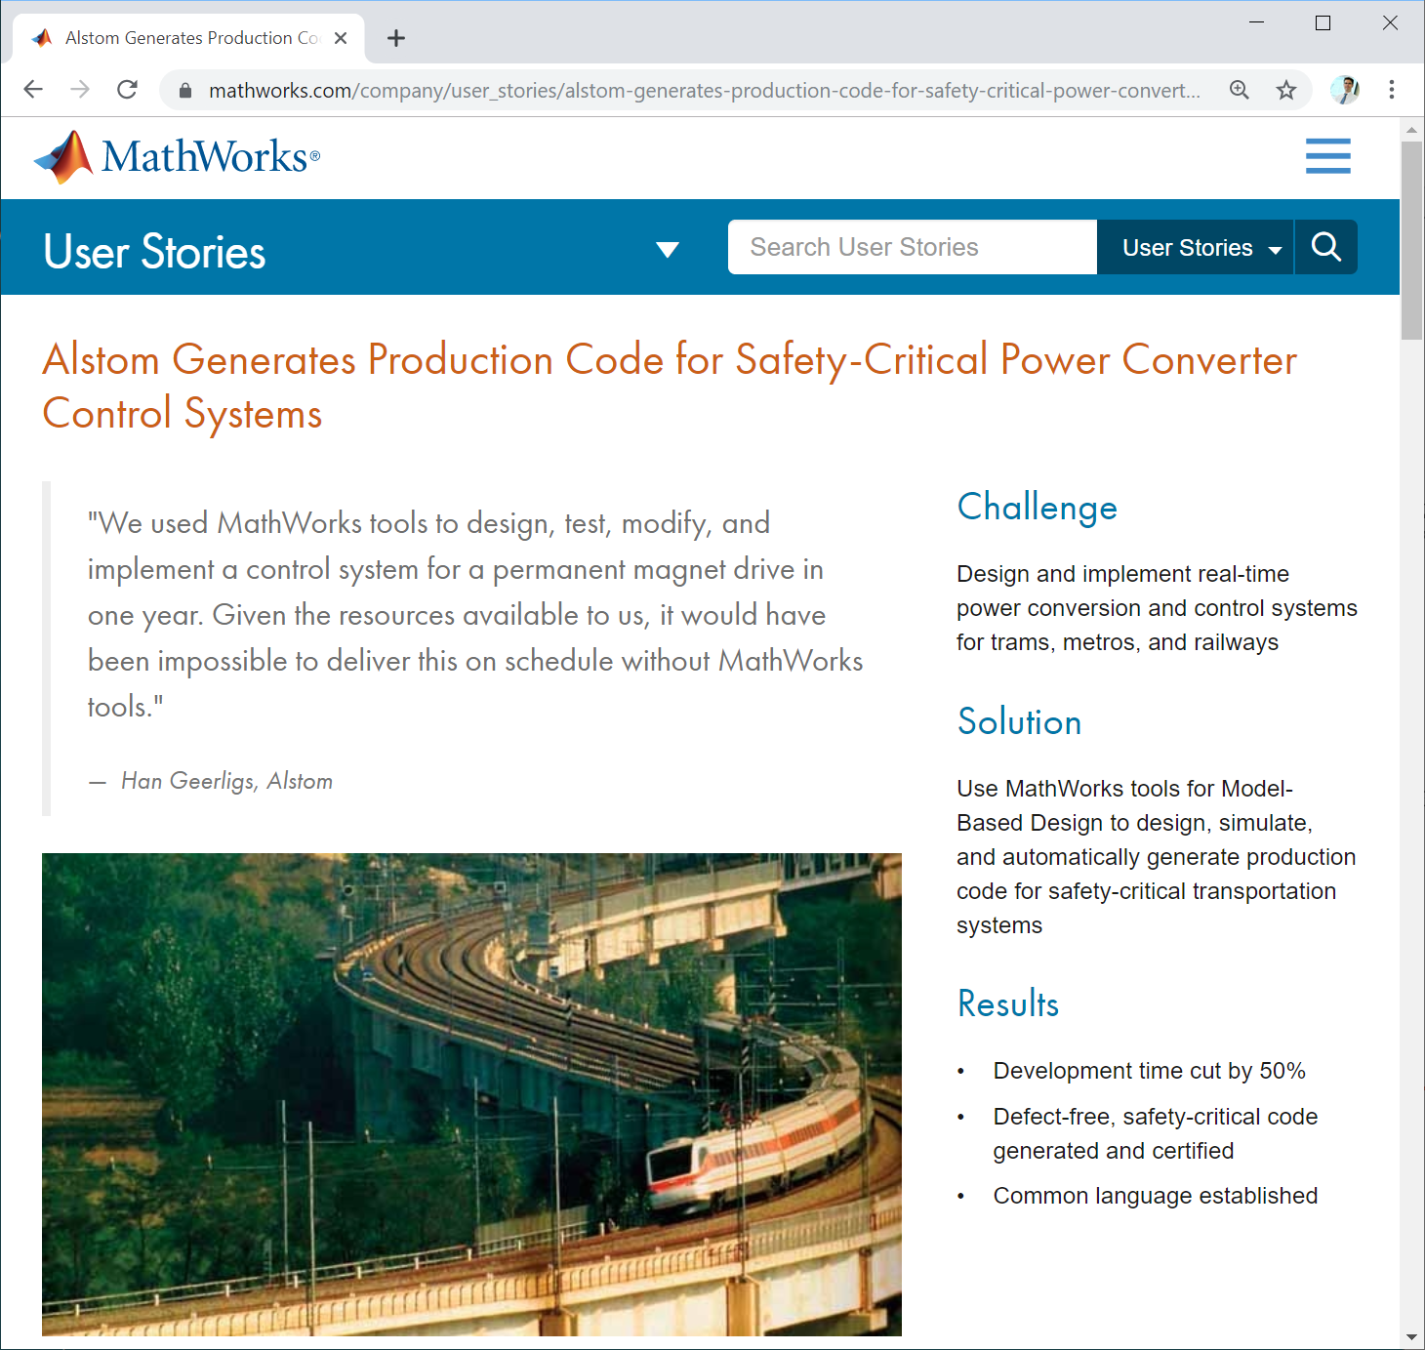
Alstom Converters
“The power converters used on trams, metros, and trains are sophisticated, safety-critical systems that require hard, real-time responses. [..] engineers modeled and automatically generated defect-free production code [..].”
  https://www.mathworks.com/company/user_stories/alstom-generates-production-code-for-safety-critical-power-converter-control-systems.html

Slide 20
Why Is This Problem Hard?

Slide 21
Cannot Formally Prove Simulink Correct
Full formal correctness proof of any real MLOC+ software very expensive
Not a one-time cost: 2 releases / year
No complete formal specification of Simulink language / semantics
Bottom line: No proving of bug absence
Looking for bugs in Simulink looks like the next best thing → Testing
Formal Spec of Simulink Language / Semantics

Slide 22
Background: Randomized Differential Testing
Random Generator
2 compilers (or 2 configurations of same compiler) that are supposed to produce equivalent results.
Test oracle := “Output 1 = Output 2”
[+] Don’t need full formal language specs to find bugs
[+] No false warnings: If undefined behaviors are avoided
[+] Effective: Found lots of bugs in real C-compilers: GCC, LLVM
generate
Code, Input
Compiler 1
Compiler 2
compile
Executable 1
Executable 2
run on input
Output 1
?
Output 2
if (Output 1 ≠ Output 2):
Likely compiler bug

Slide 23
Is Differential Testing a Good Fit for Simulink?
Studied bug reports MathWorks published for Simulink version 2015a
  Search for: incorrect code generation
  17 Feb 2016: 50 bug reports, 47 fixed in subsequent releases
Key finding:
  Over 50% of reports: Simulation result ≠ Output of generated code
  ➔ Differential testing seems promising
Our study results online:
  https://docs.google.com/spreadsheets/d/1l0npmC7k906M5rECmLmfALXT-kLD3mRtX-3ylUXTmxc/pubhtml

Slide 24
50 SL Bug Reports: Incorrect Code Generation
Bug Report Type (a Report May Fit Several Types) | [%]
Involves code generator | 60
Specific data-types, block parameters, port/function arguments | 56
Mismatch: simulation result vs. generated code's output | 54
Depends on the way blocks are connected | 36
Depends on overall model configuration settings | 32
Requires hierarchical models | 24

Slide 25
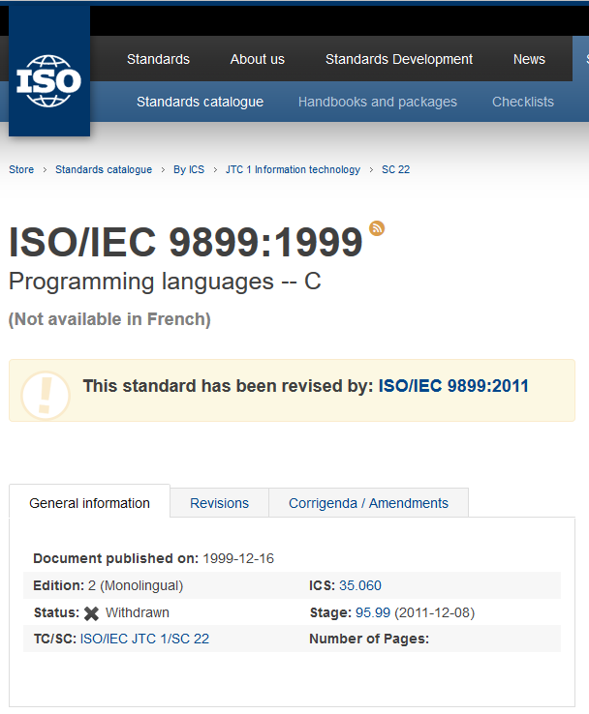
Problem: Simulink is Less-specified Than C
Having some partial language specification is useful:
  Efficient generator (not generating many invalid tests)
Example: CSmith differential testing tool for C-compilers generate tests that follow C99 specification
https://www.iso.org/standard/29237.html

Slide 26
Need to Pass the Compile Stage to Be Useful
Random Generator
At least one compiler should accept a generated program
Both compiler versions reject a generated program → Ignore program as invalid
  Generation effort wasted
generate
Code, Input
Compiler 1
Compiler 2
compile
Executable 1
Executable 2
run on input
Output 1
?
Output 2
if (Output 1 ≠ Output 2):
Likely compiler bug

Slide 27
What Did We Do About It?
Adapt Differential Compiler Testing from
C-Compilers to CPS Development Tool Chains

Slide 28

Our Core Technique to Generate Valid Models
“Feedback-driven” model generation:
Generate initial model
  May not compile
Automatically fix model until it compiles
  Guide via CPS tool chain errors/warning messages

Slide 29
Published Several Papers, Including:
Chowdhury et al., “CyFuzz: A Differential Testing Framework for Cyber-Physical Systems Development Environments”, In Proc. 6th Intl. Workshop on Design, Modeling and Evaluation of Cyber Physical Systems (CyPhy), pages 46—60. 2016.
Chowdhury et al., “Automatically Finding Bugs in a Commercial Cyber-physical System Development Tool Chain with SLforge”. In Proc. 40th Intl. Conference on Software Engineering (ICSE), pages 981—992. 2018.
Chowdhury, et al., “A Curated Corpus of Simulink Models for Model-based Empirical Studies”, In Proc. 4th Intl. Workshop on Software Engineering for Smart Cyber-Physical Systems (SEsCPS), pages 45—48. 2018.

Slide 30
Summary Of Our Simulink Bug Reports
TSC = MathWorks Technical Support Case; St = status of bug report (NB = new bug, KB = known bug, FP = false positive); P = discovery point (C = Compile Time, R = Runtime); F = bug type based on essential feature (A = Hang/Crash Error, S = Specification, C = Comparison, H = Hierarchy, E = EMI, ? = not further investigated); Ver = Simulink version affected.

Slide 31
Background on Simulink

Slide 32
CPS Model as Block Diagram: Toy Example

Slide 33
Input block: Source
If-then-else block from built-in block library
Directed connection edge, tool supports various semantics incl. dataflow
In-port
Out-port
Output block: Sink
If left unspecified: Tool infers port’s datatype
User can re-use & configure blocks from libraries or define new block types (e.g., via C / MATLAB code)
Block: CPS component, performs operation on in-port data
Child model
Notes:
Child model: Block representing the child model
-- This figure shows both the parent model and three child models

Slide 34
Simulink Workflow
Load & prepare (“compile”) model
Model m is valid = No errors during model m loading & preparation
  Simulink raises errors for datatype mismatches, sample time conflicts, etc.
Simulate model
  If no error found during compiling
  Iteratively solve model’s network of relations via numerical methods
  Produce sequence of output values for each output block
  Some simulation modes include code generation (e.g., “Accelerator” mode)

Slide 35
Explicit Notion of Execution Time
Execution time implicit in most other programming languages, e.g.:
  How much wall-time passes during function call up to environment
Here a first-class citizen, handled explicitly
  Sample time
Some loops in model’s connection relation need special treatment
  Algebraic loop: Block b produces output at time t that b needs as input at t

Slide 36
Simulation and Sample Time
When block outputs are calculated?
  User specified intervals (“sample time”)
  Can be inherited for individual blocks
How many samples?
  User-specified total duration/interactive
Different solvers
  Fixed step/variable step
  E.g.
  sample time : 1
  total duration : 10 sec
  num. samples : 10

Slide 37
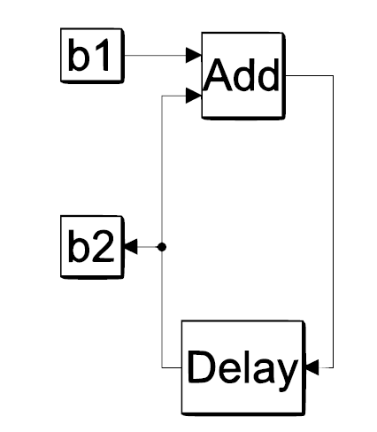
Invalid Dataflow Loops
1
Aka algebraic loops
1
Accumulator = 1
Repeat x times
Print(Accumulator)
Accumulator += 1
Initial Condition: 0

Slide 38
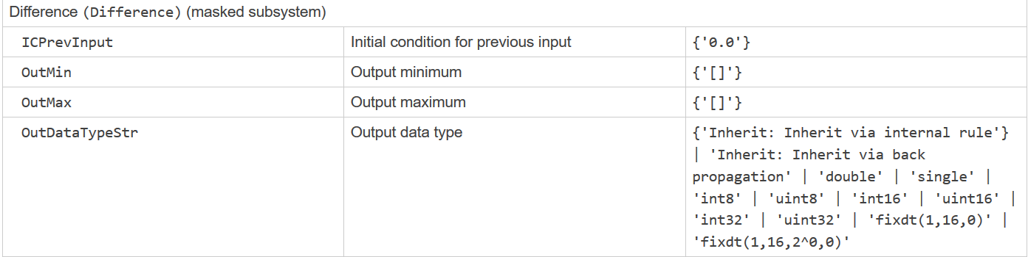
Data Types
At input/output ports
Simulink infers data-types left unspecified
Image: https://www.mathworks.com/help/simulink/slref/block-specific-parameters.html

Slide 39
Generating Valid Simulink Models W/O Knowing the Simulink Language Specs
CyFuzz

Slide 40
CyFuzz for Simulink (SL): Overview
Random Generator
SL Model with Input
2 Simulink configurations supposed to produce equivalent results
Config: E.g.: normal simulation vs. accelerated mode with code gen
generate
SL Config 1
SL Config 2
compile
Executable 1
Executable 2
Signals logged at each time step
run on input
Output 1
?
Output 2
if (Output 1 ≠ Output 2):
Likely bug in Simulink

Slide 41
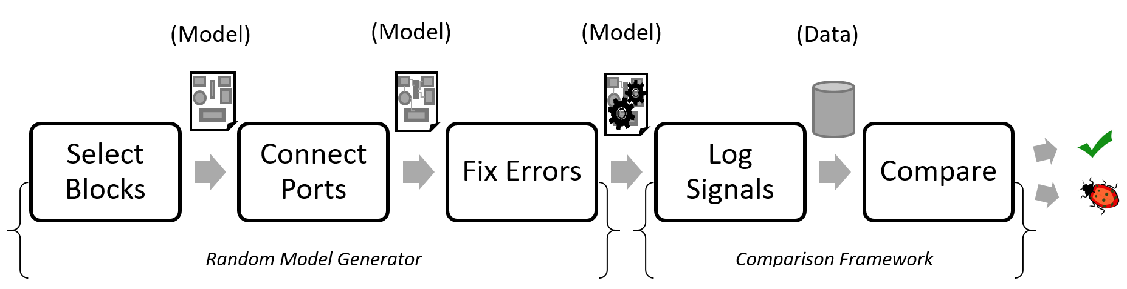
CyFuzz: 5 Phases
Random Model Generator
Comparison Framework

Slide 42
Phase 1: Initialize Model & Generate Blocks
Create new empty model
Randomly generate N blocks from supported block libraries
  Can bias selection via detailed configuration options
  Place blocks in model
Ensure that model contains source & sink nodes
  May get input values from constant / random value generating blocks
Generate random C-code & integrate into model via S-function
  For custom blocks, via our customized version of Csmith
Configure each block’s parameters

Slide 43
Phase 1: Example Configuration
Simulink Library | Conf. [%] | Actual [%]
Discrete | 35 | 33.3
Concrete | 35 | 33.3
Source | 15 | 20.0
Sink | 15 | 13.3

Slide 44
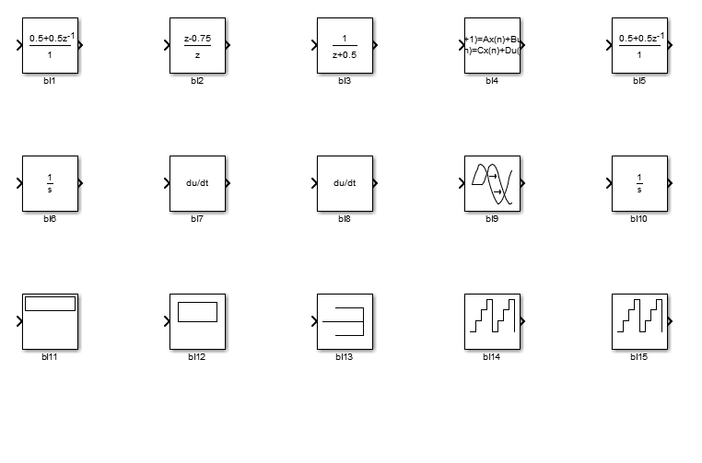
One Example Initial Model Generated from Above Given Example Configuration

Slide 45
Apply Phase 1 Recursively:
Hierarchical Models
Create nested child (aka sub) models
Child model can select parameters (number of blocks, block selection parameters etc.) on its own
Parent model does not reuse child model (but could)
Child’s own blacklist (and whitelist) of blocks (not all blocks can be used in a child model)

Slide 46
Phase 2: Connect Blocks
Maximize number of connected blocks
Iteratively & randomly connect unconnected input/output ports
May result in models that do not compile, e.g. if:
  Output port’s datatype incompatible with datatype of input port connected to
Some output ports may be left unconnected

Slide 47
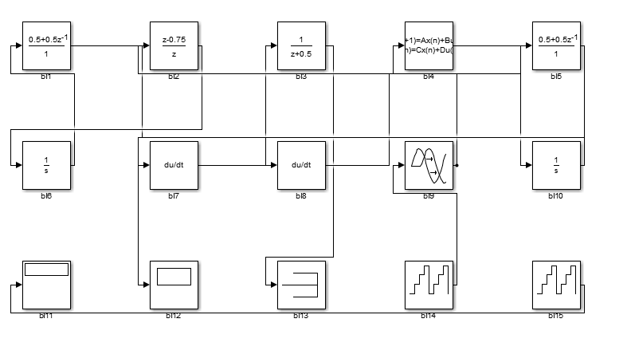

Slide 48
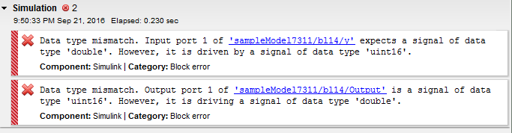
Phase 3: Iteratively Fix Errors in Model
Simulink’s “compile” step produces detailed error messages
Parse error message & fix model accordingly
  Such a “fix” may introduce new errors

Slide 50
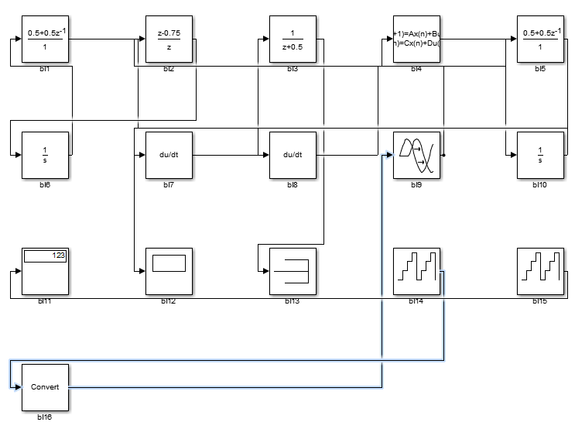
[+] Easy: Don’t need to know type rules
[+] Worked for simple models (<100 blocks)
Fix: Re-connect blocks via added “Convert” block to fix data-type incompatibility

Slide 51
Phase 4: Log Model Output Values
Values of
All output ports of
All blocks at
All simulation steps
Simulink’s signal logging API

Slide 52
Phase 5: Compare Model Output Values
Simulate a given model in two simulation modes, e.g.:
  “Normal Mode” vs. “Accelerated Mode with Optimization On”
Compare logged values
  Configurable tolerance for floating-point values
  For our experiments: Only compared values of last simulation step
Manually inspect any value mismatches

Slide 53
Evaluating CyFuzz

Slide 54
Research Questions (RQ)
RQ 1: Which portion of the generated models compile / simulate?
RQ 2: Can CyFuzz find Simulink bugs?
RQ 3: What is the runtime of CyFuzz’s phases?

Slide 55
Experimental Setup
CyFuzz prototype supports 4 of 15 built-in Simulink block libraries
Not included in evaluation:
  Additional block libraries (“toolboxes”)
  Custom blocks, hierarchical models
Matlab 2015a on Ubuntu 14.10
Normal mode vs. Accelerator vs. Accelerator w/ optimizer
Limit each model
  Generation to 10 fix attempts
  Simulation via 12ms timeout

Slide 56
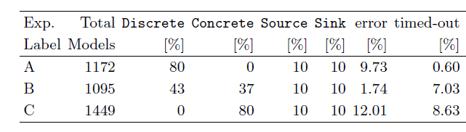
̴80% of Generated Models Okay (RQ 1)
3 experiments w/ various library weights
[+] Simulink compiled & simulated some 80% of generated models
  Errors and time-outs fluctuated with library weights

Slide 57
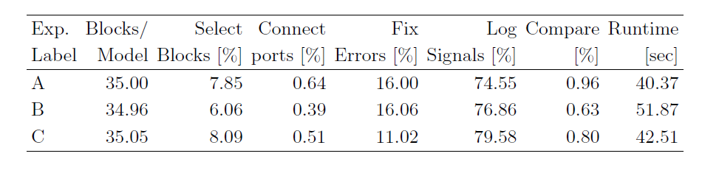
̴45 Second Avg. Total Runtime (RQ 3)
#1 most expensive: Log signals (contains model simulation)
#2 most expensive: Iteratively fix errors

Slide 58
CyFuzz Did Not Find Any New Simulink Bugs

Slide 59
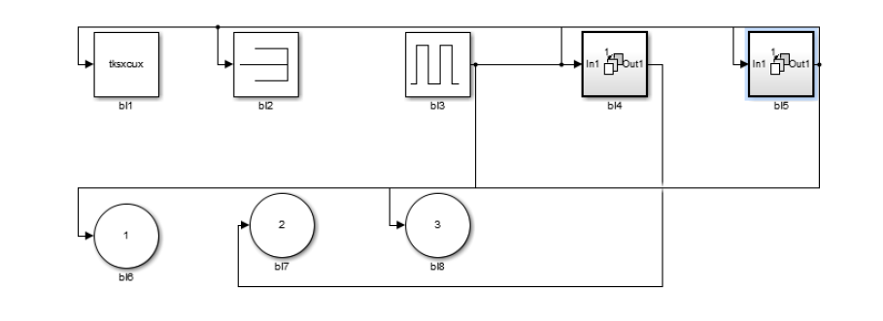
But Reproduced Known Simulink Bug (RQ 2)
Model outputs differ between Normal and Rapid Accelerator Modes
MathWorks confirmed issue as bug, fixed in later releases

Slide 60
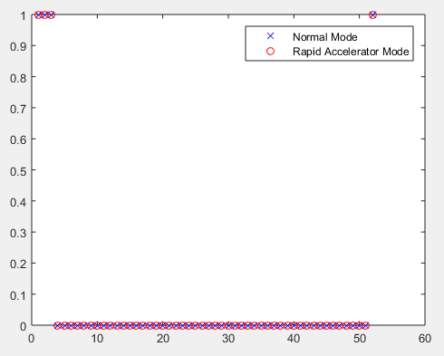
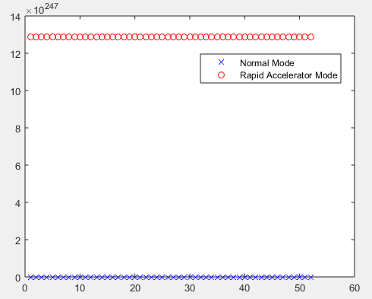
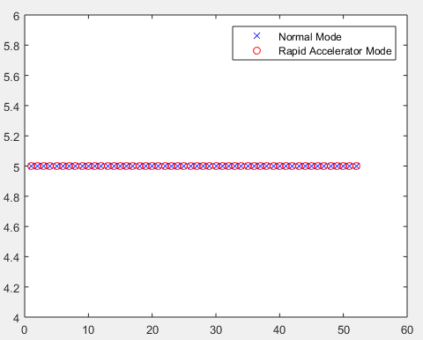
0 vs. 13E247
X Axes: Simulation step
Y Axes: Output value

Slide 61
Generating Realer Valid Models Faster
SLforge

Slide 62
CyFuzz Shortcomings
CyFuzz-generated models are simple:
  Supported few Simulink libraries / toolboxes, e.g.:
  No conditional execution (if then else) / loops
  Can’t create large hierarchical models
Iterative error fix heuristic: Inefficient, may not terminate
  CyFuzz did not leverage informal Simulink language specs (web sites, ..)
Found no new bugs
Are CyFuzz-generated models realistic? Probably not!
  Can’t tell for sure either: No large-scale study of public Simulink models

Slide 63

How Do Real Simulink Models Look Like?
Corpus

Slide 64
Large Study of Public Simulink Models
400k+ blocks of public Simulink models
  [+] Insight on how engineers design models
  [+] Guide our model generator to create realistic models
  [+] Enable evaluating model-generation power
  [+] Benefit model-based empirical research in general
Context
  Largest previous study: 100k blocks, but all company-internal
  Avg. Simulink model at Delphi reported in hundreds of block range

Slide 65
Study Setup
Simulink configuration our organization has licensed
  Includes many libraries
With our config we could only compile about half of public models
  Did not have access to many other libraries

Slide 66
Model Classification: t, s, a, o
(t) = Tutorial: Official Simulink tutorial models from MathWorks1
  In: Automotive, aerospace, industrial automation, general applications, modeling features
  Plus domain-specific library we had access to: Aerospace
  Minus a few we considered toy examples
  Example included model: NASA HL-20 airframe (1,665 blocks)
(o) = Other
  Academic papers (5 models), colleagues (7), web searches (16), and tbd
  Example: 208 block Toyota “Benchmarks for Model Transformations and Conformance Checking”

Slide 67
Model Classification: t, s, a, o
(s) & (a) = Simple & Advanced
  GitHub keyword search (“Simulink”) + file extension search (.mdl and .slx)
  SourceForge
  Matlab Central filtered by “content type: model” w/ highest average ratings or “most downloads” in last 30 days
(s) = Simple
  GitHub: Non-forked / non-favorited
  Matlab Central: Manual check for demo / academic assignment
(a) = Advanced
  Example: 1,320 block model of DC-DC boost converter

Slide 68
Model Metric Collection
Existing tools
  Simulink built-in: sldiagnostics
  https://blogs.mathworks.com/simulink/2009/08/11/how-many-blocks-are-in-that-model/
Existing tools use conflicting definitions, e.g.: block count as
  Plain block count or “net functionality” (← definition we used, too) vs.
  Multiply blocks in a referenced (child) model by number of child’s (re-) uses
Wrote tools for additional metrics in MATLAB
  Source code is available together with CyFuzz / Slforge

Slide 69
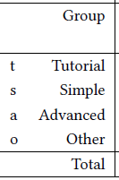
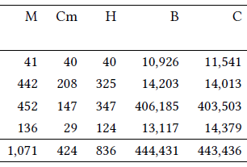
M: models
Cm: models compiled with license
H: models with hierarchy
B: blocks
C: connections

Slide 70
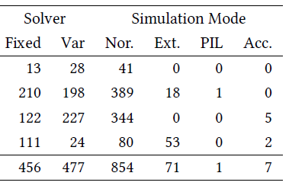


Fixed: Fixed-step solver
Var: Variable-step solver
Nor: Normal Mode
Ext: External Mode
PIL: Processor in the loop
Acc: Accelerator Mode

Slide 71
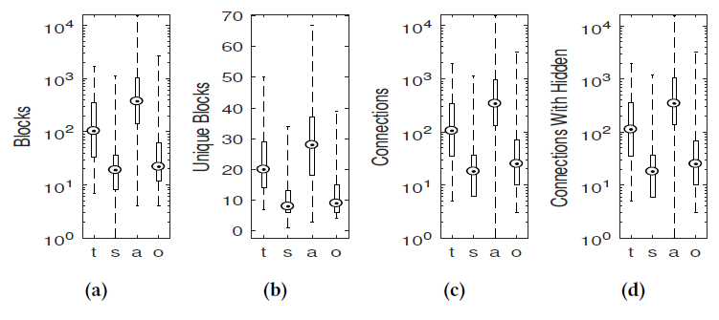
Distinct block types
E.g.: Goto blocks

Slide 72
Model-internal Code Reuse Was Rare
Can reference (reuse) child model many times in same model
Found only one model using this feature
  In the tutorial group
Do Simulink users reuse S-functions instead?
S-function reuse was also very low
  < 0.5% median value

Slide 73
Algebraic Loops Were Rare
Only in 18 models
In our sample of 1k models

Slide 74
Most-used Blocks
Top-3 across categories: Inport, Outport, SubSystem. Rest:
(t) = Tutorial
  Product, Constant, Sum, Gain, From, Selector, Mux, Demux, Terminator, Goto, UnitConversion, BusSelector, Fcn, Integrator, Math, Trigonom
(s) = Simple
  Constant, Gain, S_Function, Terminator, Sum, DataTypeConv., Demux, Mux, Scope, PMIOPort, From, Product, RelationalOp., Goto, Ground, Integr.
(a) = Advanced
  Constant, From, PMIOPort, Sum, Gain, Goto, Product, Mux, Demux, RelationalOp., Switch, Fcn, SimscapeMulti., PMComp., Ground, Terminator

Slide 75
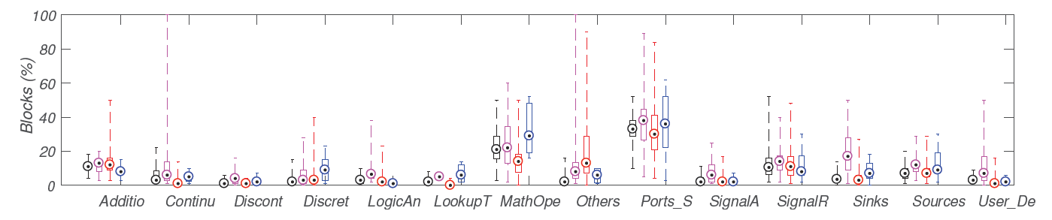




Additional Results on Subset of Models
Subset of 391 models (vs. 1k) with 145k blocks (vs. 444k)
Participation of various libraries across four categories t,s,a,o:
t,s,a,o
Math Operations
Ports & Subsystems
From, Goto: Signal Routing
Few custom blocks (“User_Defined”)

Slide 76
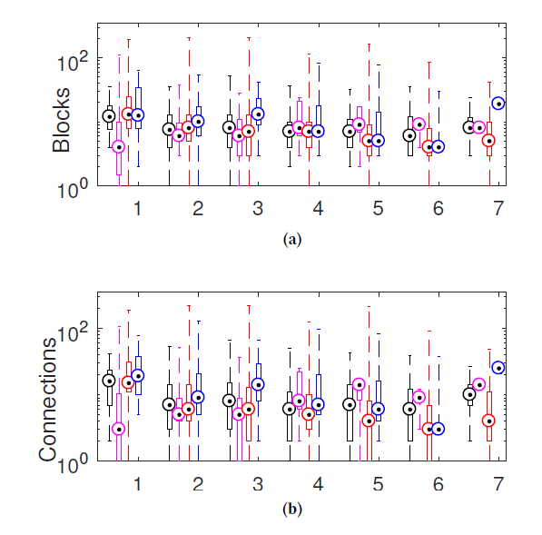
t = tutorial
s = simple
a = advanced
o = other
Hierarchy Depth →
Blocks →
t,s,a,o
Connections →
Hierarchy Depth →

Slide 77
Using Simulink’s Semi-formal Language Specs
SLforge

Slide 78
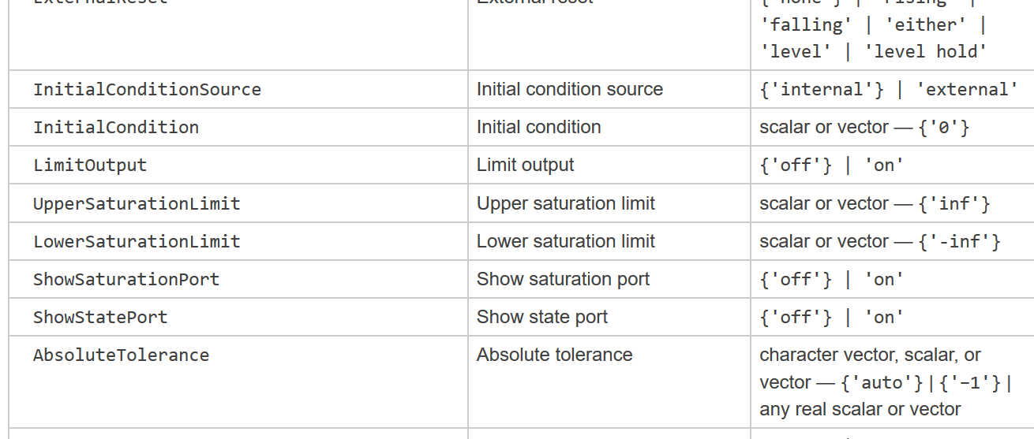

Slide 79
Best Effort: Gather Semi-formal Specifications
Focus on specifications for blocks from most-used libraries
Focus on aspects that caused CyFuzz errors
  Algebraic loops, datatype inconsistency, sample time inconsistency
Simulink’s spec style relatively constant over time
  Our parser worked for spec of several releases (R2015a -- R2017a)
Datatype & parameter specifications (partially) for built-in blocks
  Via regular-expression based parsing of Simulink websites
  Limited by Simulink’s free-form specification style

Slide 80
Example Free-form Specifications
Direct feed-through property
As described for blocks: Variable Time Delay, Discrete Filter, Delay
  “Yes, of the time delay (second) input”
  “Only when the leading numerator coefficient does not equal zero”
  “Yes, when you clear Prevent direct feedthrough”

Slide 81
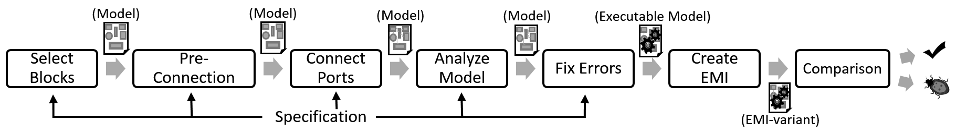
SLforge ≈ CyFuzz + Specifications + Basic EMI
First 5 SLforge phases use gathered specifications

Slide 82
Phase 1: Ensure Model Satisfies Basic Rules
E.g.: Configure each block’s sample time to satisfy type / inheritance rules
E.g.: For each “If” block there is 1 “Then” block & 1 “Else” block

Slide 83
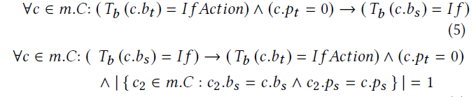
Phase 2
Create correct-by-construction connections, e.g.:
Control-flow connections between “If” and “Then” / “Else” blocks

Slide 84
Phase 4: Search Model for Conflicts w/ Spec
Forward-propagate known datatypes, add type conversion blocks on demand
Add Delay blocks to break algebraic loops

Slide 85
Evaluating SLforge

Slide 86
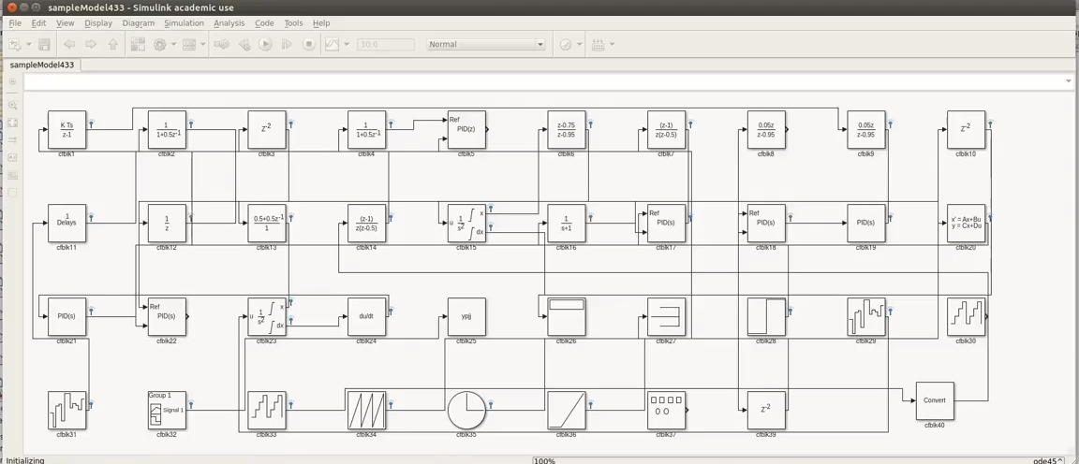
Screenshot of a Randomly Generated Model

Slide 87
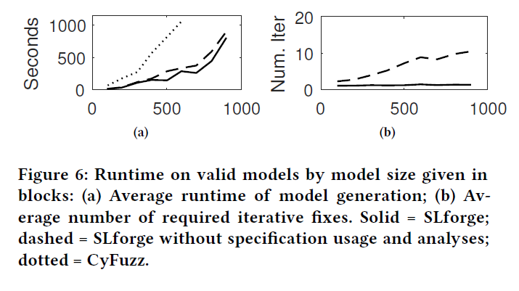
SLforge Generates Models More Efficiently
Blocks per Model
Blocks per Model
Figure: Runtime Analysis
Figure: Number of “Fix Error” Iterations
Dotted: CyFuzz
Dashed: SLforge (except the analysis phase)
Solid: SLforge
Dashed: CyFuzz
Solid: SLforge

Slide 88
SLforge Can Generate Rich Models
Hierarchical depth: up to 7
Blocks/model: 2,152 (average)
Connections/model: 2,544 (average)
Supports new frequently-used libraries:
  Subsystems and Model referencing
  Math Operations,
  Logic and Bitwise operations,
  User-defined C code using Csmith (S-functions)

Slide 89
SLforge Found New Bugs
Continuously generated models for five months
Reported 13 unique bugs (Simulink versions: R2015a, R2017a)
  False reports: 2
  Confirmed bugs by MathWorks Support: 11
  New bugs: 9

Slide 90
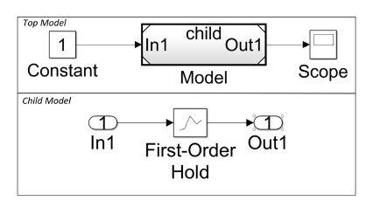






Example Bugs SLforge Found: TSC-02472993
Model (top) refers to the child model (bottom). Simulink fails to handle rate transition automatically for the First-Order Hold block.

Slide 91
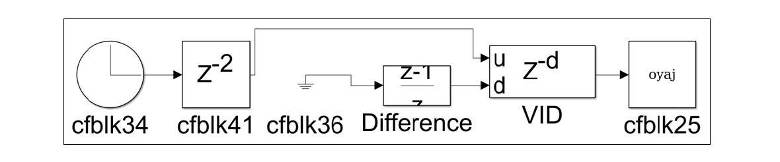
TSC-02614088
Despite supporting datatype double in its d port, VID issued a datatype inconsistency, saying it prefers datatype integer.

Slide 92
Equivalence Modulo Input-based Testing
EMI in SLforge

Slide 93
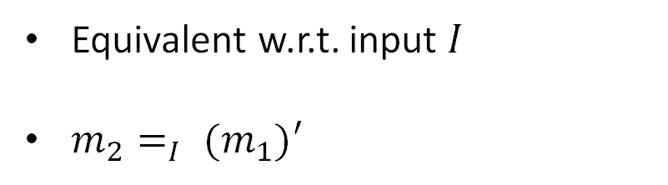
Background: Equivalence (Modulo Input) Testing
I
Model 1
Model 2
Equivalent w.r.t. input $I$
$m_{2}=_{I} (m_{1})′$
change
compile
Executable 1
Executable 2
execute
compare
Output 1
?
Output 2
Reference: Su et al. “EMI Testing: Finding 1000+ Bugs in GCC and LLVM in 3 Years”. Available: http://web.cs.ucdavis.edu/~su/emi-project/emi-testing.pdf

Slide 94
Basic Static EMI-based Mutation
Delete all blocks statically dead (i.e.: not connected to Sinks)
[+] Easy: Use Simulink’s Dead Block Elimination Optimization

Slide 95
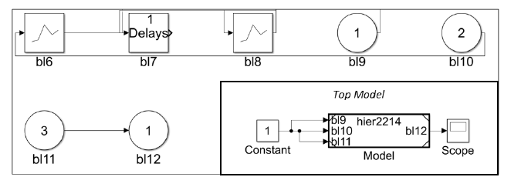











Bug SLforge Found via EMI: TSC-02476742
Top Model’s Model block is a placeholder for the child model,
All blocks in child model except bl11 and bl12 are dead, but: Simulink did not remove these dead blocks in Accelerator mods

Slide 96
Publications With Full Author Lists
Shafiul Azam Chowdhury, Taylor T. Johnson, Christoph Csallner, “CyFuzz: A Differential Testing Framework for Cyber-Physical Systems Development Environments”, In Proc. 6th International Workshop on Design, Modeling and Evaluation of Cyber Physical Systems (CyPhy), pages 46—60. 2016.
Shafiul Azam Chowdhury, Soumik Mohian, Sidharth Mehra, Siddhant Gawsane, Taylor T. Johnson, and Christoph Csallner, “Automatically Finding Bugs in a Commercial Cyber-physical System Development Tool Chain with SLforge”. In Proc. 40th International Conference on Software Engineering (ICSE), pages 981—992. 2018.
Shafiul Azam Chowdhury, Lina Sera Varghese, Soumik Mohian, Taylor T. Johnson, and Christoph Csallner, “A Curated Corpus of Simulink Models for Model-based Empirical Studies”, In Proc. 4th International Workshop on Software Engineering for Smart Cyber-Physical Systems (SEsCPS), pages 45—48. 2018.

Slide 97


Acknowledgements
This material is based upon work supported by the National Science Foundation under Grants No. 1117369, 1464311, 1509804, 1527398, 1713253, and 1736323, by the Air Force Research Laboratory (AFRL) through contract numbers FA8750-13-2-0115, FA8750- 15-1-0105, and FA8650-12-3-7255 via WBSC 7255 SOI VU 0001, and by the Air Force Office of Scientific Research (AFOSR) through contract numbers FA9550-15-F-0001, FA9550-15-1-0258, and FA9550-16-1-0246.
Any opinions, findings, and conclusions or recommendations expressed in this material are those of the authors and do not necessarily reflect the views of AFRL, AFOSR, or the National Science Foundation.
This material is partly supported by a MathWorks Research Grant.

Slide 98
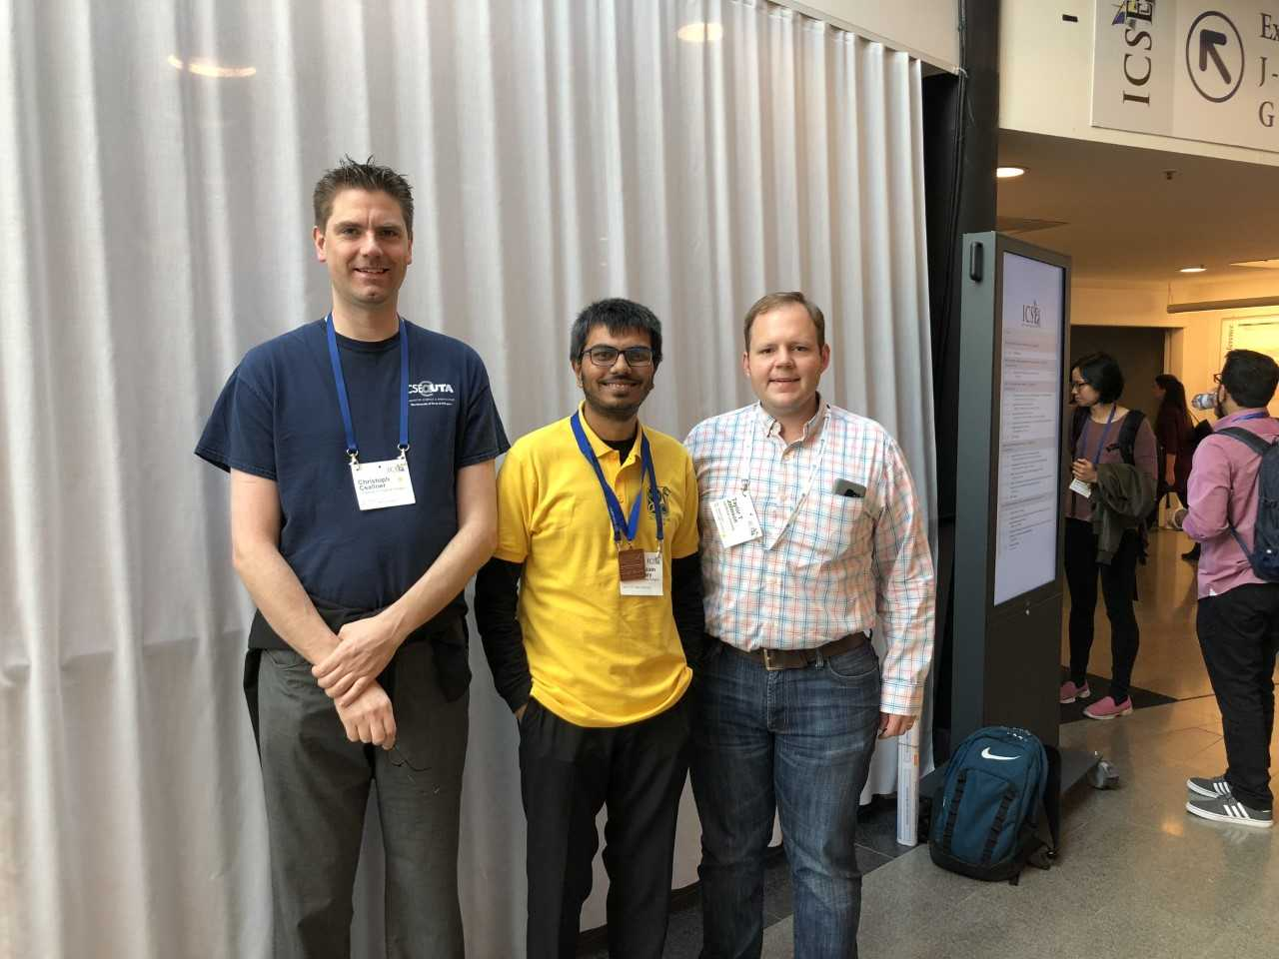
Credits
Many of the slides based on Shafiul’s slides
(he just defended his Ph.D. dissertation at UTA)

Slide 99
Summary, Q&A
Simulink by MathWorks used widely
Found 10+ “compiler” bugs in Simulink
  We are looking for bugs in the Simulink tool
Simulink vendor MathWorks confirmed these as bugs
Other results
  USD 1M in grants from the National Science Foundation (NSF)
  USD 32k gift to UTA from MathWorks to continue research
  Source code available (BSD license) https://github.com/verivital/slsf_randgen

Slide 100
Thank You!

