Slide 1

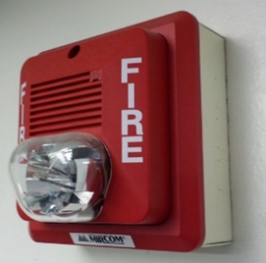



Slide 2
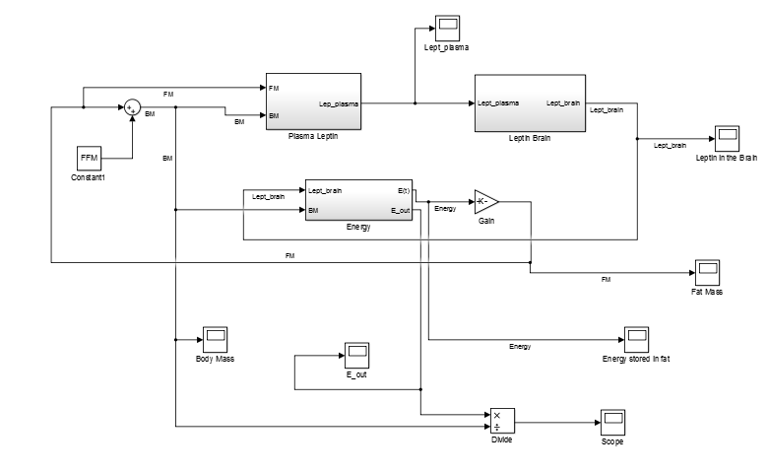





Deploy
Data-flow Model
Simulate
Engineer
Executable
Image of the Simulink model: available: https://commons.wikimedia.org/wiki/File:Simulink_lept.png

Slide 3
Tool Improvement Approaches
Formally verifying components
[-] Currently Not feasible
Large codebase
Formal
Spec.
[-] No complete and/or updated formal specifications
Rapid release cycle of products
Notes:
Ideally, we should formally verify that there are no bugs.
Unfortunately, this not feasible to formally verify the entire CPS tool chain -- due to the large code base
And also, commercial CPS tool chains have rapid release cycle.
So it’s hard to get complete and/or updated formal specifications.

Slide 4
Automatically Finding Bugs in a Commercial Cyber-Physical System Development Tool Chain with SLforge
Shafiul Azam Chowdhury
Soumik Mohian
Sidharth Mehra
Siddhant Gawsane
Dr. Taylor T. Johnson
Dr. Christoph Csallner
The University of Texas at Arlington
Vanderbilt University
github.com/verivital/slsf_randgen
This material is based upon work supported by the National Science Foundation under Grants No. 1117369, 1464311, and 1527398. Any opinions, findings, and conclusions or recommendations expressed in this material are those of the author(s) and do not necessarily reflect the views of the National Science Foundation.
This material is based upon work supported by the Air Force Office of Scientific Research (AFOSR) contract numbers FA9550-15-1-0258 and FA9550-16-1-0246, and by Air Force Research Lab (AFRL) contract number FA8750-15-1-0105. Any opinions, findings, and conclusions or recommendations expressed in this publication are those of the authors and do not necessarily reflect the views of AFRL or AFOSR.
Notes:
Welcome to the talk on automatic bug finding -- in Cyber-Physical System tool chains -- with our scheme SLforge

Slide 5
Overview
Eliminating bugs from Cyber-Physical System (CPS) tool chain is crucial
Existing CPS tool chain testing scheme is inefficient in finding new bugs
Addressing its limitations, we present SLforge
Systematic and efficient model generator
Found 10+ confirmed bugs in MathWorks’ Simulink
Large-scale study on public Simulink models
Drives model generation and evaluation
Notes:
Existing CPS tool chain testing scheme is inefficient in finding bugs.
In this paper we identify its limitation and address them, presenting a systematic model generator
which has already found 11 confirmed bugs in Simulink.
We also did a large-scale study on public Simulink models
To gain insigtht on how engineers model in the real world.
So we can guide the model geneator to create models which are similar to the realistic pubic models.
And also evaluate the model generation power.

Slide 6
Background: Differential Testing with CyFuzz
Model
Generator
generate
CPS Model
[+] Don’t need full formal language specs to find bugs
[+] No false warnings if undefined behaviors are avoided
CPS Tool Chain
-o0
-o1
compile
Executable 1
Executable 2
execute
compare
Output 1
?
Output 2
Notes:
In prior work we presented the first known differential testing framework for CPS tool chain called CyFuzz.
Quick background on differential testing:
Say the CPS tool chain we want to test offers two modes:
one with no compiler optimization, and other enables optimization
Now, CyFuzz has a test generator which automatically creates a random CPS model

Slide 7
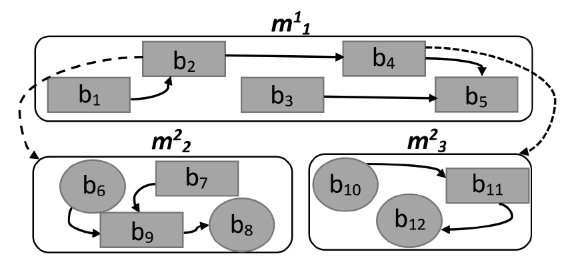
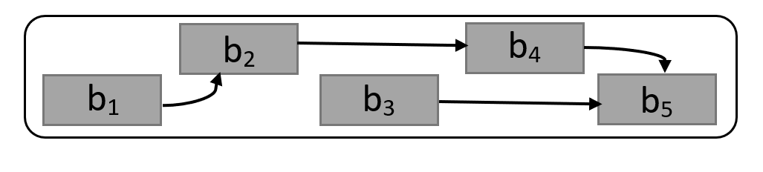
Background: CPS Model
Block: Node, basic component of CPS model, represents a formula / code
Connection: Edge between blocks
Block library: Similar to a standard library of traditional programming language
Custom Blocks: Native (e.g., C) code
Hierarchy: block representing a child model
Notes:
A CPS model contains of blocks, which accepts data using input port, performs calculations, and sends outputs to other blocks.
We can choose vendor provided built-in blocks from libraries
Or even define custom block behavior using procedural code.
Instead of flat models, we can create them in hierarchies, where a block in a “parent” model is actually a placeholder for an ENTIRE “child” model.

Slide 8
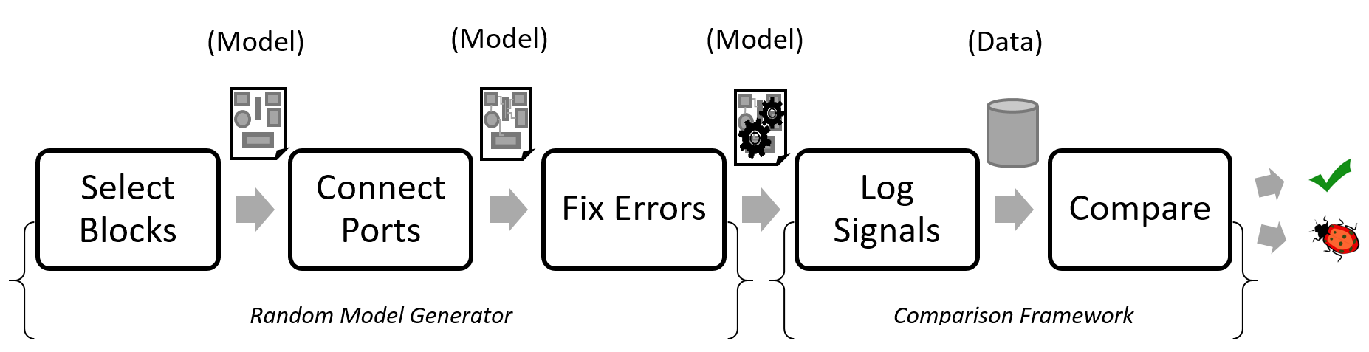
Background: CyFuzz Phases
Random Model Generator
Comparison Framework
Notes:
CyFuzz is organized in 5 phases:
The first 3 phases create a random model
And the following two takes the model, executes it in different configurations, and compare them.
In the first phase it selects which blocks should be in the model
Next, it randomly connects the blocks
The model is likely invalid, so it has a Fix Error phase,
Where it repeatedly compiles the model, figures out what went wrong and tries to fix it – so that the compiler would accept it as a valid model.
Next we run the model and *log* output in different modes
And compare them for discrepancy

Slide 9
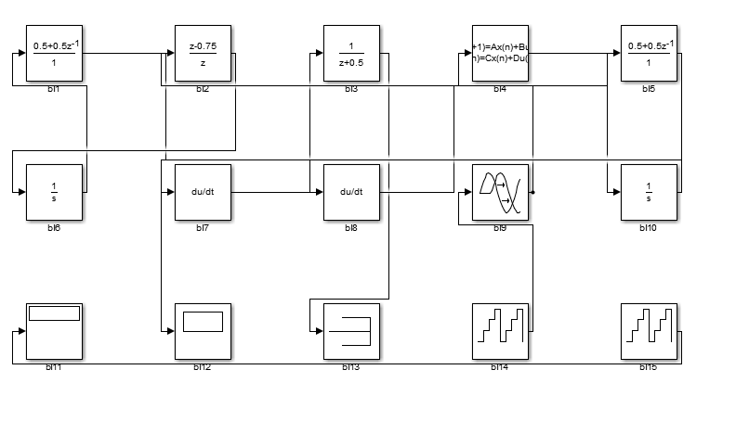
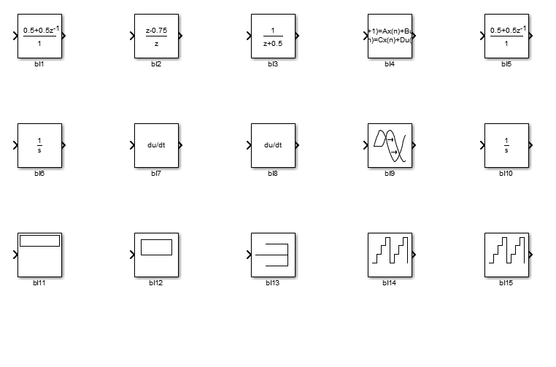
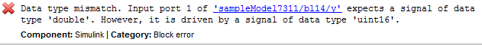
Background: CyFuzz Fix Errors
Compile model: error
Notes:
The core is the Fix Error phase, so we give an example.
Say this is a randomly generated model.
The FE phase compiles it and sees error

Slide 10
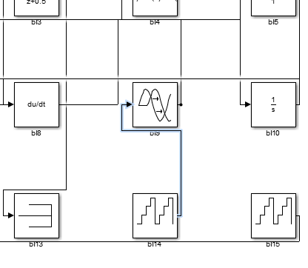
Background: CyFuzz Fix Errors
Parse error message(s)
Identify problematic components

Slide 11
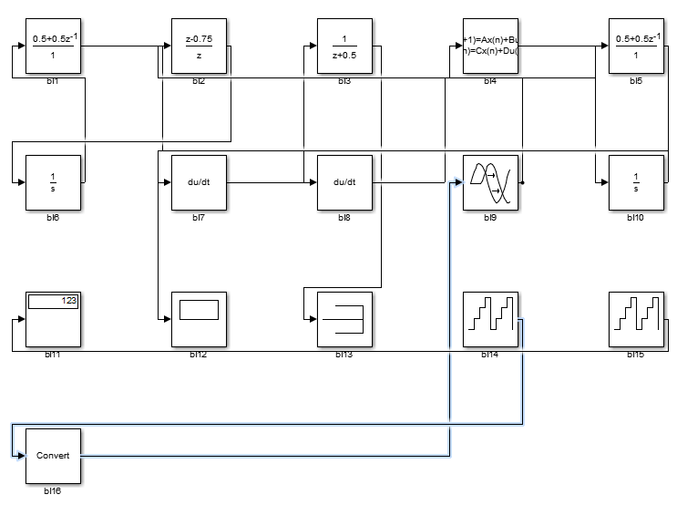
Background: CyFuzz Fix Errors
Add a new block to fix the data-type incompatibility
[+] Easy to implement
No knowledge of type rules needed
[+] Worked well for small, simple models (<100 blocks)

Slide 12
Background: Equivalent Modulo Input (EMI) Testing
Model 1
Model 2
change
Models have fixed input
compile
Executable 1
Executable 2
execute
compare
Output 1
?
Output 2

Slide 13
CyFuzz Shortcomings
Fix Error heuristics: inefficient, may not terminate
Did not leverage modeling specifications
Models are simple:
Can’t create large hierarchical models
No support for conditional execution (If Else) and loops
Found no new bugs

Slide 14
Challenge: Evaluating CyFuzz-generated Models
No large-scale study of publicly available Simulink models!
which could…
[+] Give insight on how researchers design models
[+] Guide the generator to create realistic models
[+] Evaluate the model-generation power
[+] Benefits model-based empirical research in general
Notes:
It was hard to evaluate the models generated by CyFuzz – are they powerful and realistic?

Slide 15
Contributions
Improved CyFuzz’s model generation scheme (Slforge)
Parsing public specifications and leverage them in model generation
Formalization of the specifications
Intermediate model representation and analysis
Experimental evaluation:
Efficiency
Model-generation capability
Found 10 confirmed bugs (8 new)

Slide 16
Largest Study of Public Simulink Models
Collected and studied 391 Simulink models:
MathWorks-provided tutorial models
Popular public repositories
MathWorks’ FileExchange and GitHub
Academic and search engine results

Slide 17
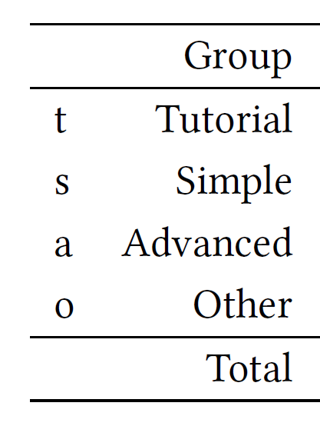
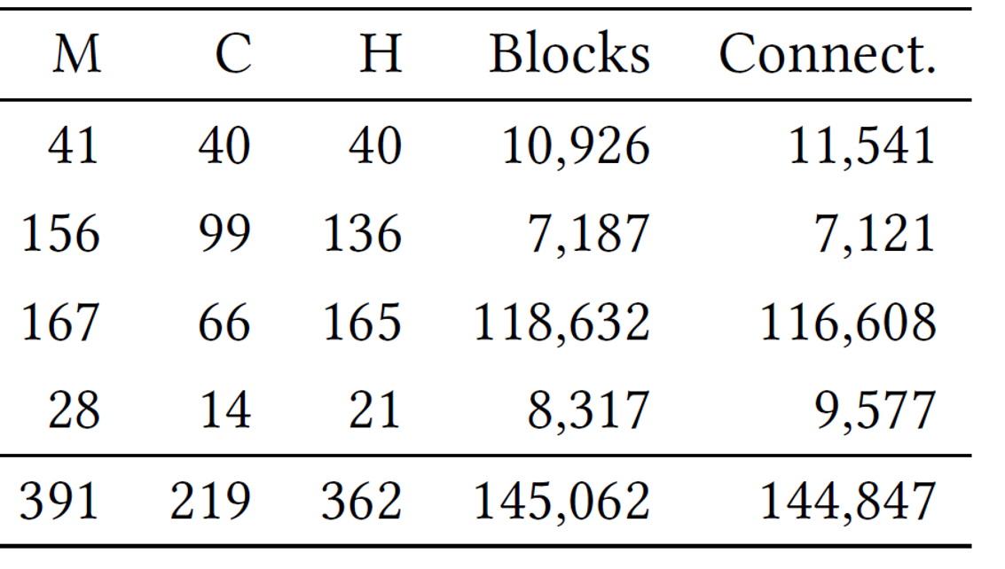
Largest Study of Public Simulink Models
Collected and studied 391 public Simulink models:
Classified into groups:
M: # of Models
C: # of models which compiled
H: # of models having hierarchy

Slide 18
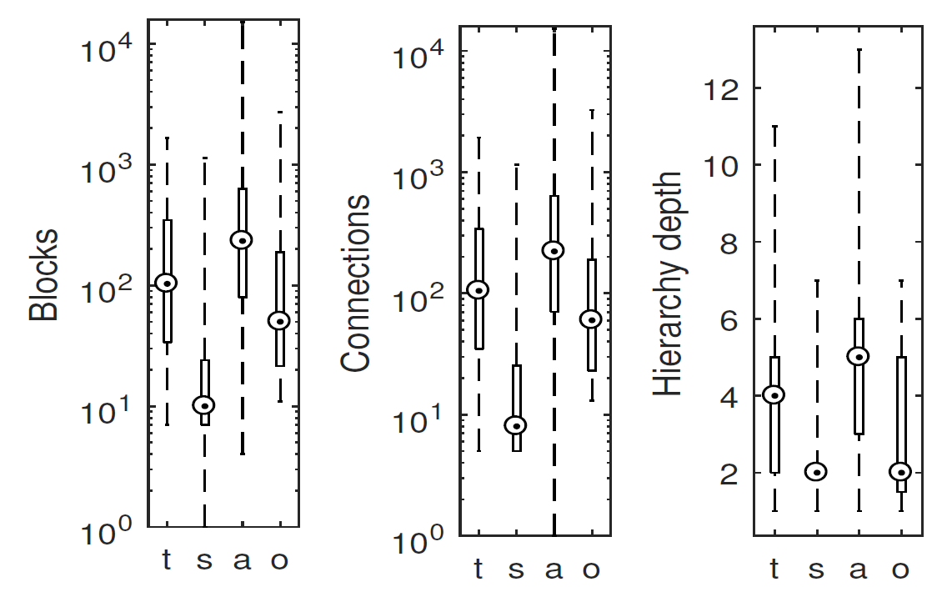
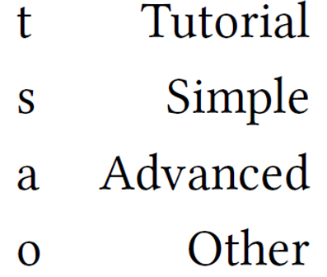
Blocks
Connections
Hierarchy Depth

Slide 19
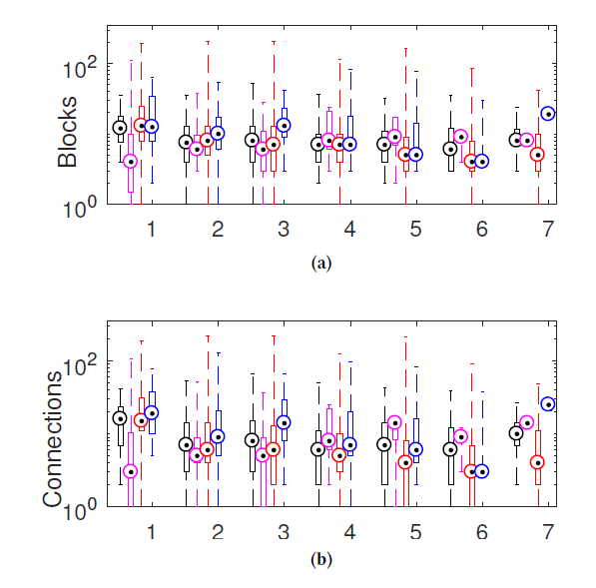
Blocks
Hierarchy Depth
Connections
Hierarchy Depth

Slide 20
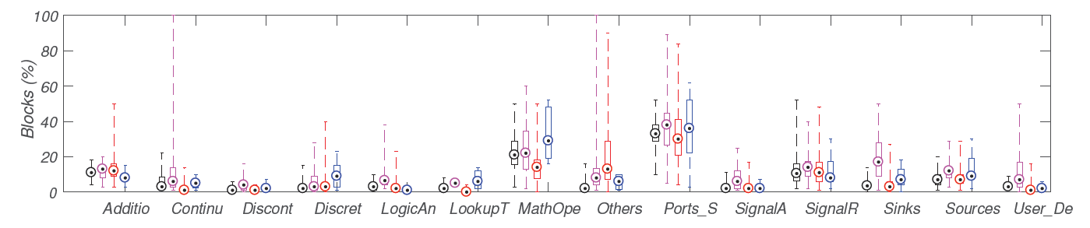
Participation of Libraries

Slide 21
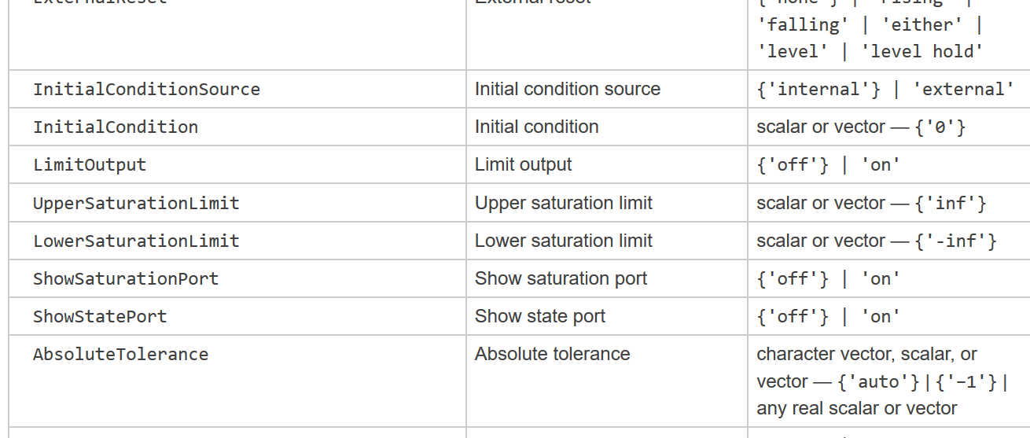
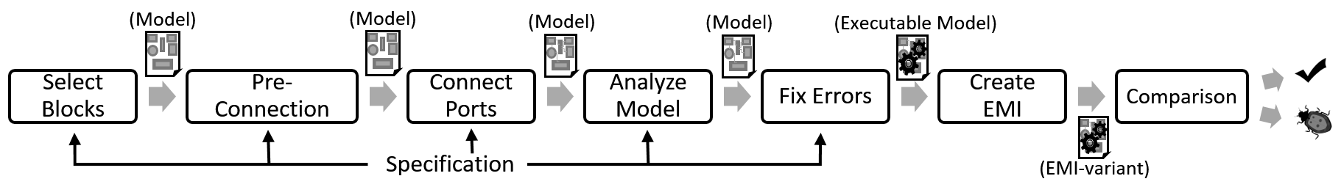
SLforge
Extending CyFuzz codebase, open-source
Parses publicly-available specifications

Slide 22
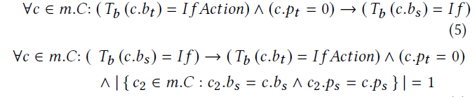
SLforge
Checks which connections are invalid by the specifications

Slide 23
Slforge New Phases
Graph search detects type inconsistencies and removes algebraic loops

Slide 24
EMI-based Testing
Statically creates EMI-variants
SLforge creates EMI variants from the generated models
Uses Simulink’s Dead-block optimization API

Slide 25
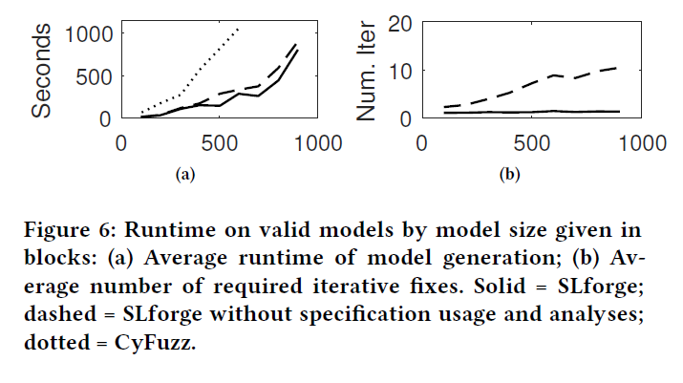
RQ: SLforge Generates Models Efficiently
Blocks per Model
Blocks per Model
Figure: Runtime Analysis
Figure: Number of “Fix Error” Iterations
Dotted: CyFuzz
Dashed: SLforge (except the analysis phase)
Solid: SLforge

Slide 26
RQ: Generating Realistic Models
Generate models up to hierarchical depth 7
2,152 blocks/model (average)
2,544 connections/model (average)
Supports new frequently-used libraries:
  Subsystems and Model referencing, Math Operations,
  Logic and Bitwise operations, S-functions

Slide 27
RQ: Bug-Finding Capability
Continuously generated models for five months
Reported 12 issues
  Confirmed bugs: 10
  New: 8

Slide 28
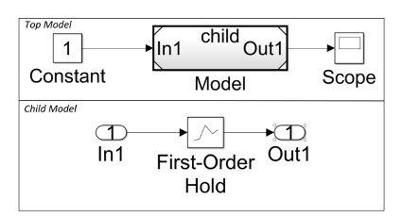
Example Bugs
Bug TSC-02472993: The Model block (top) refers to the child model (bottom). Simulink fails to handle rate transition automatically for the First-Order Hold block.

Slide 29
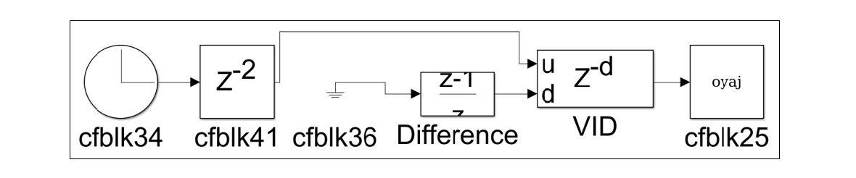
Example Bugs Found
Bug TSC-02614088: In spite of supporting double data-type in its d port, block VID issued a data-type inconsistency as it prefers integer type.

Slide 30
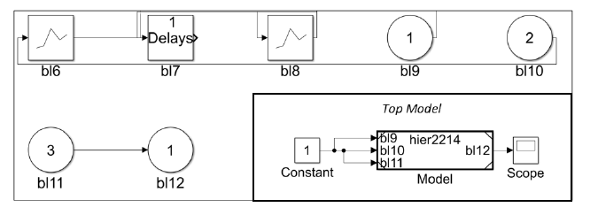
Example Bugs Found
EMI Bug TSC-02476742: The Top Model’s (in bottom right corner) Model block is a placeholder for the child model (top and left), where all blocks except bl11 and bl12 are dead, however, were not removed in the Accelerator mode.

Slide 31
Thank You!

