Slide 1
Doodle2App: Native App Code by Freehand UI Sketching
Soumik Mohian
soumik.mohian@mavs.uta.edu
Christoph Csallner
csallner@uta.edu
Computer Science and Engineering Department
University of Texas at Arlington
Website- http://pixeltoapp.com/doodle/
Github- https://github.com/soumikmohianuta/Doodle2App

Slide 2
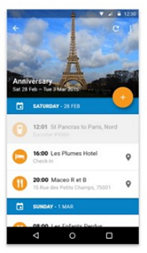
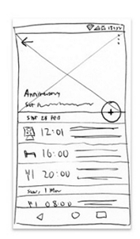
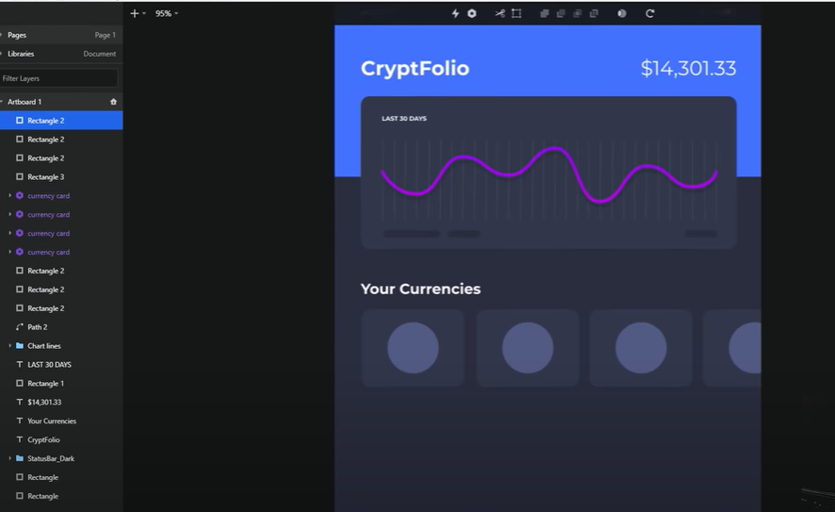
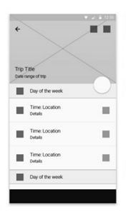
Goal: Freehand sketching to ready-to-compile app code.
Address this Gap
Avoid manually recreate prototypes in ``high fidelity'' tools.
Converting free hand sketches to UI code
Immediate feedback on preview
Low-Fidelity Drawing
Using Art Supplies
https://www.youtube.com/watch?v=joB2BkFvgjM
http://murdochcarpenter.com/portfolio/wireframes/

Slide 3
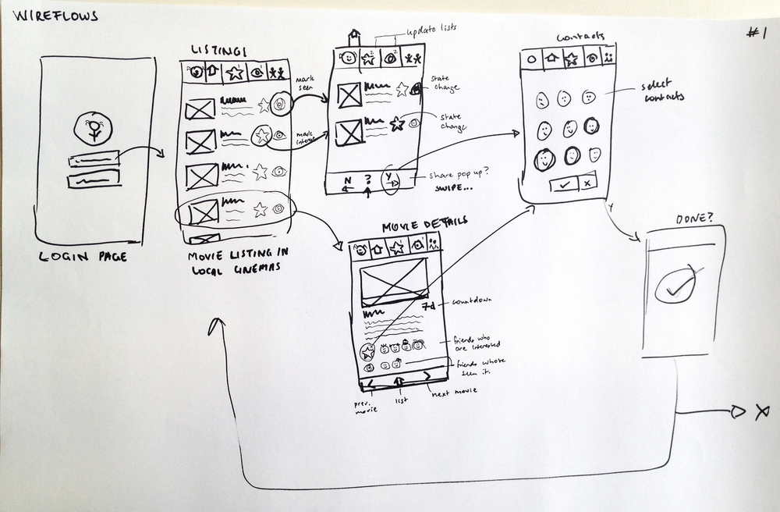
Low-fidelity remains important
Low-Fidelity Drawing
Quick and easy
Used by most (Survey result- 72/87 use art supplies)
Ease of use
Learning Process
Appeared satisfied (Why change?)
http://www.iamannelise.com/share-a-show
Carter, Adam S., and Christopher D. Hundhausen. "How is user interface prototyping really done in practice? a survey of user interface designers." 2010 IEEE Symposium on Visual Languages and Human-Centric Computing. IEEE, 2010.

Slide 4
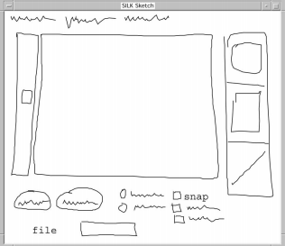
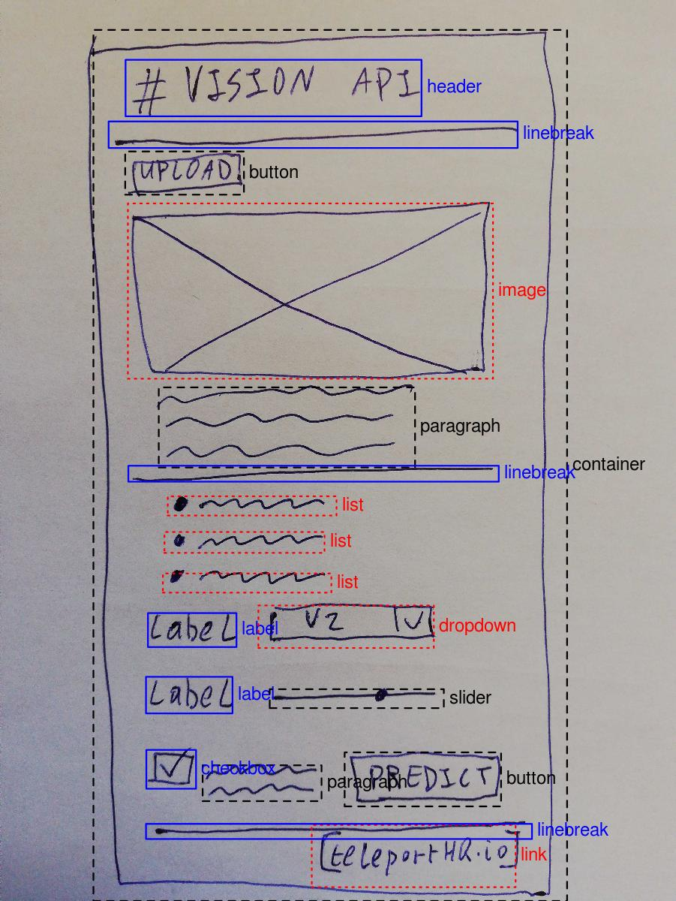
Related Work
SILK
Teleport
Teleport (2019)
Pen on paper Drawing
Take Snapshot
Send it to Teleport Vision API
Landay, James A., and Brad A. Myers. "Sketching interfaces: Toward more human interface design." Computer 34.3 (2001): 56-64.
SILK support four primitives components
Teleport have low recognition accuracy
https://github.com/teleporthq/teleport-vision-api

Slide 5
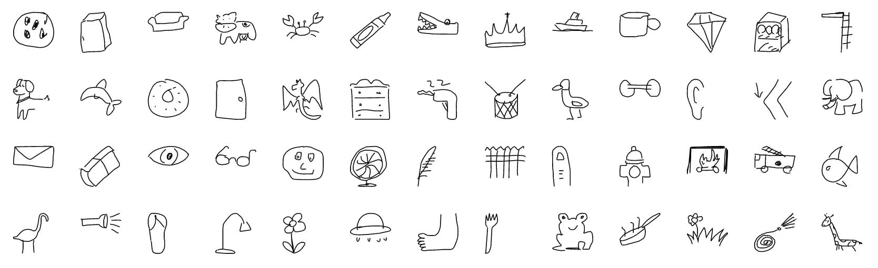
Idea: Leverage Google QuickDraw
https://github.com/googlecreativelab/quickdraw-dataset
Vector Representation
Collection of Stroke Sequences
Stroke ends on touch end
Stroke is a sequence of straight lines
Line is given by their x/y endpoint coordinates.
QuickDraw Dataset
50 million drawings
345 categories
140K Drawing per category
Vector representation of drawings
Few categories relevant to common UI classes

Slide 6
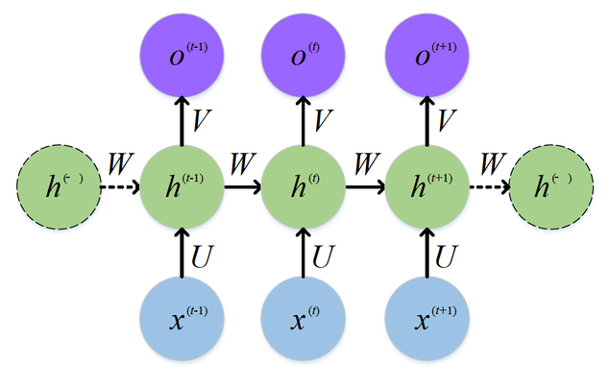
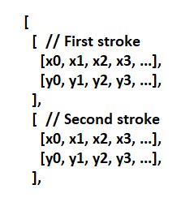
Background: RNN
RNN
Input
Output:
Class Label
Recurrent Neural Network
RNN and variants achieved state-of-the art algorithm for sequential data.
Drawings as stroke sequence- Detection, Auto Completion, Image Retrieval
Feng, Weijiang & Guan, Naiyang & Li, Yuan & Zhang, Xiang & Luo, Zhigang. (2017). Audio visual speech recognition with multimodal recurrent neural networks. 681-688. 10.1109/IJCNN.2017.7965918.

Slide 7
What are the most common UI Elements on Android
Most common Android UI element type according to RICO-
Container
Image
Icon (a small interactive image)
Text
Text button
Web view
Input
List item
Switch (a toggle element)
Map view
Slider
RICO dataset: 66k unique Android app screens from 9.3k apps from 27 app categories.
Captured runtime UI hierarchy of each screen and clustered all screens' elements by visual similarity.
Most common Icons - Back, menu, hamburger, cancel, search, plus, avatar, home, share, settings, star.
Biplab Deka, Zifeng Huang, Chad Franzen, Joshua Hibschman, Daniel Afergan, Yang Li, Jeffrey Nichols and Ranjitha Kumar. 2017. Rico: A Mobile App Dataset for Building Data-Driven Design Applications.

Slide 8
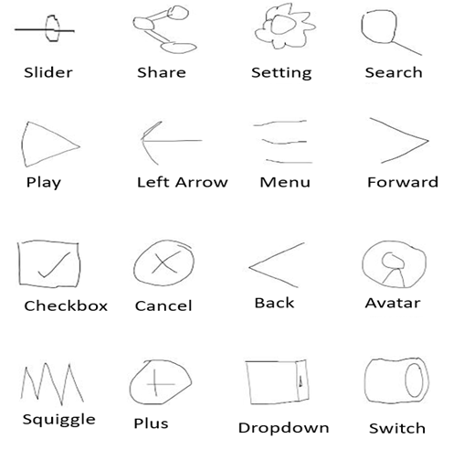
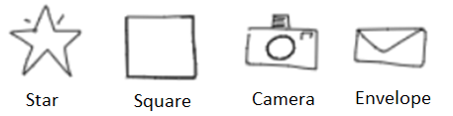
Dataset
Turk User
QuickDraw

Slide 9
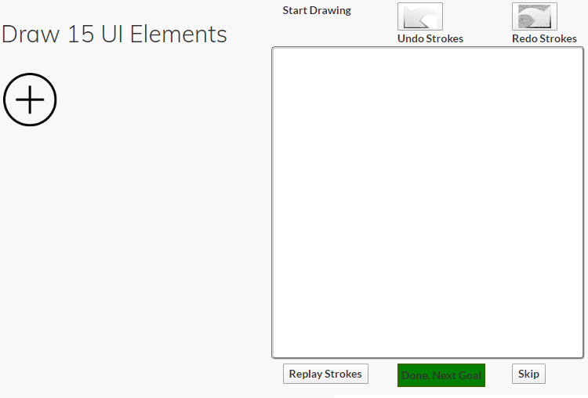
Data Collection Process
Drawing Interface
No publicly available dataset of user interface sketches.
Recruited Amazon's Mechanical Turk users to draw on a Digital Interface.
Drawings are reviewed for quality assurance.
Drawings available at - https://doi.org/10.5281/zenodo.3653552
Corpus of UI sketches at the stroke-level, with over 10k sketches of 16 UI element categories collected from hundreds of individuals

Slide 10
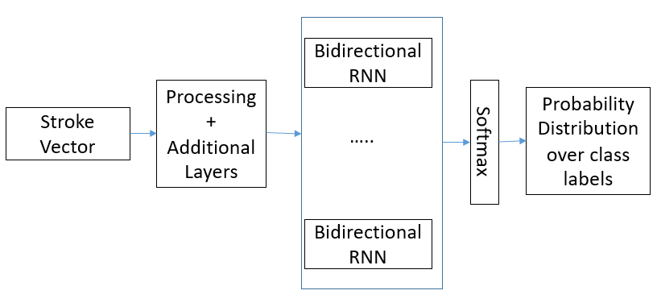
Design Overview: Sketch Classifier
Network Architecture
Sketch Dimension Normalization
Adaptation of the Quick Draw Paper’s Network
Added layers and adjusted filter numbers to improve accuracy.
Convolutional Neural Network
Adjusted number of Layers
Training
Trained Quick Draw on 20 Classes that will be not used in our tool
Transfer Learning: Initialize layers with the pre-trained network.
Further trained the network on our Dataset.
Notes:
Buuble

Slide 11
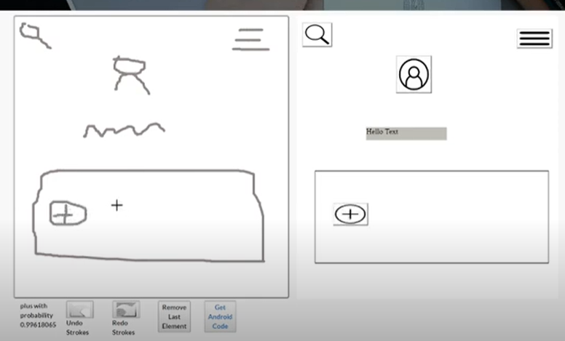
Drawing Interface and Preview
Drawing on the interface
Drawing Elements are separated by keyboard press ‘z’ or double tap event
Functionalities like Redo, Undo
Classified Label with Probability
Preview Rendered in the Website

Slide 12
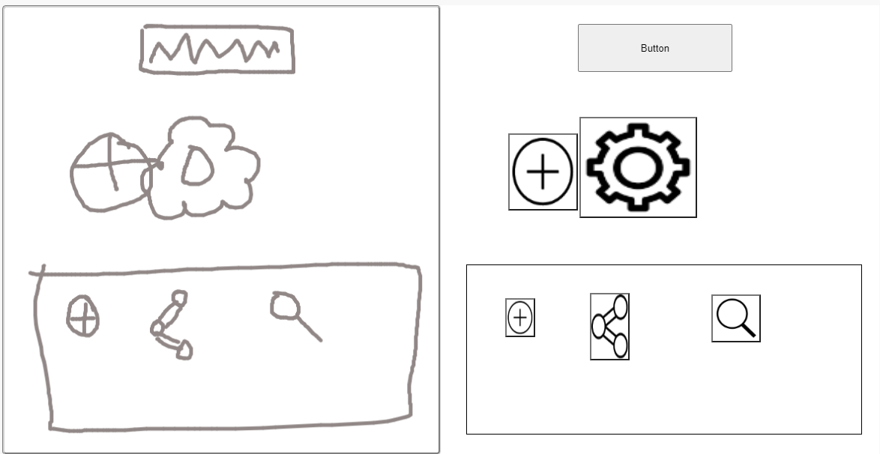
Post Processing
Complex Element
Overlap
Nesting
Recursively Find Nesting Hierarchy in the Sketches.
Detect Complex UI Element based on pre-defined rules.
Detect overlap and adjust their position accordingly.

Slide 13
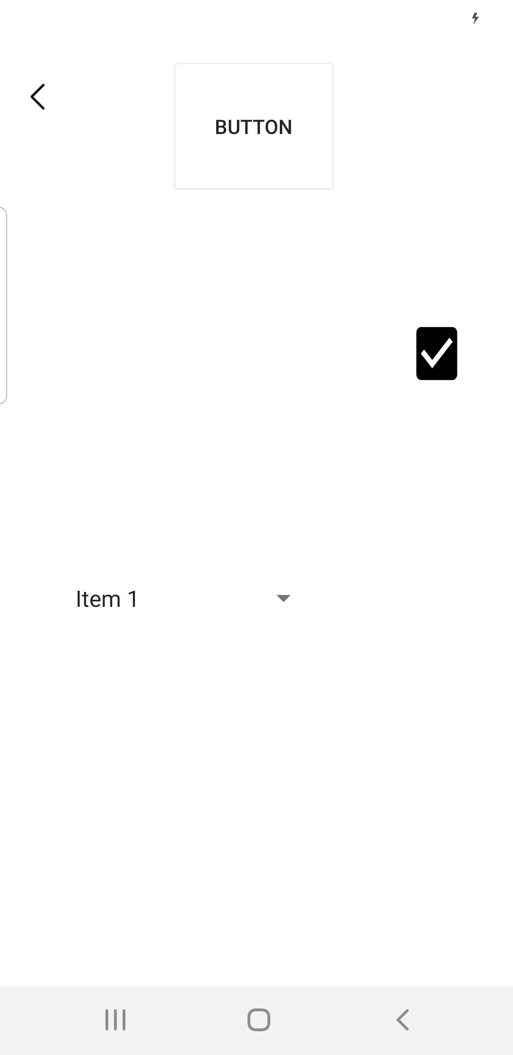
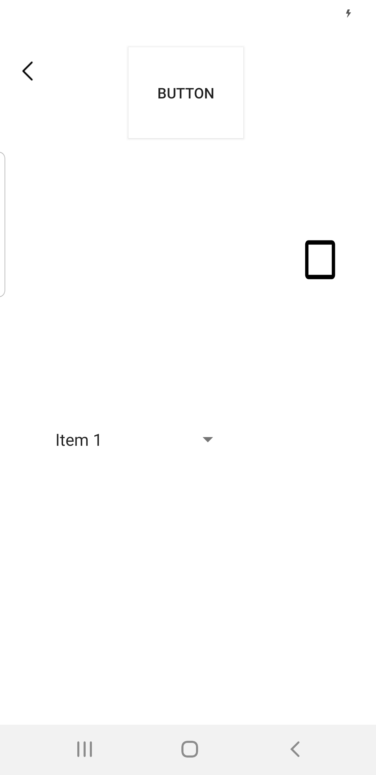
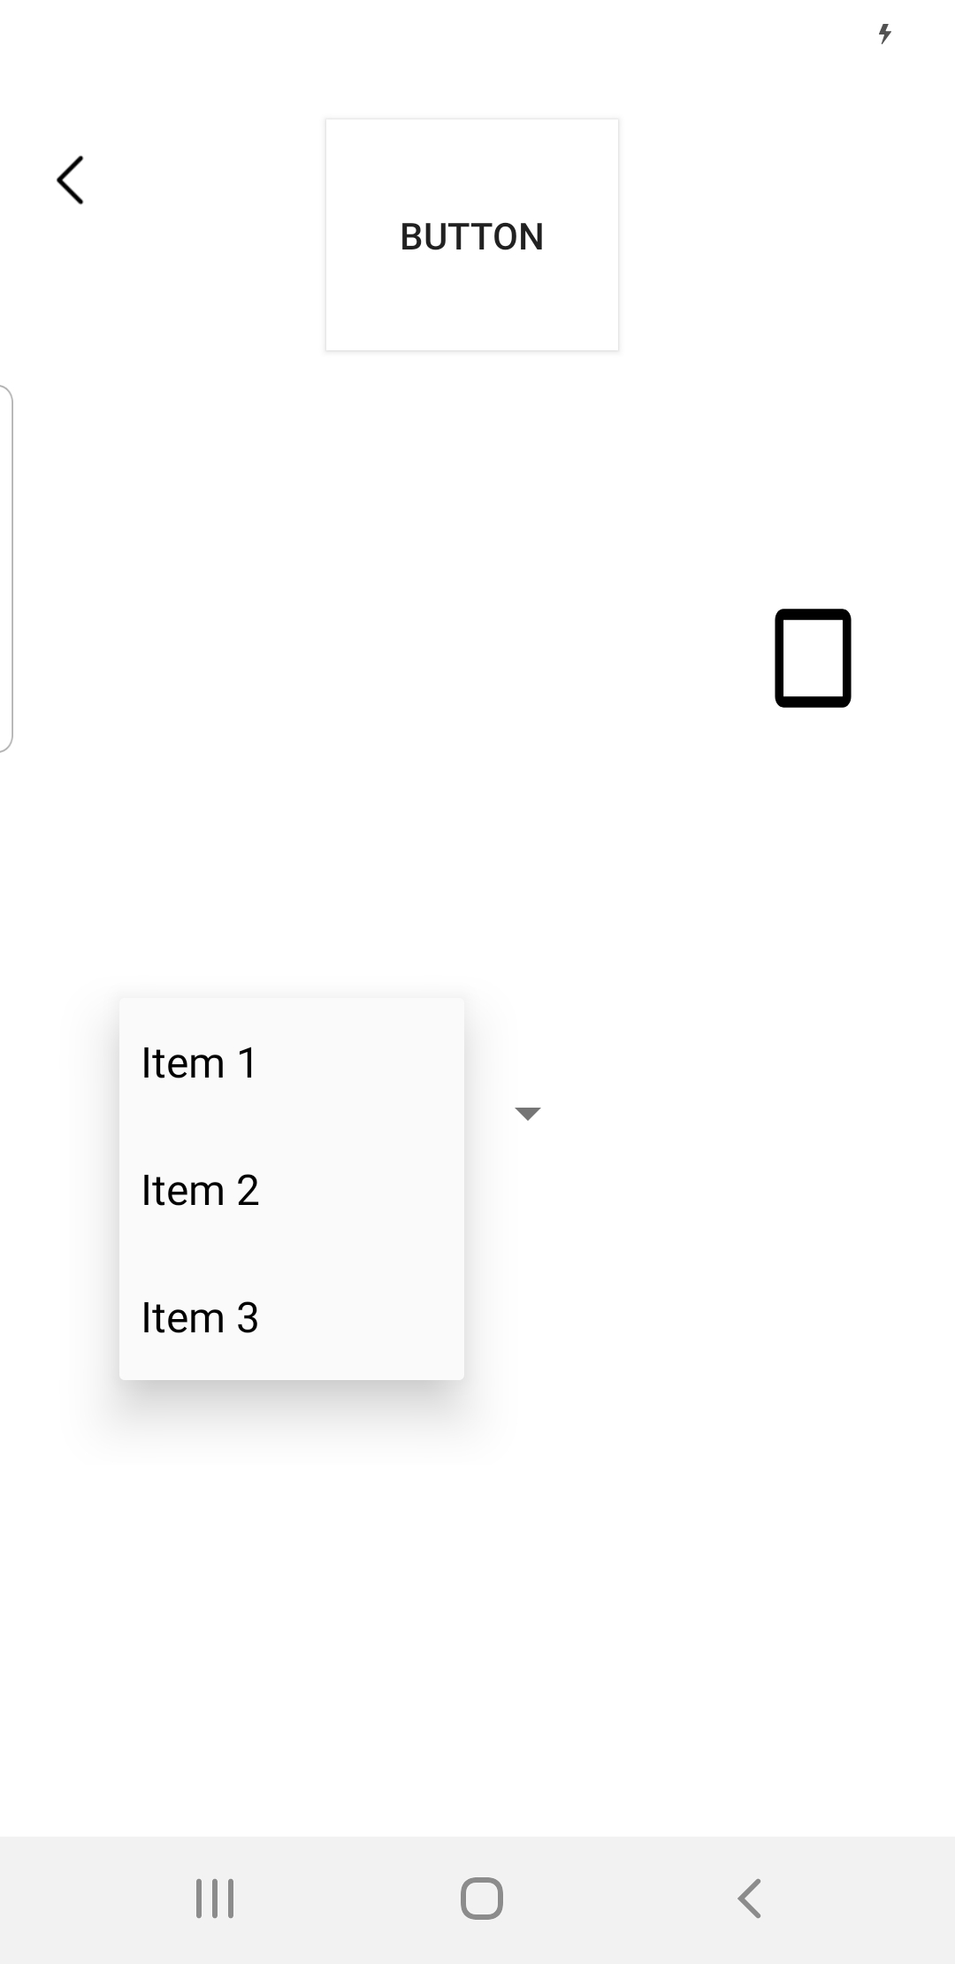
Interactive UI Component
Drop-Down Interaction
CheckBox Interaction
Generated Screen

Slide 14
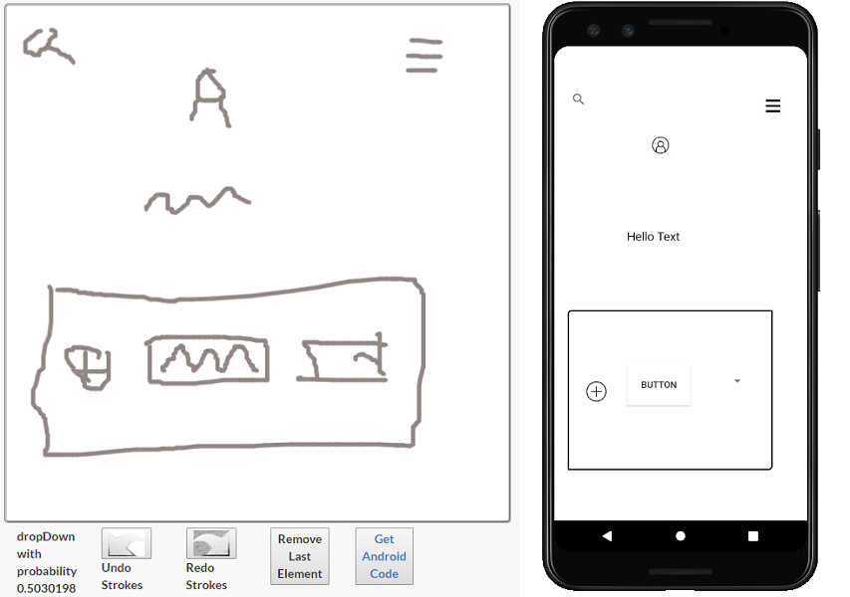
Output
Drawing
Ready To Deploy
Single Page Android App

Slide 15


Evaluation
Evaluation at the level of recognizing and converting individual atomic UI elements
Compare with the most closely related competitor.
Research questions
RQ1: What is Doodle2App's runtime to classify a single UI element sketch and convert the drawing into an Android code?
RQ2: How does Doodle2App compare with the state-of-the-art tool Teleport in terms of classification accuracy?
https://creativemarket.com/

Slide 16
RQ1: Fast Classification and Conversion
Sketch Detection
Processed some 20 atomic UI elements, both locally and on an Amazon EC2 instance.
Average runtime 26ms (locally) and 20ms (EC2).
Code Generation
Time to convert it to an Android app was 526ms (locally) and 94ms (EC2).

Slide 17
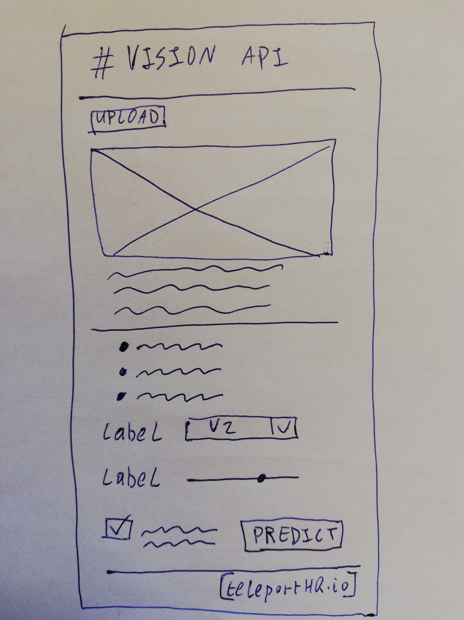
RQ2: Accuracy and comparison
Comparison with Teleport
Teleport's Website calls out problems with recognizing sliders and ratings due to fewer training samples.
On test Data of the 7 overlap classes that overlap with Teleport
Raster Representation passed to the Teleport's vision API.
Captured Average runtime and classification accuracy.
Teleport classified correctly 124 (17.4%).
Teleport
https://github.com/teleporthq/teleport-vision-api
Doodle2App achieved an accuracy of 93.9%.

Slide 18
Future Work
Multi Screen Support
Identify and Detect Transitions
Backend Code based on the Context
http://www.iamannelise.com/share-a-show
Fully Functional App

Slide 19
Acknowledgement
Christoph Csallner has a potential research conflict of interest due to a financial interest with Microsoft and The Trade Desk. A management plan has been created to preserve objectivity in research in accordance with UTA policy. This material is based upon work supported by the National Science Foundation (NSF) under Grant No. 1527398 and 1911017.

Slide 20
Tool Demo
https://youtu.be/P4sb0pKTNEY
Website- http://pixeltoapp.com/doodle/

Slide 21
Questions ?

