Slide 1

P2A: A Tool for Converting Pixels to Animated Mobile Application User Interfaces
Siva Natarajan, Christoph Csallner
Computer Science and Engineering Department
The University of Texas at Arlington (UTA)
Notes:
17 minutes talk + 3 min Q&A

Slide 2
Mobile App: Animated UI
Consumers expect customized UI:
  Screens with non-standard visual features
  Multiple screens with inter-screen transitions
  In-screen animations
Many non-programmers are good at designing such UI
  Dedicated user experience (UX) & user interface (UI) experts
  But don’t have background to implement UI design in code
Notes:
This talk is about the beautiful user interfaces of mobile applications.
[] auto-play video of actual in-screen animation?
[] Add more citations & references from paper

Slide 3
Typical Mobile App Development Process
User experience / UI experts
SW Dev
Screen Design,
Storyboard
Screen
Design
Code w/
Animations
Animation
Design
Lo-fi
Design:
Pencil
Hi-fi
Design:
Photoshop
(Optional:)
Animate:
Flinto, etc.
Code:
Android
Studio
Change Requests
Notes:
Animation design is throw-away

Slide 4
UI & UX Experts ↔ Software Engineers
Gap
User experience / UI experts
SW Dev
Screen Design,
Storyboard
Screen
Design
Code w/
Animations
Animation
Design
Lo-fi
Design:
Pencil
Hi-fi
Design:
Photoshop
(Optional:)
Animate:
Flinto, etc.
Code:
Android
Studio
Often emulator-based throwaway
Change Requests
Expensive & error-prone
Notes:
Animation design is throw-away

Slide 5
Goal: Empower UI & UX Experts
P2A
Screen
Design
Code w/
Animations
Screen Design,
Storyboard
Animation
Design
Lo-fi
Design:
Pencil
Hi-fi
Design:
Photoshop
(Optional:)
Animate:
Flinto, etc.
Code:
Android
Studio
Change Requests

Slide 6
Start From Pixel-Based Screen Designs
Support many design tools
Support reverse engineering screen shots
P2A
Screen
Design
Code w/
Animations
Screen Design,
Storyboard
Animation
Design
Lo-fi
Design:
Pencil
Hi-fi
Design:
Photoshop
(Optional:)
Animate:
Flinto, etc.
Code:
Android
Studio
Why not this?
Market fragmented
Proprietary formats
Future work
Change Requests

Slide 7
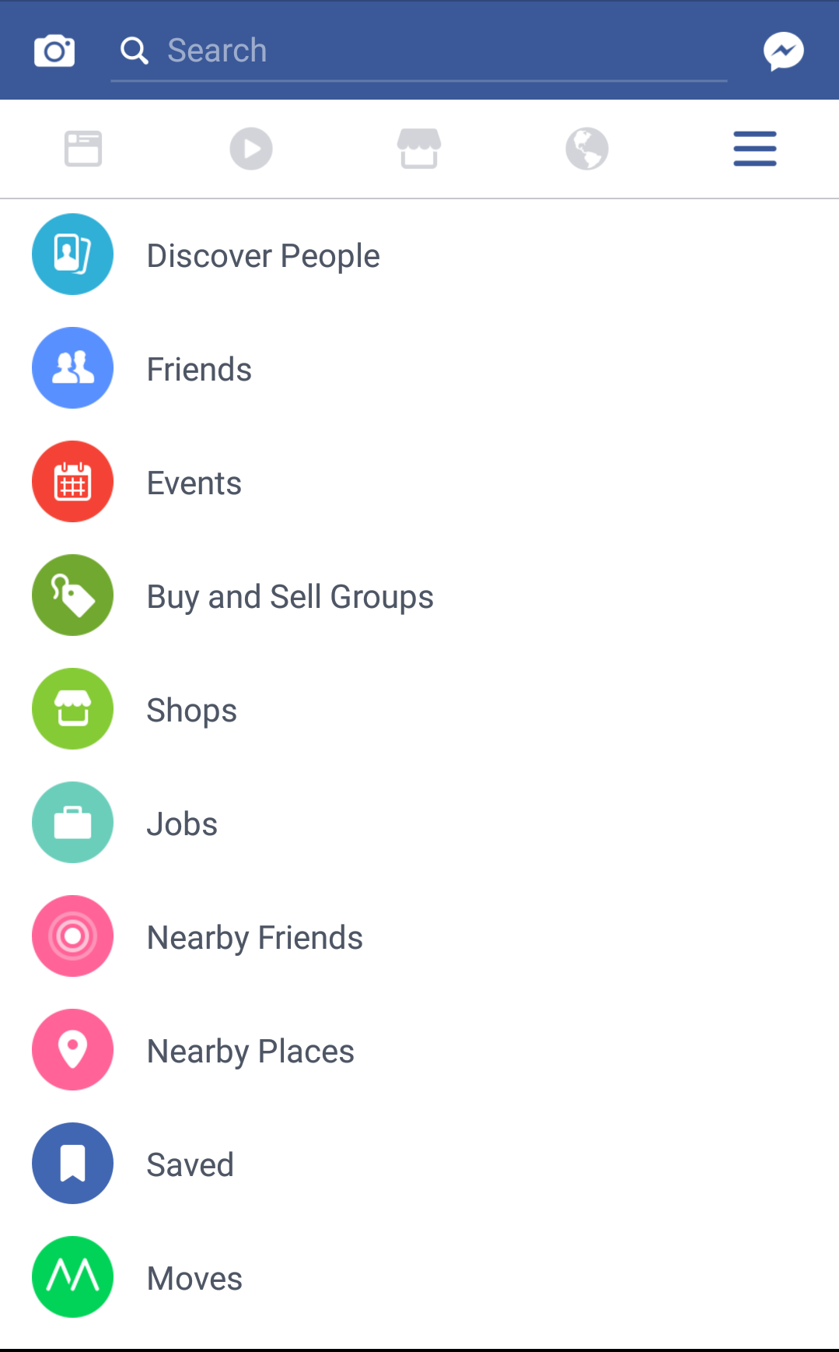
Motivating Example: Facebook App
Tap on “Discover People” should
trigger transit to another screen
via sliding animation
(Facebook app on Android,
version 105.0.0.23.137)

Slide 8
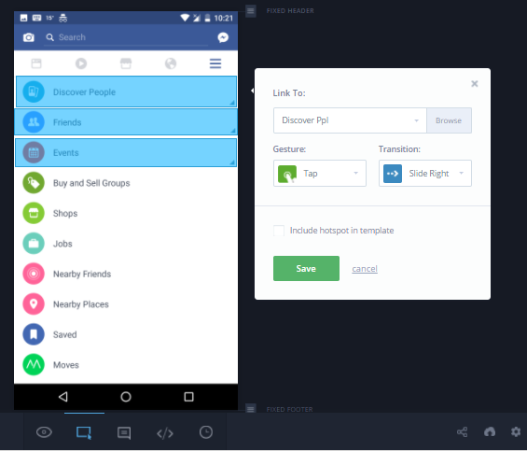
In Practice: User Marks Up Screen to Create Throwaway Prototype in Invision
Notes:
User marks up the screen at the pixel level (the large rectangles) and specifies screen transitions
- e.g., from the menu screen to the ``Discover People'' screen

Slide 9
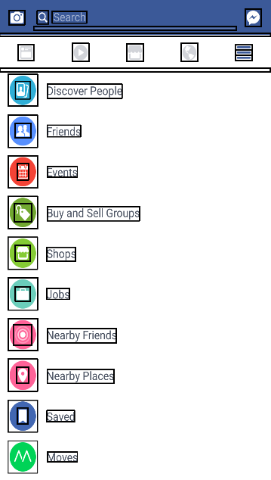
P2A (via REMAUI) Infers Screen Elements & Target Code Structure

Slide 10

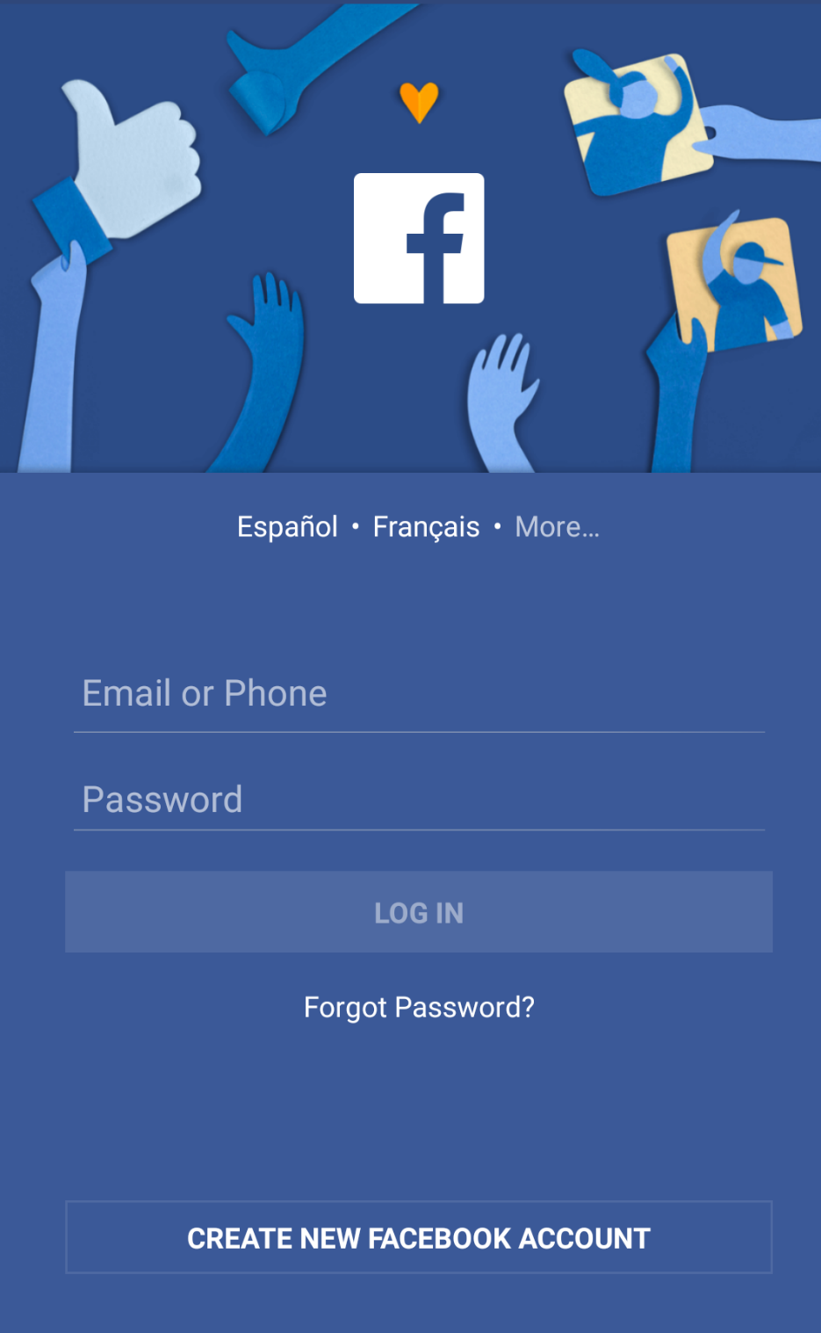
In-screen Animation: Login Screen
Facebook f:
Changes color
Slides up
  Translation
Expands
  Scaling
Other elements fade in after that

Slide 11
Throwaway Prototype vs. Native Code
Adobe Flash, Framer.js: Define animations manually (15 min)
P2A infers source code that runs on stock Android phone (30 s):
  public void onStartAnimation()
  { // ..
  f.leftMargin -= 11; // new logo location
  f.topMargin -= 324;
  f.width=56; // new logo dimensions
  f.height=58;
  // ..
  }
Framer.js: https://github.com/koenbok/Framer

Slide 12
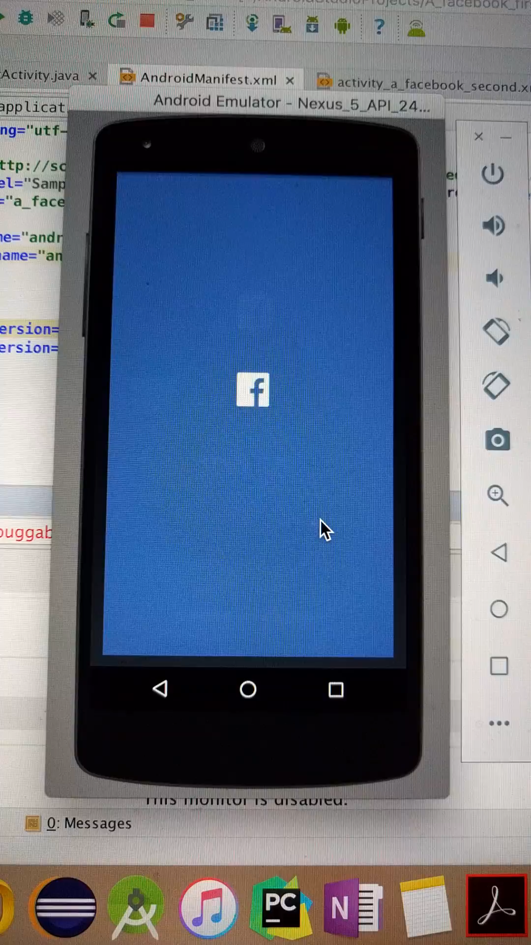
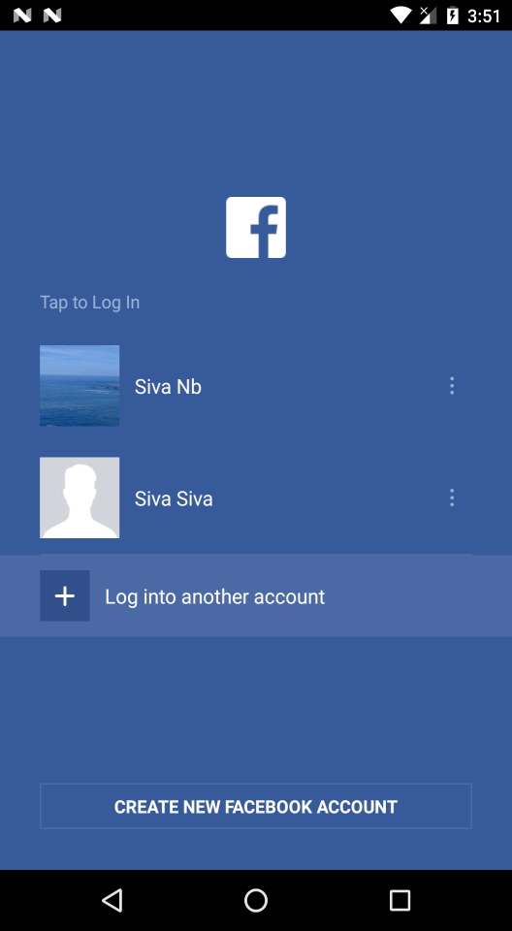

Slide 13
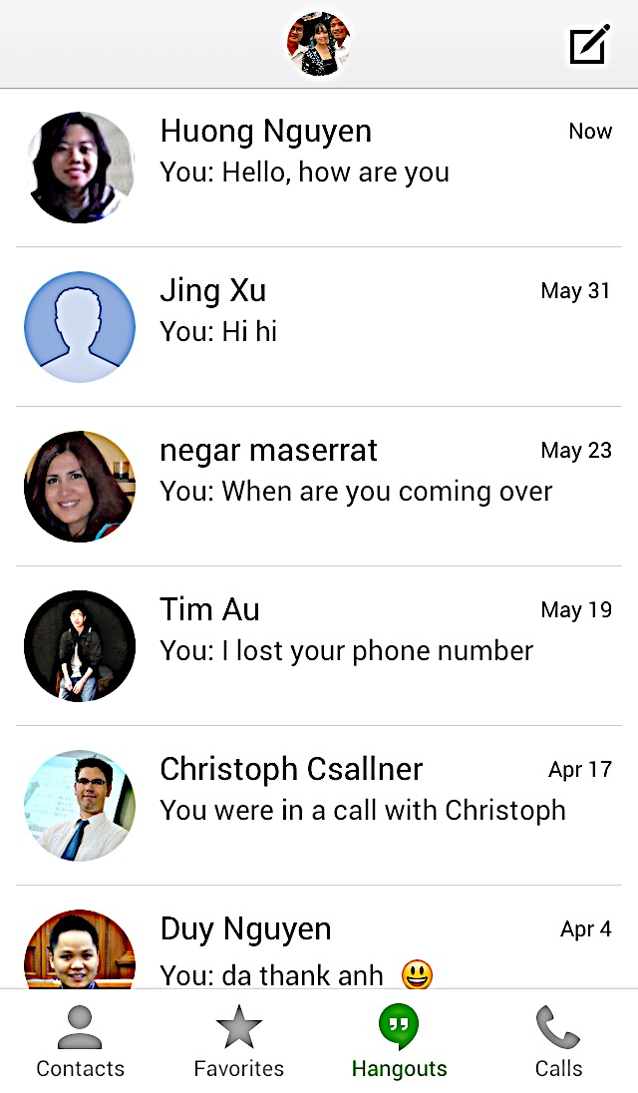
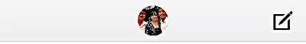




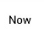
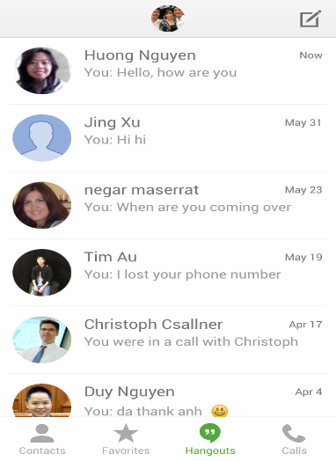
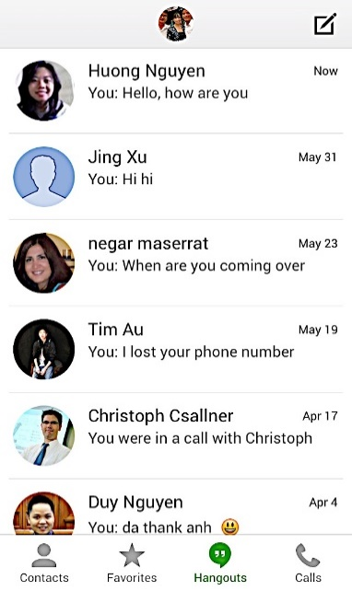
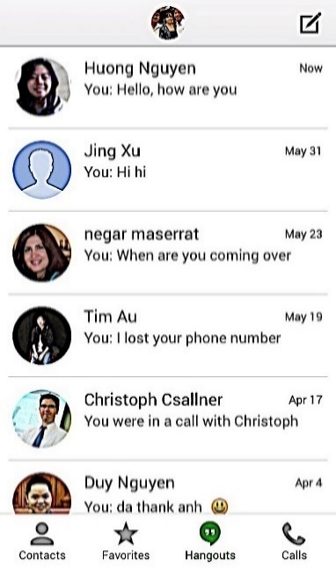
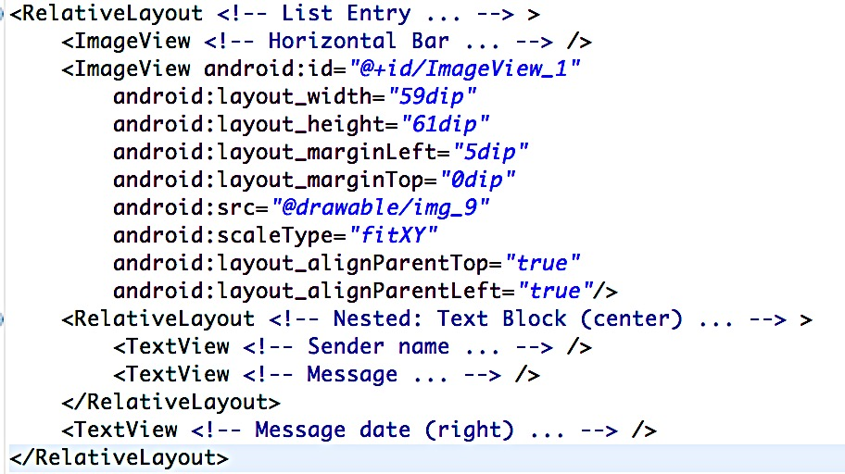

Background: App UI Container Hierarchy
…
…
…
…
Notes:
Entire screen: Root
OS renders parent first, then children on top
→ Reduce rendering time: Flat hierarchy, minimal overlap

Slide 14
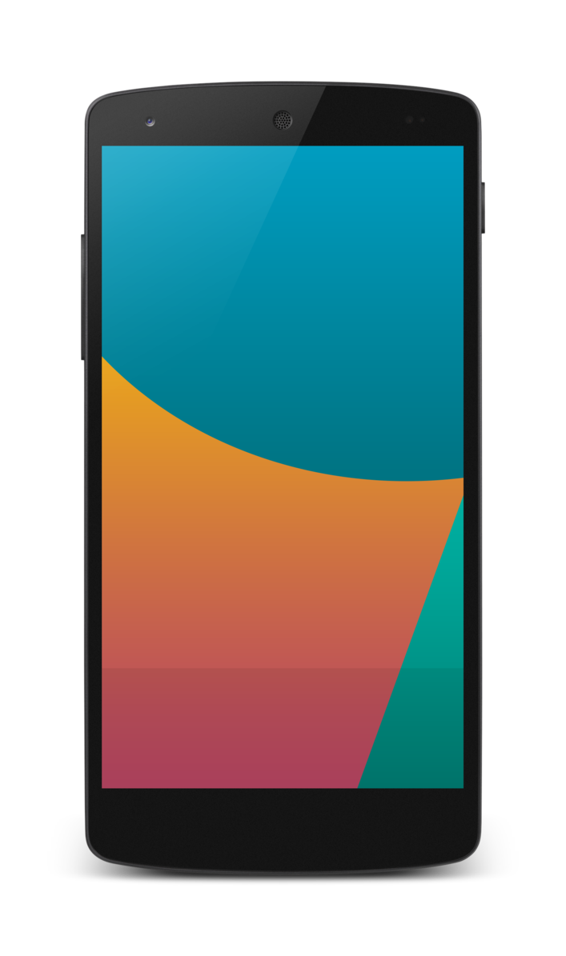

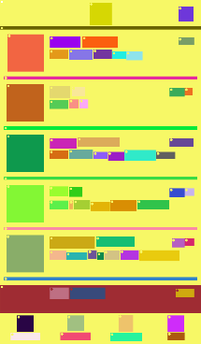
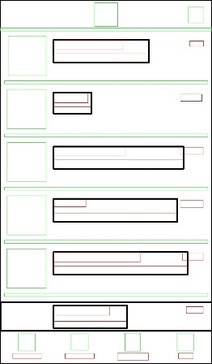
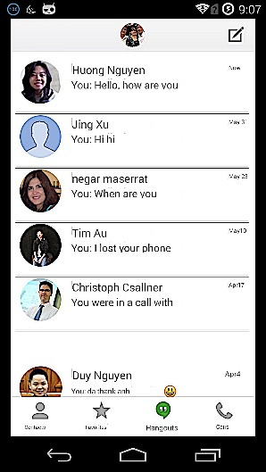
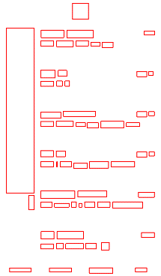
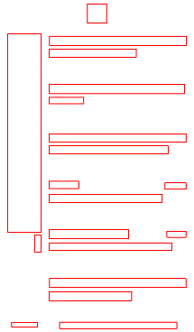
REMAUI: Vision + OCR + Heuristics
Computer Vision
(2)
Merge
(3)
Identify
lists
(4)
Compile,
Deploy
& Run
(6)
Limitations
  Only single input screen
  No transitions between screens
  No in-screen animations
(1)
OCR
(5)
Export
Input:
UI bitmap
Images, Text, Source Code
Output:
Generated app with inferred UI
Box:
Word
Box:
Line

Slide 15
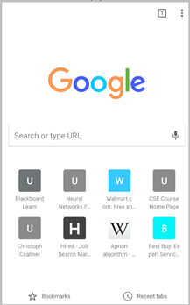
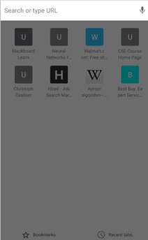
Infer Animation: Match “Similar” Elements
Android Chrome
UI elements “look similar”
But they differ pixel-by-pixel
Notes:
P2A currently animates element within its parent view

Slide 16
Goal: Match “Similar“ Elements Efficiently
May differ in location, size, and color
Comparing each pair of UI elements pixel-by-pixel: O(e*f*p):
# screen-A elements * # screen-B elements * # pixels/element
Disregard elements that only change very little
Merge two screens
  Create ode that transitions elements from start to final state

Slide 17



Idea: Use Perceptual Hashing
Images look similar to a human → Similar perceptual hash
  Map image to fixed length hash-value (“fingerprint”)
Strong compression that (only) preserves key properties
Widely used for finding copyright violations on the web
  Even if copies have different watermarks or other small variations
Example:
Hamming Distance
Over Threshold
4
24
304ffec61bff9
104efec61bdd9
1fdfff3efe47f

Slide 18
Three Research Questions (RQ)
What is P2A's runtime?
… For generating code for inter-screen transitions (RQ 1)
  Prototype status: Expect non-interactive use, within a few seconds
… For inferring in-screen animations & generating code (RQ 2)
  Computer vision / OCR expensive: Expect around one minute
Does a P2A-inferred in-screen animation look visually similar to the original animation (RQ 3)
  Some animations complex, expect issues in generated animations

Slide 19
Subject Groups: Inter-screen & In-screen
Ideal subjects: “Screen design + app” pairs
  Hard to obtain from third parties
Instead: “Screenshot + app” pairs from Google Play store
  Top-100 free Android apps (April 2017), but remove games, then:
RQ 1: Ten apps with most inter-screen transition effects
  Total: 107 screens
RQ 2 & 3: Thirty apps that contained in-screen animations
  Capture screenshot before and after animation
  Total: 30 animations, 60 screens

Slide 20
RQ 1: Below 2 s
Subsets of each app’s inter-screen transitions
Runtime depends on # screen elements
2.7Ghz
Core i5
Mac Book Pro
16GB RAM

Slide 21
RQ 2: Below 70 Seconds
26 s on average
Breakdown across three main steps
  Step 1: REMAUI-style preprocessing ← Took most time
  Step 2 & 3: Match screen elements ← perceptual hashing
  Step 4: Generate code
All steps depend on # screen elements
Worst case (69 s): Many elements in both start & end screen

Slide 22
RQ 3: Visual Error of Final State Screen
SSIM(x,y) in [-1;1] // higher SSIM(x,y) means x and y are “more similar”
Notes:
-- SSIM is widely used “structural similarity” metric
-- Error related to runtime: More screen elements are more complex, need more time, and are more likely wrong

Slide 23
Related Work
Android Studio, Eclipse, Xcode
  (+) Powerful interactive GUI builders
  (-) Complex, especially for non-programmers
Supernova Studio: Design in Sketch tool → Code
  (+) New & exciting: Recently went into public beta
  (-) Cannot process Photoshop / pixels; doesn’t infer animations
Previous approaches based on different assumptions
  App follows visual language known to tool [MobiDev, SILK, …]
  App uses standard desktop-style widgets [Prefab, …]
  Tool can inspect existing UI at runtime [PAX, …]

Slide 24
Questions
Superimposed on screens
Screen
designs
View
hierarchies
Screen
flow
Animated
UI
Assets,
Code
Reverse
engineer
Add
transitions
Infer
animations
Export
REMAUI: Vision, OCR
User connects inferred elements
Via perceptual hashing

Slide 25
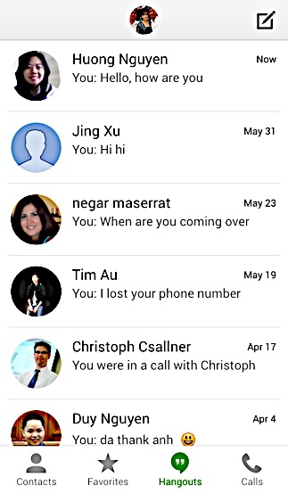
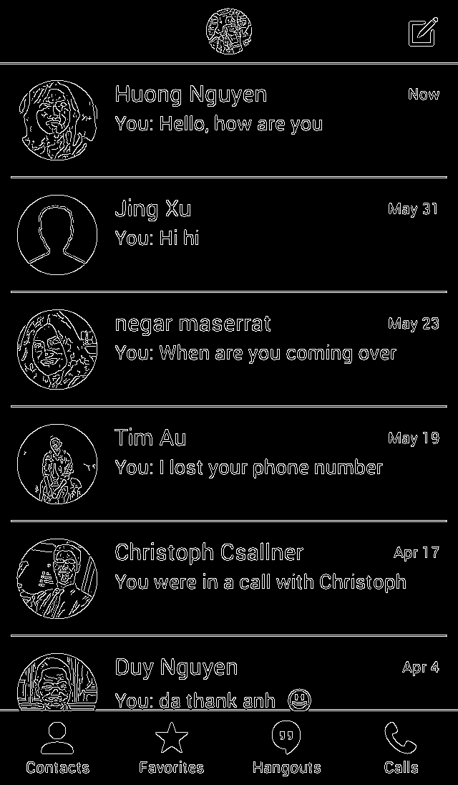
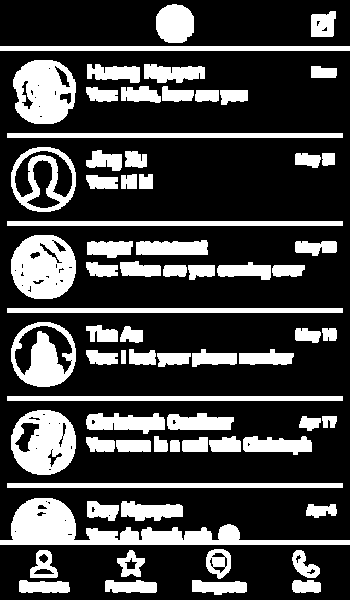
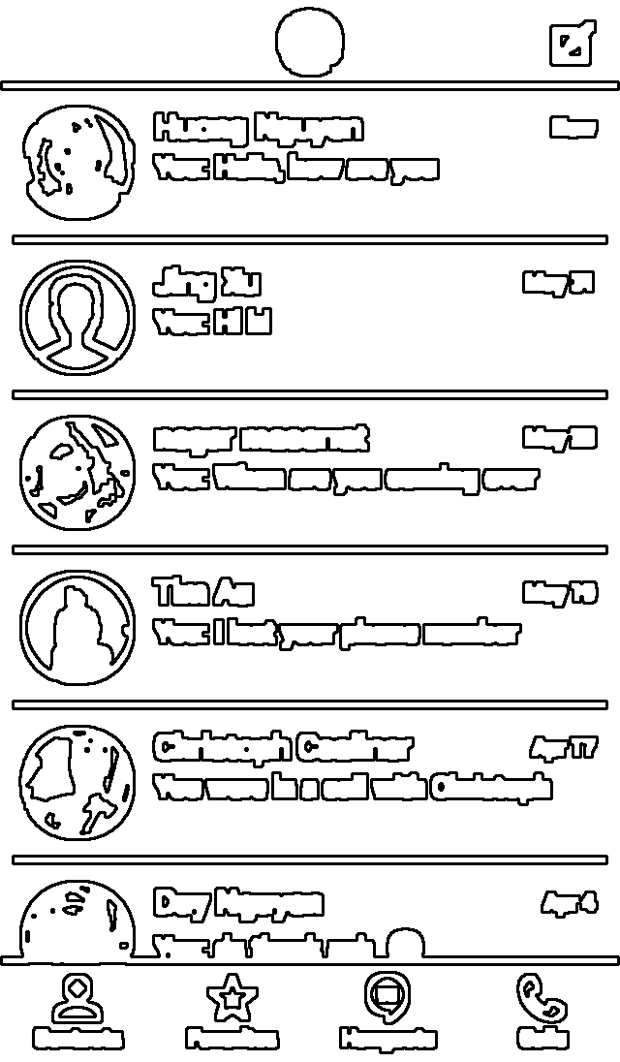
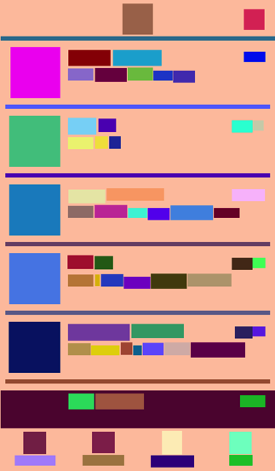
REMAUI, Step 2: Computer Vision
Input Bitmap
Edges
(Canny)
Dilated Edges
Contours
Draft UI Structure

Slide 26
Perceptual Hashing Details
Common resolution
Discrete Cosine Transformation (DCT)
Cache computed perceptual hash values
Hamming distance on binary representation of perceptual hash
Efficiently Hamming distance on 64-bit perceptual hash
  Constant time: xor, popcount
O(p*(e+f)) overall, down from O(p*e*f)
Heuristic Hamming distance threshold

Slide 27
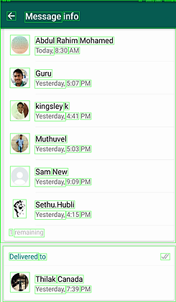
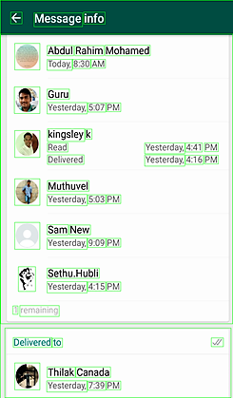
Example: Match OCR Results

Slide 28
Example Inferred Inter-Screen Transition
public void onClick(View view) {
switch(view.getId()) {
case R.id.TextView_11:
Intent in = new Intent(this, AmazonHomeAct.class);
Slide anim = new Slide();
getWindow().setEnterTransition(anim);
getWindow().setExitTransition(anim);
aO = ActivityOptions.makeSceneTransitionAnimation(this, null);
break;
}
}

Slide 29
Animations & Transitions: Android
Bind (“register”) Java event handler method to a UI element
  Either in XML or Java
Then OS passes events to handler code
  Events: Click (tap), long click, swipe, …
Inter-screen transition: UI elements exit / enter screen:
  Slide (move through screen edge), explode (from center), fade, …
In-screen animation: Add, remove, animate UI elements:
  Move, scale size, rotate, opacity, …
Notes:
We currently do not handle any of the Android default events (press hardware ``back'' button, user rotating the screen, switching the application out and back in (``home''), user sending device to sleep and reactivating it (``power''), press hardware ``menu'' button).
Android 5.0 & later

Slide 30
Case Study: 10 Inter-screen Transitions
Task | Invision | Flinto | P2A
Load & preprocess screens | 38 | 12 | 103
Assign inter-screen transitions | 122 | 192 | 135
Generate target platform code | n/a | n/a | 2
Total [s] | 160 | 204 | 240
Run on a standard desktop computer
Invision & Flinto output only run in an emulator
Notes:
Consider cutting

Slide 31
P2A Prototype: Generates Android
Runs REMAUI on each input image
Inter-screen transition: Expects one start and one final screen
In-screen animation: Generates “view animation” style code
  Easier than generating the more powerful “property animation”
Generates Android code
  Ready to compile & run on stock Android phones
P2A evaluated on 2.7Ghz Core i5 Mac Book Pro 16GB RAM

Slide 32
30 Subjects: In-screen Animation Types
10: element fade-in only
2: translation only
1: scaling only
6: scaling & translation
4: translation & fade-in
3: fade-in and fade-out
1: translation, fade-in, scaling (Walmart)
1: translation, fade-in, fade-out (Waze)
2: other combinations

Slide 33
RQ 3: Screen Similarity via SSIM
Widely used “structural similarity” metric
Values in [-1;1], higher SSIM: x & y are more similar
Slide window over both images, for each window compute similarity of brightness µ, contrast σ, and structure → SSIM(x,y), then avg:
  σ_{xy} is correlation of windows x,y (after removing contrast)
  small constant c_{i}
Compared final animation states: Original vs. generated app
Notes:
mu & sigma

Slide 34
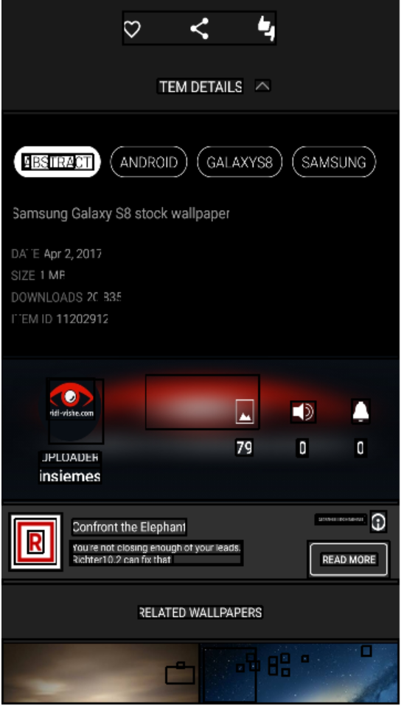
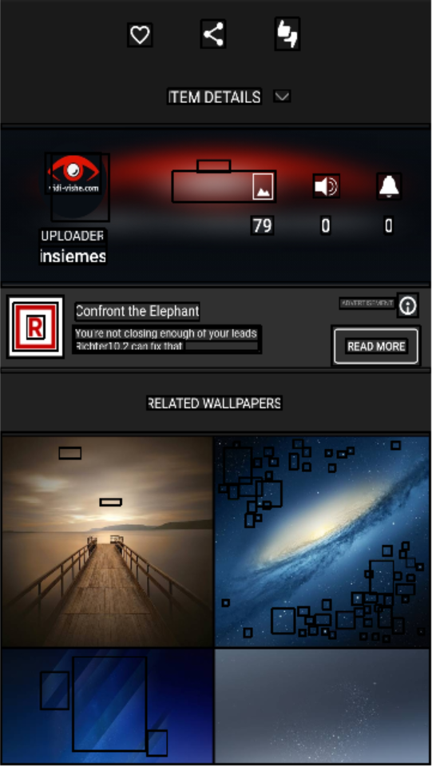
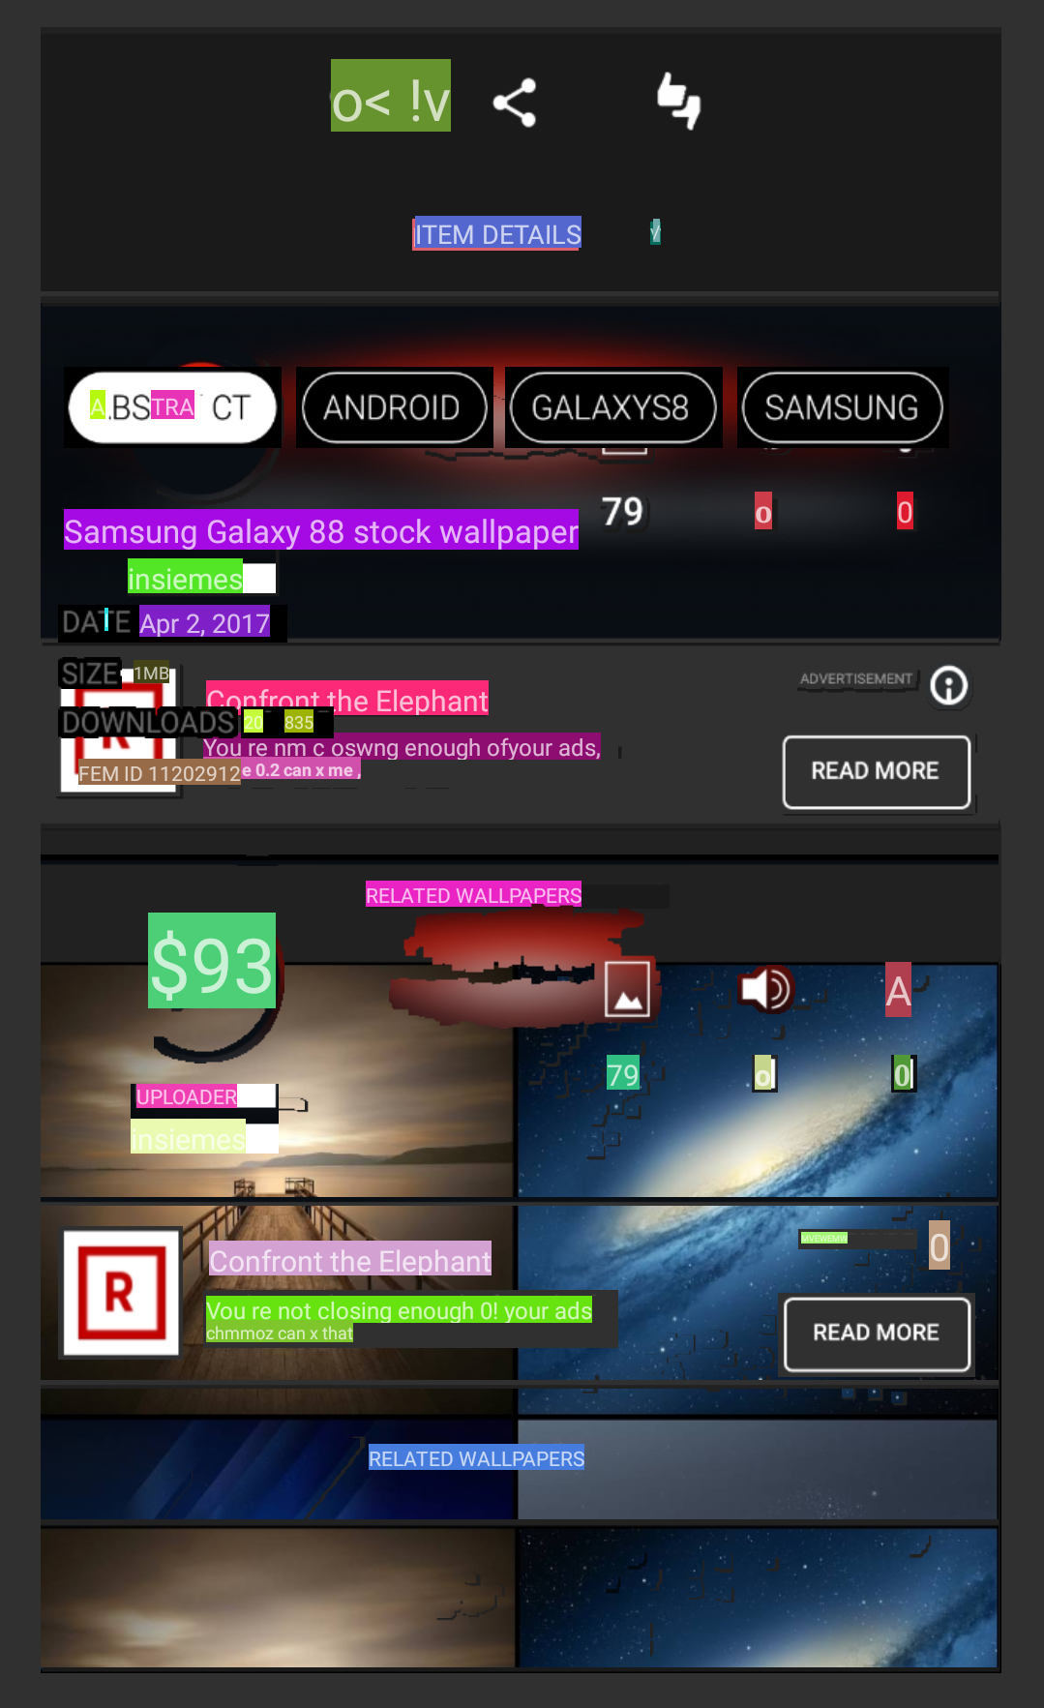
High Error: Dark theme, many elements

Slide 35
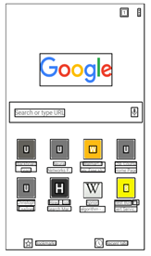
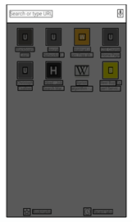
Better
Inferred correct animation even though matching elements are “grayed out”

Slide 36
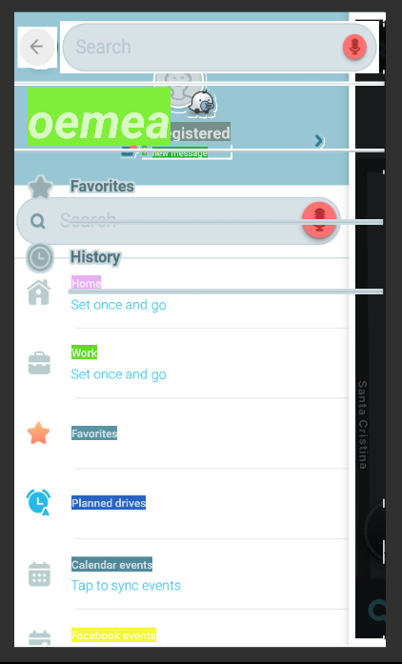
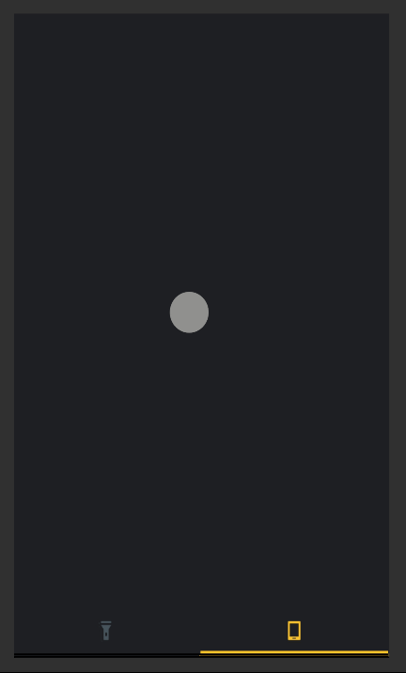
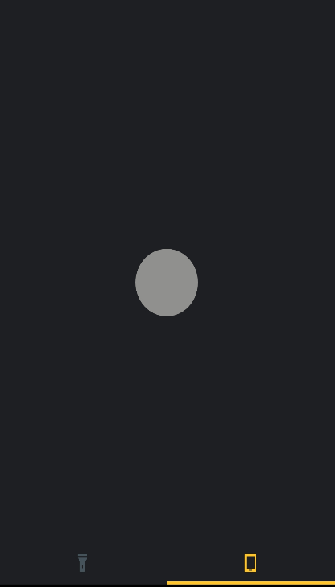
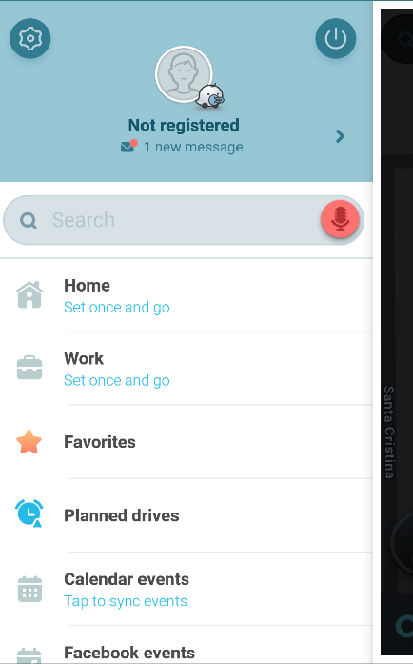
Worst case Similarity with SSIM index : 0.3
Best case Similarity with SSIM index : 0.96
Auto-Generated output - Waze
Auto-Generated output - Flashlight
Input - Flashlight
Input - Waze

Slide 37
References
MobiDev
  Julian Seifert et al. 2011. MobiDev: A tool for creating apps on mobile phones. In Proc. 13th Mobile HCI. ACM, 109–112.
PAX
  Tsung-Hsiang Chang, Tom Yeh, and Robert C. Miller. 2011. Associating the visual representation of user interfaces with their internal structures and metadata. In Proc. 24th UIST. ACM, 245–256.
Prefab
  Morgan Dixon and James Fogarty. 2010. Prefab: Implementing advanced behaviors using pixel-based reverse engineering of interface structure. In Proc. CHI. ACM, 1525–1534.
REMAUI
  Tuan A. Nguyen and Christoph Csallner. 2015. Reverse engineering mobile application user interfaces with REMAUI. In Proc. 30th ASE. IEEE, 248–259
SILK
  James A. Landay and Brad A. Myers. 1995. Interactive sketching for the early stages of user interface design. In Proc. CHI. ACM, 43–50.

