Slide 1

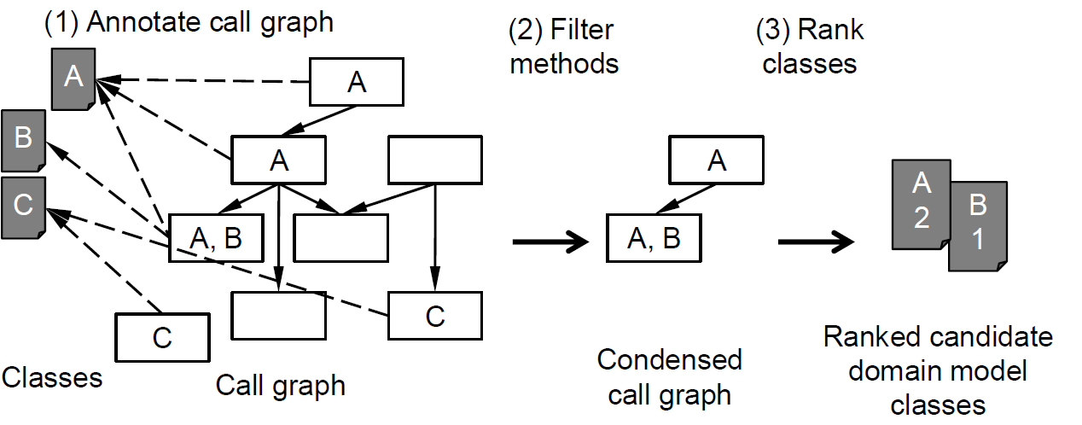
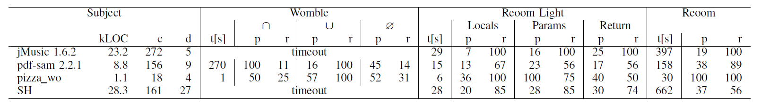
Reverse Engineering Object-Oriented Applications Into High-Level Domain Models With Reoom
Tuan Anh Nguyen, Christoph Csallner
tanguyen@mavs.uta.edu, csallner@uta.edu
Computer Science and Engineering Department
University of Texas at Arlington (UTA), USA
Maintain large software system
Which of these N classes should I look at first? ☹
Problem
Observations / Heuristics
Design documents typically not up to date with code.
Business concepts not readily available in the code.
Requires reasoning about large complex code base.
(O1) If an intermediate result is a domain model object, the code more likely refers to it explicitly:
- Assign to local variable, field, etc.
- May aid debugging
- May be seen as more stable over time
(O2) A domain model class is likely used together with other domain model classes
- To navigate domain relations
- To provide business functions
Challenge: Automatically pinpoint the domain model classes: The high-level business concepts
Reoom Approach: Light-weight Static Analysis
Implementation
On top of static inter-procedural Java analysis framework MoDisco
Call graph: Explicit method and constructor calls in analyzed public methods and constructors
Over-approximates virtual calls
Not captured: Calls via reflection, bytecode, or native code
(1) Check O1: Annotate each method m with classes m’s code refers to explicitly. Example: 8 methods, 3 classes
(2) Check O2: Remove m from call graph if m does not appear in a call chain that explicitly refers to ≥2 classes
(3) Rank classes that annotate remaining methods, by how often they are referenced explicitly
Research Questions (RQ)
How do Reoom and Womble compare in runtime performance (RQ1) and precision and recall (RQ2)?
What is the benefit of step (2), which requires relatively expensive inter-procedural analysis (RQ3)?
Subjects
Reoom Light: Reoom without step (2)
jMusic: “These [five] classes form the backbone of the jMusic data structure”
pdf-sam: Identified domain classes with our own domain knowledge
pizza_wo: Plain Java version of well documented pizza shop tutorial
SweetHome3D: “This UML diagram should help you understand which classes are available [..]”
Reoom vs. closest competitor—Womble*: Higher precision (p) and recall (r) values are better; SH = SweetHome3D 1.5; c = classes and interfaces; d = domain model classes in c; t = runtime (Womble seeded: sum of d runs, Reoom Light: sum of three runs) ; ∩/∪ = results for classes identified by each or any seeded Womble run; Ø = average precision and recall of Womble’s seeded runs. Experimental setup: 16 GB RAM 2.6 GHz Core i7 MacBook Pro running OS X 10.10.2.
(*) D. Jackson and A. Waingold: "Lightweight extraction of object models from bytecode," in Proc. 21st ACM/IEEE International Conference on Software Engineering (ICSE). ACM, May 1999, pp. 194—202.

