Slide 1
DeepFuzzSL: Generating Simulink Models with Deep Learning to Find Bugs in the Simulink Toolchain
2nd (Virtual) Workshop on Testing for Deep Learning and Deep Learning for Testing (DeepTest’20)
Sohil L Shrestha, Shafiul Azam Chowdhury, Christoph Csallner
sohil.shrestha@mavs.uta.edu, shafiulazam.chowdhury@mavs.uta.edu, csallner@uta.edu
CSE Department, University of Texas at Arlington

Slide 2
Overview
Eliminating bugs from Cyber-Physical System (CPS) tool chain is crucial.
Simulink by MathWorks widely used in industry
Simulink = Popular CPS development tool chain
Existing testing tool SLforge [1] focuses on fuzzer, that relies on documented semi formal specification.
We hope to capture undocumented specification using deep learning to fuzz Simulink toolchain
Found 2 bugs in Simulink toolchain
Simulink vendor MathWorks confirmed these as bugs
One bug missed by previous State of the art tool, SLForge [1]
[1] from Chowdhury et al. . Automatically Finding Bugs in a Commercial Cyber-Physical System Development Tool Chain With SLforge. ICSE 2018

Slide 3
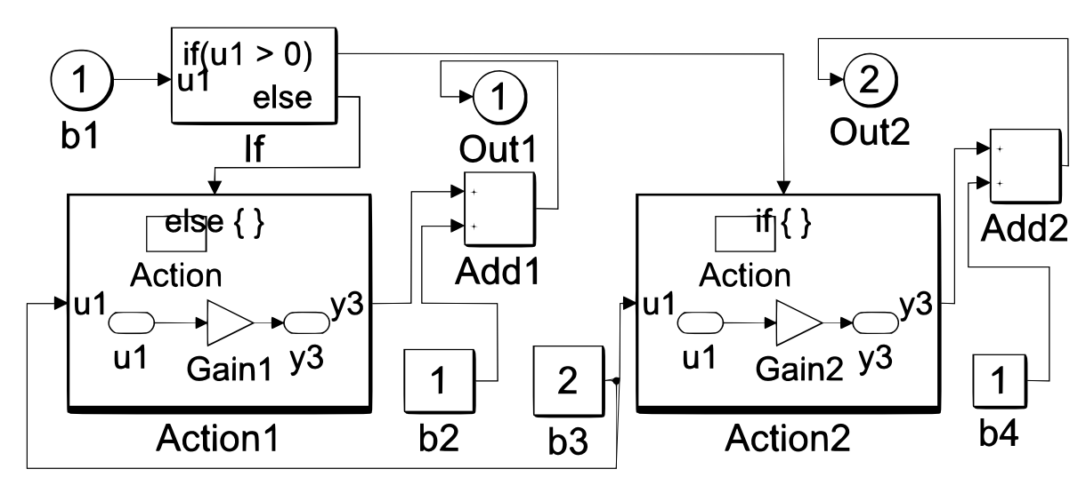







What is the problem?
Deploy
CPS
Executable
System Model as Block Diagram [2]
Generate and compile code
Prototype
use
Engineer
CPS: Cyber Physical System
Image Source [2] from Chowdhury et al. SLEMI: Equivalence Modulo Input (EMI) Based Mutation of CPS Models for Finding Compiler Bugs in Simulink. ICSE 2020

Slide 4

Why is the problem hard?
[-] Large Code base (MLOCs)
[-] No complete and/or updated formal specification
[-] Rapid release cycles

Slide 5

Fuzzing/ Randomized Differential Testing
Well established technique for compiler validation
Stress test compiler using random test case.
State-of-the-art fuzzer are language dependent
Depend on the language grammar
Requires expert knowledge
Considerable effort to port to other languages
Image taken from :https://embed.cs.utah.edu/csmith/

Slide 6
Randomized Differential Testing : SLforge
Random model generator (“fuzzer”)
generate
Simulink models
[+] Don’t need full formal language specification to find bugs
[+] No false warnings if undefined behaviors are avoided
Compiler
optimizer on
Compiler
optimizer off
CPS toolchain compile
Execute
Output 1
Output 2
compare
If Output 1 ≠ Output 2: Likely compiler bug

Slide 7
Motivation: SLforge
[+] State of the art random model generator
[+] Found 8 new confirmed Simulink bugs
[+] Randomized Differential Testing
Parsed semi-formal free specifications from Simulink’s web page automatically, and rigorously incorporated them.
[-] Require to manually update the rules (expensive)
[-] only incorporates documented specification
[-] Does not generalize to other tool chains. (Platform specific)

Slide 8
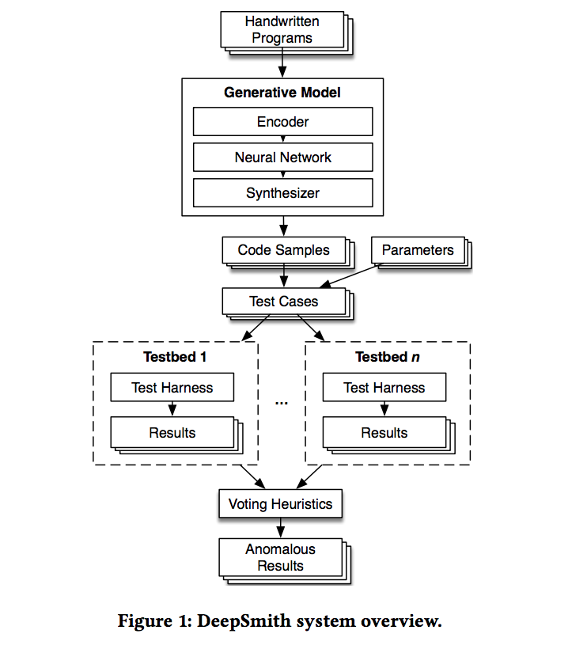
Motivation: DeepSmith
Generates realistic program after learning from real world program using Language Modeling.
Found 50+ bugs in OpenCL
Claim: Easily extensible to other language with minimum engineering effort (LOCs)
[+] Unlike OpenCL, Simulink language does not have publicly available specification
Using deep learning to generate Simulink model makes more sense
Figure 1 Source: Cummins et al. Compiler fuzzing through deep learning. ISSTA 2018

Slide 9
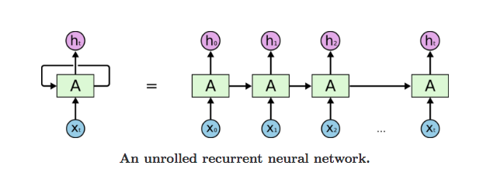
Language Modeling: Recurrent Neural Networks
Task of predicting the words that comes next
Formally, Given a sequence of words x<1>,x<2>...x<t>, compute the probability distribution of next word x<t+1>
Example : The writer of the books _____
Long Short Term Memory
Variant of RNN
Learns Sequential and Syntactic Recency

Slide 10
Our Approach: DeepFuzzSL
Use deep learning to learn from Simulink models directly.
[+] Does not require rules or grammar to build random program generator
[+] No need to gather specification from webpage
Evaluate the claim made by DeepSmith
Hypothesis : Capture undocumented Simulink specifications that is missed by earlier approach.

Slide 11
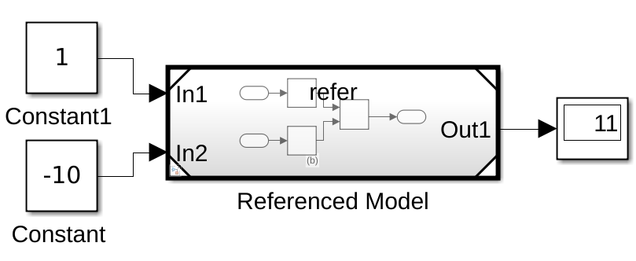
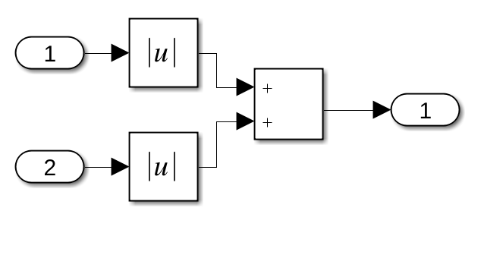
Background: Simulink models
Block: main element of model, represents a equations / code
Connection: Edge between blocks
Block library: Similar to a standard library of traditional programming language
Hierarchy: block representing a child model

Slide 12
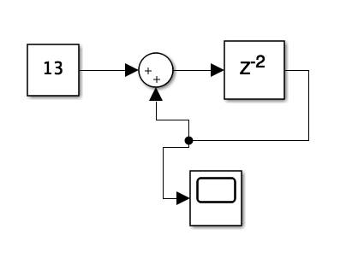
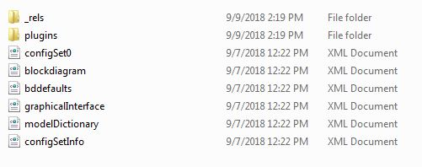
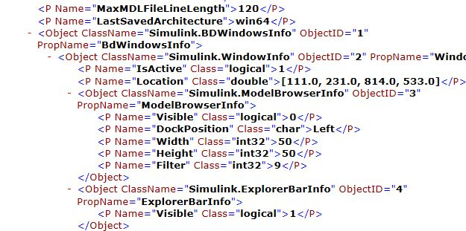
Study: Simulink File Format (SLX vs MDL)
Fig 1. A simple Simulink model created using Simulink
Fig: Equivalent code in extracted SLX file format

Slide 13
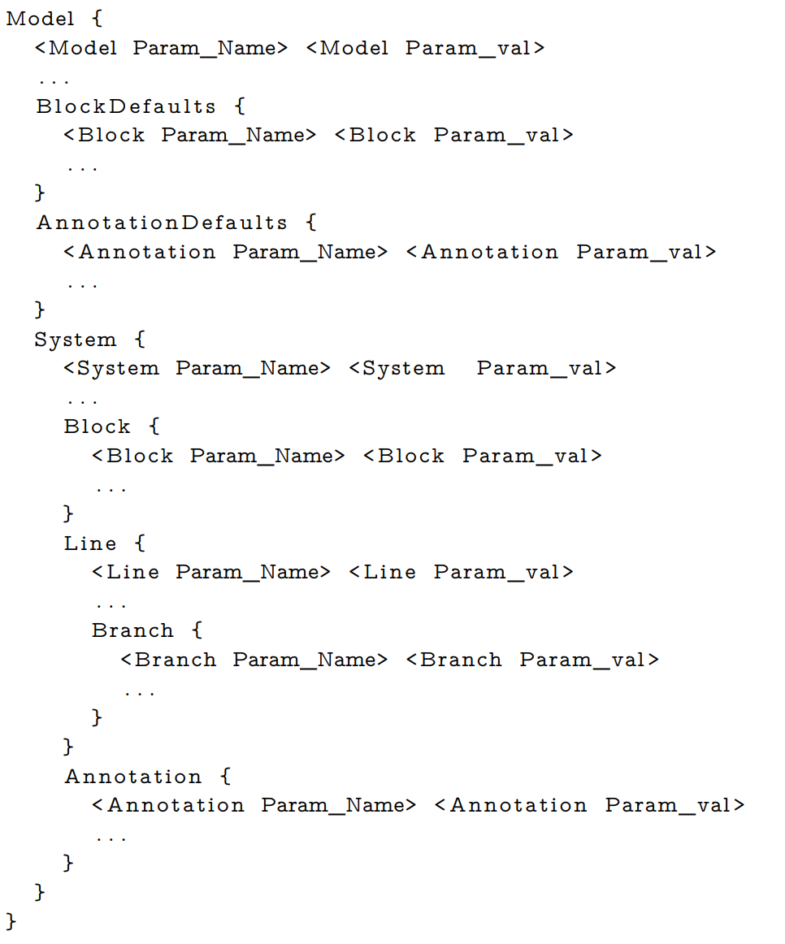
Study: Simulink File Format
MDL: Simulink’s old file format
Why we chose mdl file format?
MDL file are single self sufficient text file
Easy to generate sample Simulink model
Easy to preprocess the Simulink model
MDL file can easily be converted to .slx format, without losing semantics.
Model component designed by user are stored inside 𝑆𝑦𝑠𝑡𝑒𝑚{...}
Typical mdl file format representation

Slide 14
DeepFuzzSL Phases
Seed
Simulink model corpus
Valid
Simulink model corpus
Preprocess
Encoder
Deep Learner
Sampler
Filter
Seed corpus include
mdl files with System { … } inside Model{..}
valid model := model that can be opened and compiled by Simulink

Slide 15
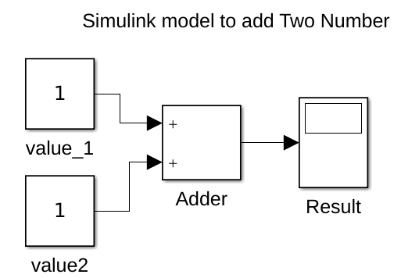
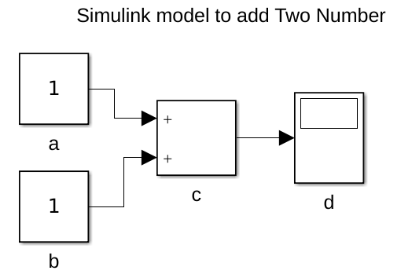

Phase 1: Preprocess
white space removal
converting long block name to shorter ones
removing any annotations and location information

Slide 16
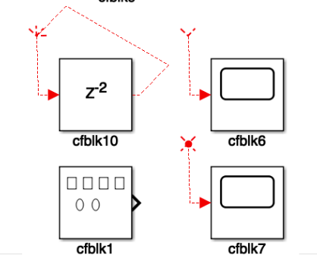
Phase: Preprocess
Block {
BlockType Sum
Name ‘Adder’ …..
}
Block {
BlockType Display
Name ‘Result ...
}
Block {
BlockType Constant
...
}
….
Line {
SrcBlock "Adder"
DstBlock "Result"
….
}
Line {
SrcBlock "Constant"
DstBlock "Adder"
….
}
Block {
BlockType Sum
Name ‘Adder’ …..
}
Block {
BlockType Display
Name ‘Result ...
}
Line {
SrcBlock "Adder"
DstBlock "Result"
….
}
Block {
BlockType Constant
...
}
Block {
BlockType Constant
...
}
Line {
SrcBlock "Constant"
DstBlock "Adder"
….
}
Initial experiment generated Simulink models had no connections between them
Generated
model
Problem
The mdl representation lists all "Blocks{ ... }" first and then the connection between them later
Solution
interleave block and connection (or line) information in the mdl file
Unmodified: 1000 LOC
Modified: 81 LOC

Slide 17
Phase 2: Encoder
Ideally we want to compress the input tokens and keep number of unique tokens low in vocabulary
Encoding | Preprocess | Vocabulary | Tokens
character | n/a | 87 | 1,056,673
character | DWR + CBN | 87 | 846,075
word | n/a | 1,063 | 466,000
word | DWR + CBN | 1,063 | 168,000
DWR: Duplicate Whitespace Removal
CBN: Convert longer block names to shorter name.
Use hybrid encoding
maps a few common keywords and parameters to tokens
and the rest to characters.

Slide 18
Phase 3: Deep Learner
Two layer LSTM network with 512 nodes per layer
Architecture same as DeepSmith
Adam optimizer with a learning rate of 0.002,
decaying 5% every epoch
mini-batch size 64
Cross Entropy loss
400 epochs

Slide 19
Phase 4: Sampler
Sample token by token
Seed the trained neural net with "Model {"
Every simulink model starts with this keyword
Halt sampling when
Open and close curly braces are balanced
maximum number of allowed tokens is reached
In our experiments, we use 5,000 as maximum tokens counts.
Equivalent to maximum token count in seed corpus.

Slide 20
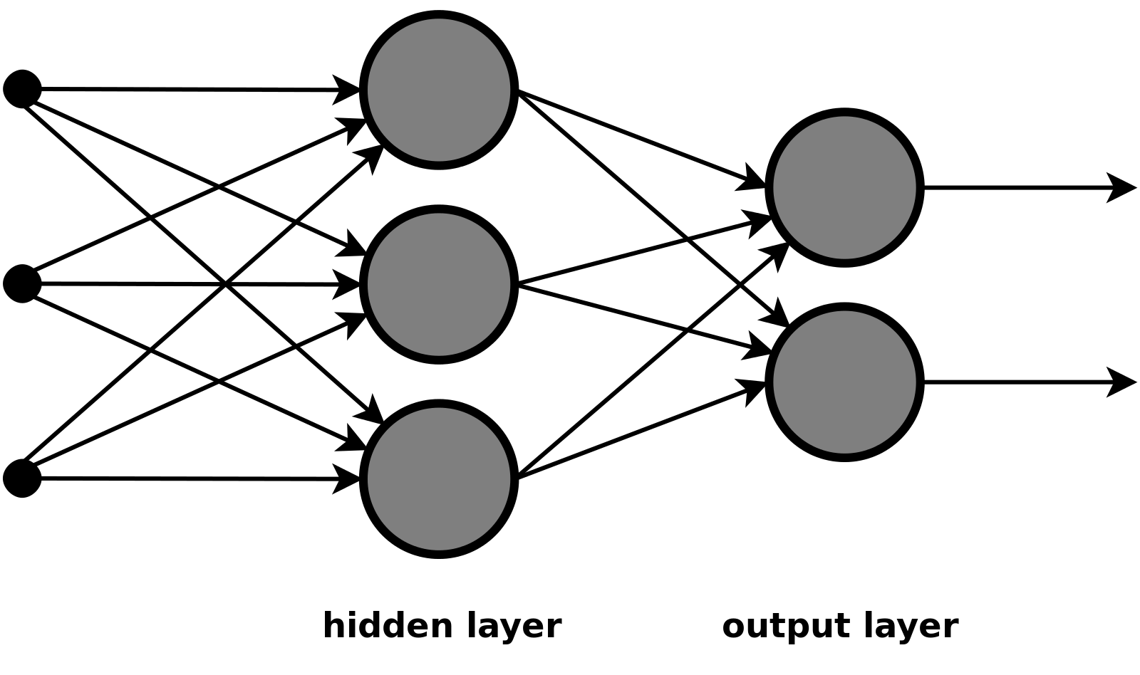
Sampler: Maximize the variation of generated model
0.1 | “Model”
0.1 | “{“
0.4 | “BlockType”
0.3 | “Name”
... | ...
Single Multinominal Experiment
“Name”
Predicted probability distribution
seed with
For input “Model {” the model predicts the next token to be “Name”
Model {

Slide 21
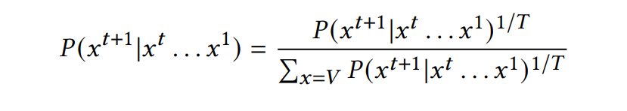
Phase 4 : Sampler
Introduce more randomness before doing Multinomial experiment.
1. Sampling with Randomization (“Temperature Sampling”)
Predicted probabilities of the tokens are scaled by hyperparameter
2. Top-k Sampling
Choose top K Predicted probabilities of the tokens
3. Top-p or Nucleus Sampling
Select the highest probability tokens whose cumulative probability mass is greater than p.

Slide 22
Phase 5: Filter
Filter the generated models by open and compile the model
Seed
Simulink model corpus
Valid
Simulink model corpus
Preprocess
Encoder
Deep Learner
Sampler
Filter

Slide 23
Experiment Setup
Training remotely
a single Texas Advanced Computing Center (TACC) Maverick 2 GTX node
128 GB RAM
two 8-core 2.1 Ghz Intel Xeon processors
4 NVidia 1080-TI GPUs
2 hours to train
Trained using 1,000 SLforge-generated models.
third-party models are quite diverse

Slide 24
RQ1: Can a LSTM-based deep learning approach generate valid Simulink models?
Generate 1,024 Simulink models from our trained LSTM network in a laptop
13 minutes to generate
Sampling Type | Valid model %
Sampling with randomization (T) =0.8 | 92.8
Top-k, k =10 | 92.5
Top-p, p=0.9 | 94.4

Slide 25
RQ2 Can a LSTM-based deep learning approach find bugs in the Simulink toolchain?
Triggered 6 Simulink crashes
five crashes - while Simulink opened a model
one crash - while Simulink compiled a model (after successfully opening it).
tested on Matlab R2017a and R2018a.
Report 2 issues as bugs
One representative of five crashes

Slide 26
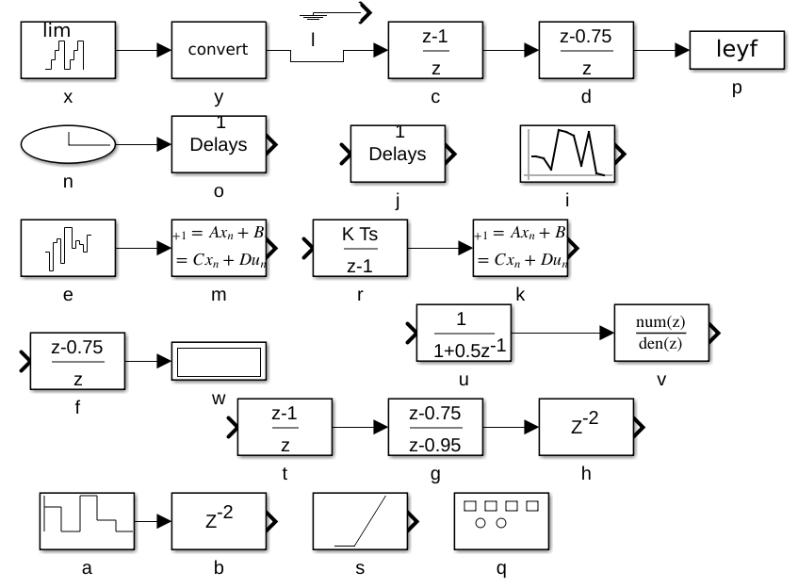
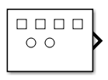
Valid Input Model (Likely New Bug) : TSC 03632450
25 blocks and 12 connections
Crashes Simulink when compiling
Missed by SLForge
SLForge calls API to generate the Signal Generator block.
Signal Generator block generated by SLforge
DeepFuzzSL Generated model

Slide 27
Conclusions
DeepFuzzSL is the first work that uses deep learning for random Simulink model generation to test the Simulink toolchain
Found 2 bugs in Simulink toolchain
Simulink vendor MathWorks confirmed these as bugs
One bug missed by previous State of the art tool
Source code available (BSD license)
https://github.com/50417/DeepFuzzSL

Slide 28



Acknowledgements
The authors acknowledge the Texas Advanced Computing Center (TACC) at The University of Texas at Austin for providing HPC resources that have contributed to the research results reported within this paper. Christoph Csallner has a potential research conflict of interest due to a financial interest with Microsoft and The Trade Desk. A management plan has been created to preserve objectivity in research in accordance with UTA policy. This material is based upon work supported by the National Science Foundation (NSF) under Grant No. 1527398 and 1911017 and a gift from MathWorks.

Slide 29
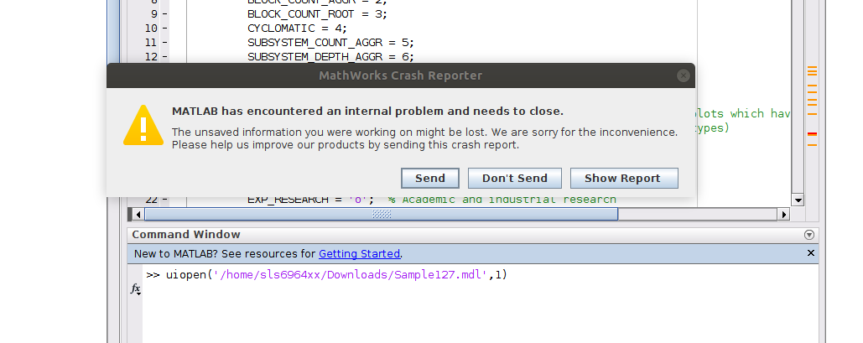
Invalid Input Model (Known Bug)
generated model consists of 3 discrete transfer function blocks
MathWorks Support determined that the generated model misses a certain parameter (OutputPortMap)

