Slide 1
SPEjs: A Symbolic Partial Evaluator for JavaScript
Sümeyye Süslü & Christoph Csallner
Computer Science and Engineering Department
University of Texas at Arlington
Arlington, TX, USA
https://github.com/SumeyyeSuslu/SPEjs

Slide 2
Partial Evaluation: Typically Fast & Shallow
Partial evaluation: Source-to-source transformation
Key observation: Current partial evaluation schemes perform fast but relatively shallow static analysis, e.g.:
Simplify expression if its variables already resolved to constants

Slide 3
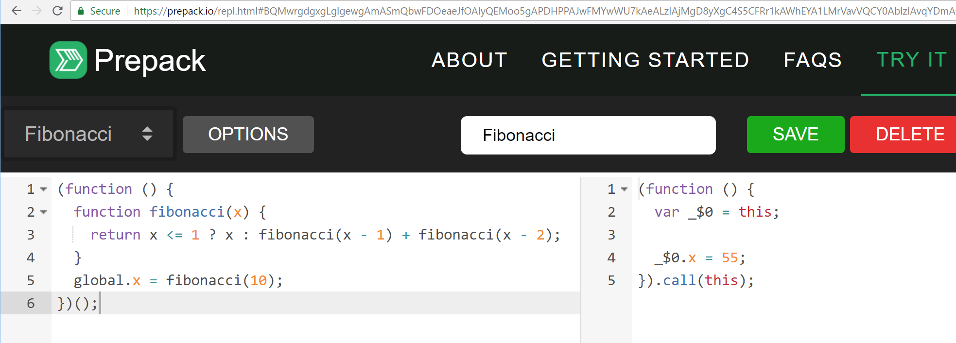
Closest Related Work: Facebook’s Prepack
Input: JavaScript
Prepack
Output: JavaScript
Notes:
Initialization code calls general-purpose libraries and uses variables that are ultimately assigned to constants
code size reduction opportunities
Precompute stuff at compile-time, by partially evaluating code
→ Initialization tasks, intermediate computations, memory allocations

Slide 4
Partial Evaluation: Typically Fast & Shallow
Key observation: Current partial evaluation schemes perform fast but relatively shallow static analysis, e.g.:
Simplify expression if its variables already resolved to constants
But no further analysis on non-resolved variables
Opportunity: Use deeper analysis
(Prepack’s analysis is already relatively deep for a partial evaluator)

Slide 5
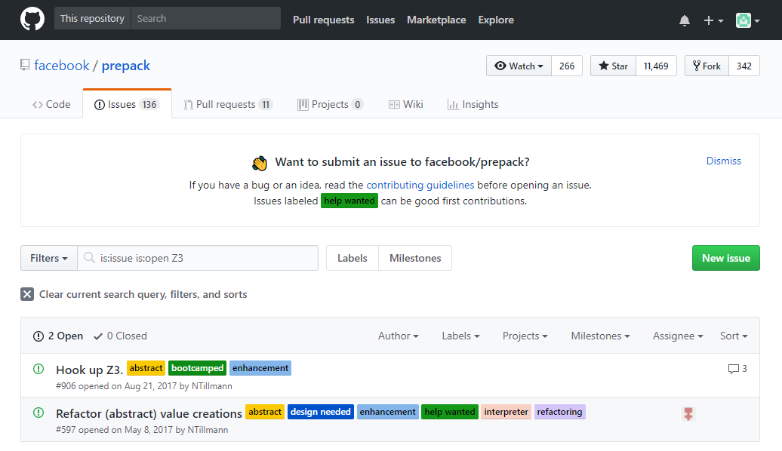
Notes:
Although it was proposed as a planned improvement, symbolic evaluation engine did not implement an SMT solver.

Slide 6
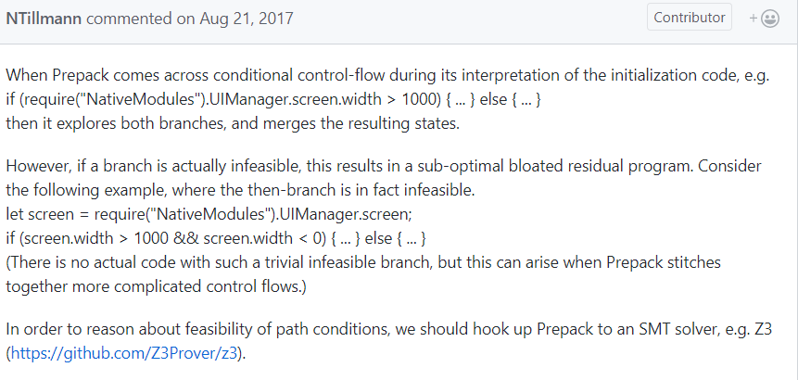
Goal: Connect Partial Evaluator to Z3
Infeasible

Slide 7
Why Partial Evaluation of JavaScript?
95% of websites use JavaScript
https://w3techs.com/technologies/overview/client_side_language/all
Who wants faster loading web sites? ☺
Many mobile apps are mostly JavaScript
E.g., Facebook app: 1.7 billion mobile (app + web site) monthly active users in 2016, some on (very) slow phones
https://www.statista.com/statistics/277958/number-of-mobile-active-facebook-users-worldwide/
Promising target: App initialization code
Passes many constant configuration values to general-purpose code

Slide 8
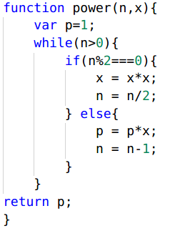

Partial Evaluation: Classic Example
Partially evaluate (= specialize) the p(n,x) function for n=3 to p_3(x)
Without changing its execution semantics (for n=3)
Given n=3:
Propagate constant n
Unroll loop
Remove dead branches
More techniques, e.g.: inline function calls

Slide 9
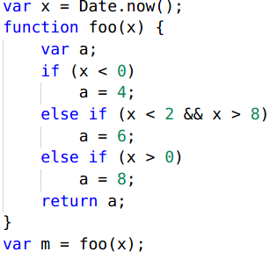
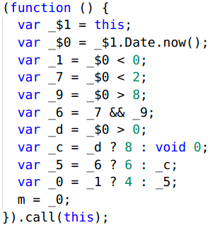
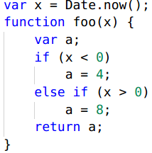
Example: Partially Evaluate Method foo(x)
Input
Output from Prepack
Output from SPEjs
Infeasible

Slide 10
Concern: Symbolic Execution is Expensive
Symbolic execution (e.g., w/ Z3) successful in many domains
Wide spectrum
No symbolic execution: Fast & shallow, e.g.: in compiler
Full symbolic execution: Slow & deep, .e.g.: in N datacenter days

Slide 11
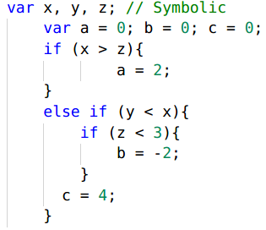
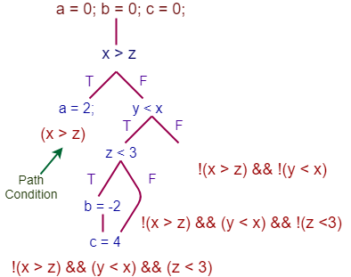
Symbolic Execution: Execute Program on Symbols
Decide red path feasibility queries via constraint solver (typically a SMT solver)

Slide 12
Approach: Local Symbolic Execution
Explore a place somewhere in the middle
Avoid high costs of full symbolic execution
But still get some benefits via local symbolic execution

Slide 13
Symbolic Execution: Typically Heavyweight Style
Symbolic execution of foo
Subset of inputs symbolic, e.g.: x
Reflect state updates symbolically
Lightweight use can still provide value for symbolic partial evaluation, e.g.:
Deciding feasibility of (x<2 && x>8) doesn’t need earlier updates to x (if any)
Analyzing a single branch by itself (without path prefix) can provide big payoff (if brach is infeasible)
Infeasible

Slide 14
Symbolic Partial Evaluator: Overview & Design
Overall design similar to a traditional partial evaluator:
Traverse abstraction of input program: AST, control-flow graph (CFG)
Maintain environment information: State of variables
Iteratively propagate inferred variable values through the program
Perform standard transformations: loop unrolling, function inlining, etc.
Evaluate program on inferred variables values
Main difference: Can represent variable as symbolic expression
Similar to environment a symbolic execution engine maintains
Check satisfiability of symbolic expressions via SMT solver

Slide 15
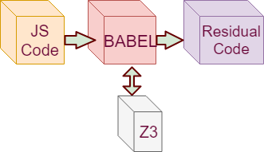
SPEjs Implementation
Babel
Extensible JavaScript compiler
Formulate feasibility queries
One query per program branch
Convert query to SMT logic
Z3 SMT solver
Decide feasibility of feasibility query
Branch infeasible → Prune from program
During partial evaluation
Notes:
SPEjs prototype analyzes following:
Declaration: Function, variable
Expression: Assignment, logical, binary
If Statement
Loops

Slide 16
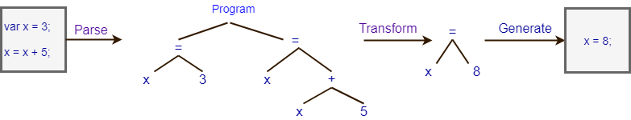
Background: Babel
Multi-purpose source-to-source compiler: https://babeljs.io/
E.g.: Widely used to convert ES6 to other versions of JavaScript
Input: JavaScript
Babel’s plugin architecture enables easy AST manipulation
Output: JavaScript

Slide 17
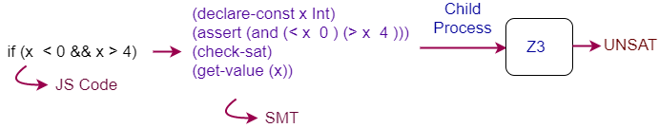
Calling Z3 SMT Solver From JavaScript
Create & pass .smt2 text file to Z3 child process, parse result
Design similar to Leena: https://github.com/mmicu/leena
AST nodes → SMT expressions
Prototype currently limited to integral data types, e.g.:

Slide 18
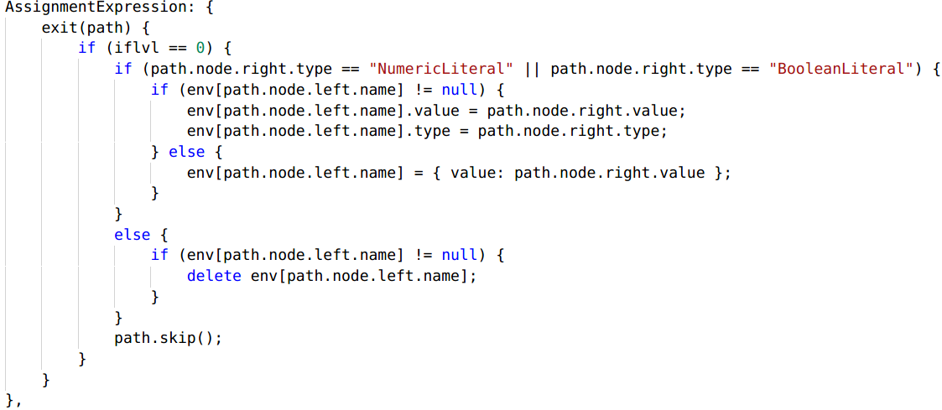
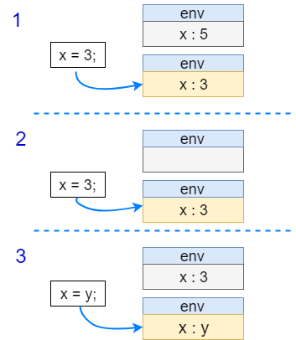
Example: Various cases when traversing AST & updating environment for variable x
Notes:
Implementation: Basic AST-based Traversal

Slide 19
Research Questions (RQ) & Expectations (E)
RQ1: SPEjs’s runtime vs. Prepack (← state-of-the-art)
E1: High overhead of symbolic execution: SPEjs slower
RQ2: Input vs. code produced by SPEjs, Prepack: Runtime
E2: In some cases: SPEjs output code fastest
RQ3: Input vs. code produced by SPEjs, Prepack: Code size
E3: In some cases: SPEjs output code smallest

Slide 20
Experimental Setup
Run Prepack 0.2.19-alpha.0, SPEjs 100 times on each sample
Prepack / SPEjs runtime via built-in Unix time function (RQ 1)
Input & output code runtime: Benchmark.js 2.1.2 (RQ 2)
https://benchmarkjs.com/
Code size (nr. statements): jsmeter (RQ 3): http://jsmeter.info
In VM on laptop
Host: 2.2 GHz 64 bit i5-5200, 12 GB RAM, Windows 10
VM: Node.js 9.2.0 on 6 GB RAM VM with Ubuntu 16.04 LTS

Slide 21
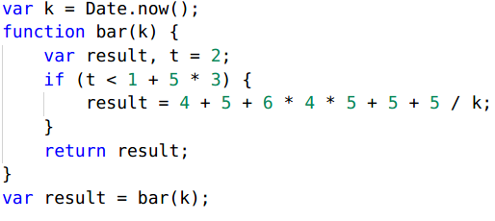
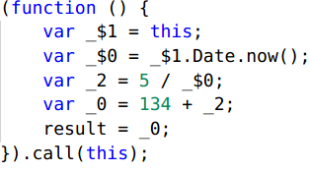
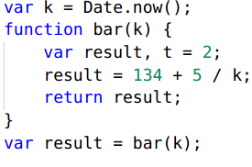
Micro Benchmark of 7 Sample Programs: Folding Binary Operations (Sample 3)
Input
Prepack output
SPEjs output: Very similar to Prepack

Slide 22
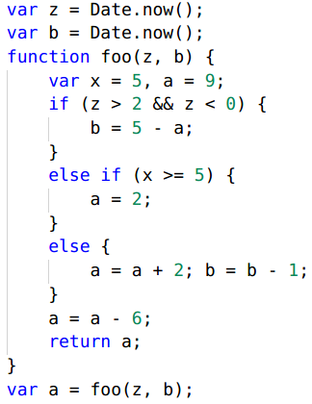
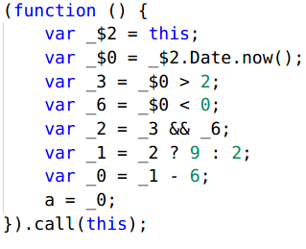
Micro Benchmark of 7 Sample Programs: Infeasible (Non-) resolved If Conditions (Sample 6)
Infeasible
SPEjs output
Prepack output:
[+] Pruned infeasible resolved if-condition x<5
[-] Kept infeasible non-resolved if-condition
Input

Slide 23
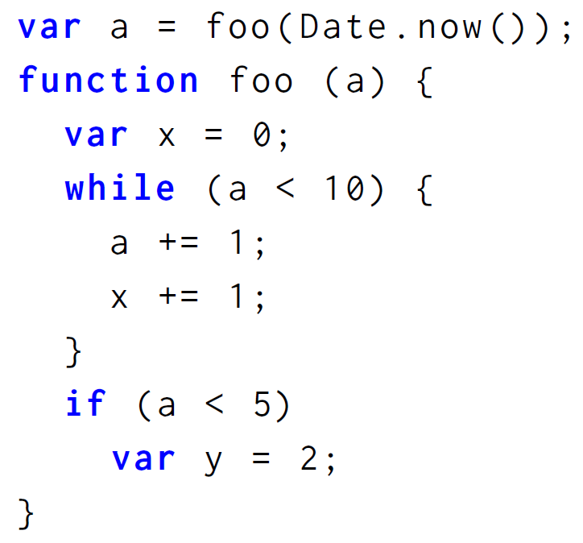
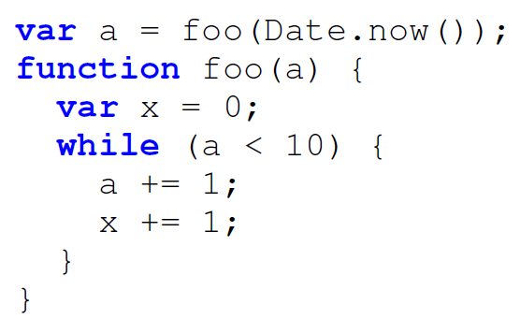
Micro Benchmark of 7 Sample Programs: Infeasible If-Block After Loop (Sample 7)
Prepack throws an error
SPEjs removes infeasible if-block
Input

Slide 24
RQ 1: “Speedup” likely due to SPEjs lack of language support, etc.
RQ 2: PP optimizes runtime, both outputs faster than original
RQ 3: Smaller code when SPEjs prunes infeasible branches

Slide 25
Related Work: Many Orthogonal Problems
Analyzing JavaScript (Large & Dynamic) Is Hard
Most questions undecidable—even for much simpler languages
Combine (future work) with orthogonal prior work on analyzing:
Pointers: Tempo C partial evaluator [Consel, Lawall, Le Meur: 2004]
Dynamic method call dispatch [Dean, Chambers, Grove: PLDI 1995]
Reflection [Shali, Cook: OOPSLA 2011]
Native x86 code [Srinivasan, Reps: OOSPLA 2015]
Remove allocations & runtime type checks [Bolz et al.: PEPM 2011]
High-performance dynamic language VM [Würthinger et al.: PLDI 2017]
Many others..
Notes:
Dean == Google’s legendary Jeff Dean
Many others:
Speeding up numerical computations
A. Berlin, “Partial evaluation applied to numerical computation,” in Proceedings of the 1990 ACM conference on LISP and functional programming. ACM, 1990, pp. 139-150.
A. Berlin and D. Weise, “Compiling scientific code using partial evaluation,” Computer, vol. 23, no. 12, pp. 25-37, 1990.
Decreasing the complexity of rank aggregation problem
J. A. Aledo, J. A. Gmez, and A. Rosete, “Partial evaluation in rank aggregation problems,” Computers & Operations Research, vol. 78, pp. 299-304, 2017.
Speeding up execution of GPU compilation
J. Fumero, M. Steuwer, L. Stadler, and C. Dubach, “Just-in-time gpu compilation for interpreted languages with partial evaluation,”2017.

Slide 26
Related Work: Partial Evaluation of JavaScript, Beyond Prepack
Google’s Closure compiler:
https://developers.google.com/closure/compiler/
Prophecy server pre-computes client heap/DOM state
[Netravali, Mickens: NSDI 2018]
JSA / IBM AppScan finds security vulnerabilities
[Tripp, Ferrara, Pistoia: ISSTA 2014]
Jeene speeds up browser-specific code
http://blog.higher-order.net/2008/09/14/jeene.html

Slide 27
Related Work: Symbolic Execution + Partial Evaluation
Symbolic execution without partial evaluation
SymJS generates test cases [Li et al: FSE 2014]
Jalangi: detects type inconsistencies [Sen et al: FSE 2013]
JavaScript security vulnerabilities [Saxena et al: Oakland 2010]
Partial evaluation to improve symbolic execution
[Rojas, Pasarenau: Bytecode 2013]
[Bubel, Hahnle, Ji: FMCO 2010]
[Ji, Bubel: FM 2012]

Slide 28
More Future Work
Analyze CFG instead of AST
Include more JavaScript features in analysis
Call Z3’s API directly, instead of via a text file
More serious evaluation on third party open source code

Slide 29


Thank You
SPEjs source code is available: https://github.com/SumeyyeSuslu/SPEjs

