Slide 1
Analysis of Mixed-mode Malware
Christoph Csallner, University of Texas at Arlington http://ranger.uta.edu/~csallner/
Joint work with: Shabnam Aboughadareh
This material is based upon work supported by the National Science Foundation under Grants No. 1017305, 1117369, and 1527398. Any opinions, findings, and conclusions or recommendations expressed in this material are those of the author(s) and do not necessarily reflect the views of the National Science Foundation.

Slide 2

Well-known malware analysis tool: TEMU
User
VM
Kernel
TEMU
VMI Driver
Send OS state
TEMU Analysis
HOST

Slide 3
Question: What if malware attacks the analysis tool, e.g., TEMU?
User
VM
Kernel
Attack
TEMU
VMI Driver
Send
OS state
HOST
TEMU
Analysis Component

Slide 4
Mixed-mode malware
Phase 1: Modify OS kernel code/data
Phase 2: Payload uses modifications in attack
Semantics determined by phase 1 success
Malware analysis can only observe phase 2 if phase 1 succeeds
But phase 1 may corrupt malware analysis

Slide 5

1
Dropper.exe
Example with TEMU-style in-guest analysis tool
(VMI = Virtual Machine Introspection)
Preventing Dropper from running would prevent analyst from observing Mal.exe’s malicious behavior
User
VMI notification
Mm1
Kernel
VMI Driver
1: Drop
VMI
...
Zw1
Pointer to Zw1
...
Function Modifier
Syscall table
2
Dropper.exe
VMI notification
Mm1
VMI Driver
2.2: Unpatch
...
2.1: Hook
Zw1
Pointer to Zw1
...
Function Modifier
Syscall table
3
3.1: Create
new process
Dropper.exe
Mal.exe
VMI Driver
Mm1
False VMI
...
Zw1’
Pointer to Zw1’
3.2: Call
ZW1
...
Current process
≠ Mal.exe
Current process
= Mal.exe
Syscall table
Zw1’’: Call ZW1, hide Mal.exe
Service A

Slide 6
Malware Analysis: State of the Art
What
TEMU [UC Berkeley]
Both
User- only
Anubis (TTAnalyze) [UC SB et al.]
Ether [Georgia Tech]
Kernel- only
d-Anubis [TU Vienna]
Where
Some components
Inside malware domain
Fully outside
malware domain

Slide 7
Example with malware analysis tool that does not analyze entire system
Mal.exe
2. Call A
User
Kernel
Execution path
for service A
1. Drop Rootkit
(kernel-mode component)
3. Intercept the execution of system call A
in kernel
Service A
4. Invoke system service B
Service B

Slide 8
Concrete example: Ether
As before: Preventing Dropper from running would prevent analyst from observing Mal.exe’s malicious behavior
Mal.exe
2. Call A
Ether logs A
User
Kernel
Execution path
for service A
1. Drop Rootkit
(kernel-mode component)
What Actually Executes
Service A
4. Invoke system service B
Service B

Slide 9
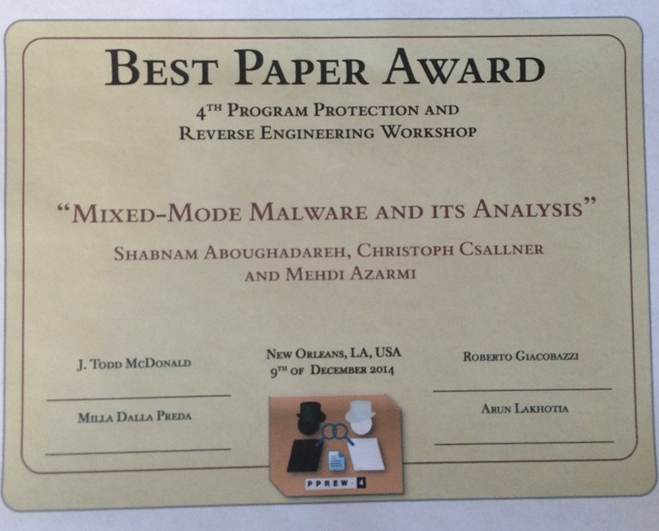
Malware Analysis
What
TEMU [UC Berkeley]
SEMU [UT Arlington]
Both
User- only
Anubis (TTAnalyze) [UC SB et al.]
Ether [Georgia Tech]
Kernel- only
d-Anubis [TU Vienna]
Where
Some components
Inside malware domain
Fully outside
malware domain

Slide 10
SEMU: Completely outside the guest
User
Kernel
QEMU
VM
Data
Code
Reverse
Engineering
Shadow Mem.
Data: Name,
addr, value
HOST
SEMU VMI
Component
Code: Name, addr
Before malware execution

Slide 11
SEMU: Completely outside the guest
User
Kernel
QEMU
VM
Data
Code
Reverse
Eng.
Tracing
Shadow Mem.
Data: Name,
addr, value
SEMU Analysis
Component
SEMU VMI
Component
HOST
Code: Name, addr
Trace
log
Trace Analyzer
Analysis
Report
After malware execution

Slide 12
Evaluation: SEMU is the only tool we tested that can fully analyze these mixed-mode malware samples:
Description | Affected Object | OS fct | Kernel LOC | User LOC | Slow- down
Modify sys calls | KTHREAD | No | 370 | 1,684 | 35.3
Modify sys calls (MDL) | SSDT | Yes | 417 | 1,684 | 38.7
DKOM object hiding | EPROCESS DRIVER_OBJECT | No | 96 | 451 | 28.2
DKSM renaming | EPROCESS | No | 111 | 451 | 20.6
Privilege escalation | EPROCESS | No | 0 | 149 | 25.2
User-mode unhook | SSDT | Yes | 0 | 710 | 29.1

Slide 13
Execution time -- Fine-grained VMI: Instruction tracing
Subject | w/o VMI [s] Ether SEMU |  | Fine VMI [s] Ether SEMU |  | Slowdown Ether SEMU
Esinfo | 0.63 | 2.42 | 20.54 | 21.39 | 32 | 8
Timezone | 0.05 | 0.79 | 4.41 | 13.03 | 87 | 16
Whoami | 0.03 | 0.72 | 4.49 | 19.83 | 149 | 27
UPX | 0.32 | 9.00 | 45.58 | 322.60 | 141 | 35
RAR a | 0.15 | 3.07 | 45.16 | 302.93 |  | 98

Slide 14
Inside-the-guest VMI in TEMU vs. Outside-the-guest VMI in SEMU
Subject | w/o VMI [s] TEMU SEMU |  | Coarse VMI [s] TEMU SEMU |  | Slowdown TEMU SEMU
PsGetsid | 1.68 | 0.56 | 3.44 | 1.09 | 105 | 95
Pslist –t | 3.19 | 1.03 | 4.69 | 1.31 | 47 | 27
Psinfo -s | 5.76 | 2.88 | 9.79 | 4.78 | 70 | 66
Coreinfo | 1.70 | 0.65 | 3.75 | 1.07 | 121 | 63
ListDLLs | 3.20 | 2.58 | 5.01 | 3.75 | 57 | 45

