Slide 1
Dynamic Symbolic Data Structure Repair
= DSDSR
Ishtiaque Hussain, Christoph Csallner
Software Engineering Research Center (SERC)
Computer Science and Engineering Department
University of Texas at Arlington, USA
May 7, 2010.

Slide 2
What is bytecode instrumentation??

Slide 3
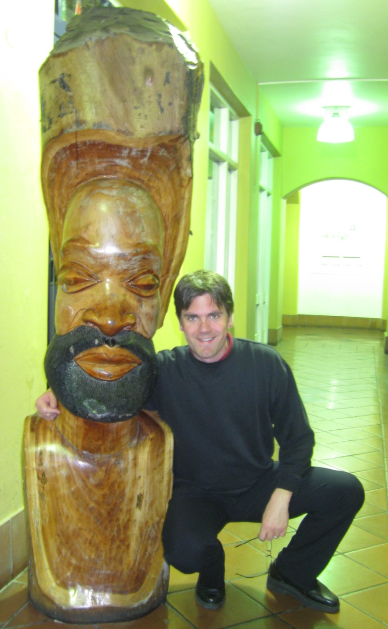
Me
Christoph
Location: Waterfront, Cape Town, South Africa
Occasion: ICSE 2010

Slide 4
Why Data Structure Repair is important?
All software use some sort of data structure underneath
Data structure corruption might result into software crash
In real time systems user intervention might not be an option for corruption repair

Slide 5
Goal:
Automatically repair corrupted data structures to prevent software crash
Perform such repair actions effectively and in a time efficient manner. Cannot wait forever!

Slide 6
Example: Singly-linked list
public class LinkedList {
Node header;
// ..
public boolean repOk() {
Node n = header;
if (n == null)
return true;
int length = n.value;
int count = 1;
while (n.next != null) {
count += 1;
n = n.next;
if (count > length)
return false;
}
if (count != length)
return false;
return true;
}
}
public class Node {
int value;
Node next;
// ..
}
value
Node
next
4
First node has a value that is equal to the number of nodes in the list.

Slide 7
4
n1 == null
T
F
n1
n2
n3
n1.next != null
F
T
public class LinkedList {
Node header;
// ..
public boolean repOk() {
Node n = header;
if (n == null)
return true;
int length = n.value;
int count = 1;
while (n.next != null) {
count += 1;
n = n.next;
if (count > length)
return false;
}
if (count != length)
return false;
return true;
}
}
2 > n1.value
F
T
n2.next != null
F
T
3 > n1.value
T
F
n3.next != null
F
T
3 != n1.value
F
T
return true
return false
Notes:
Explain, slow use “instrumentation”, mention data structure should be same, maintain all the constraints, change the last one
Careful about saying: we want it to return true, not false

Slide 8
Our approach to the problem:
public class LinkedList {
Node header;
// ..
public boolean repOk() {
Node n = header;
if (n == null)
return true;
int length = n.value;
int count = 1;
while (n.next != null) {
count += 1;
n = n.next;
if (count > length)
return false;
}
if (count != length)
return false;
return true;
}
}
public class Node {
int value;
Node next;
// ..
}
n1
n2
n3
4
First node has a value that is equal to the number of nodes in the list.

Slide 9
Our approach to the problem:
4
3
public class LinkedList {
Node header;
// ..
public boolean repOk() {
Node n = header;
if (n == null)
return true;
int length = n.value;
int count = 1;
while (n.next != null) {
count += 1;
n = n.next;
if (count > length)
return false;
}
if (count != length)
return false;
return true;
}
}
public class Node {
int value;
Node next;
// ..
}
n1
n2
n3
First node has a value that is equal to the number of nodes in the list.
Constraints:
n1 != null
n1.next != null
2 <= n1.value
n2.next != null
3 <= n1.value
n3.next == null
3!= n1.value
3 == n1.value
Solve
3 = n1.value
Notes:
Talk about dynamic type checking.
Take time to point the change in 1.value

Slide 10
Algorithm:
Normal program execution
Yes
repOk returns true?
No
Error:
Failed to repair
Yes
Too many tries?
No
Repair Attempt
I-repOk builds path condition
Modify and solve path condition
No
Found solution?
Yes
Repair data structure
Notes:
By the way, in this slide I-repOk means Instrumented repOk
Lines: thicker. Dotted lines change with different colored line

Slide 11
Existing state-of-the-art tool: Juzi
Developed by Bassem Elkarablieh and Sarfaraz Khurshid of University of Texas at Austin [ICSE’08, ASE’07]
Web link: http://users.ece.utexas.edu/~elkarabl/Juzi/index.html
Notes:
To evaluate our tool we took the leading tool in data structure repair, Juzi
Add referenceICSE ‘08 ASE ‘07

Slide 12
Juzi’s approach in solving our example problem:
public class LinkedList {
Node header;
// ..
public boolean repOk() {
Node n = header;
if (n == null)
return true;
int length = n.value;
int count = 1;
while (n.next != null) {
count += 1;
n = n.next;
if (count > length)
return false;
}
if (count != length)
return false;
return true;
}
}
public class Node {
int value;
Node next;
// ..
}
Last accessed instance
1
2
3
Last accessed field
4
4
First node has a value that is equal to the number of nodes in the list.

Slide 13
Juzi’s approach in solving our example problem:
public class LinkedList {
Node header;
// ..
public boolean repOk() {
Node n = header;
if (n == null)
return true;
int length = n.value;
int count = 1;
while (n.next != null) {
count += 1;
n = n.next;
if (count > length)
return false;
}
if (count != length)
return false;
return true;
}
}
public class Node {
int value;
Node next;
// ..
}
4
3
First node has a value that is equal to the number of nodes in the list.
Notes:
Go slow, explain why back track, Exhaustive == blindly; trial and error

Slide 14
DSDSR vs. Juzi: Conceptual differences
 | Juzi | DSDSR
Corruption assumption | Backtrack in list of field accesses | Backtrack in list of branch conditions*
Primitive field | Constraint solving | Constraint solving
Reference field | Exhaustive search | Constraint solving
Notes:
For *: We have an improvement that we are working on.

Slide 15
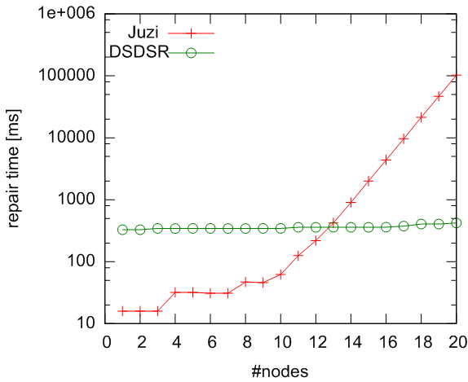
DSDSR vs. Juzi for Singly-Linked List
Notes:
Y axis is logarithmic,

Slide 16
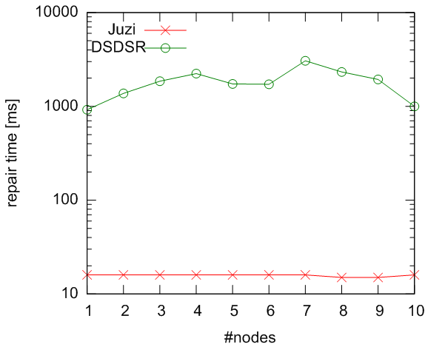
More Results: Binary Tree, return immediate

Slide 17
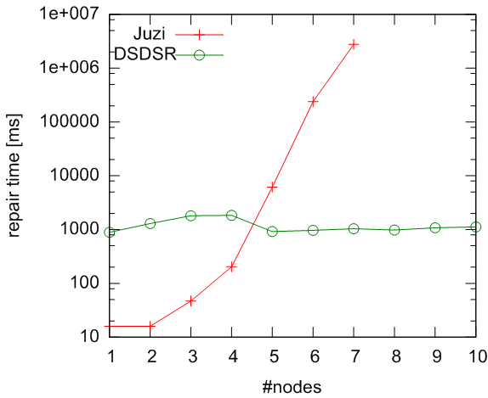
More Results: Binary Tree, return late

Slide 18
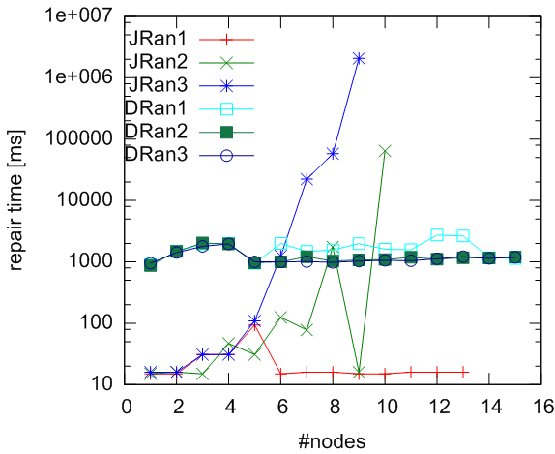
More Results: Binary Tree, return mixed

Slide 19
Thank you!
We specially thank Bassem Elkarablieh and Sarfaraz Khurshid for helping us with Juzi.

Slide 20
Binary Tree: return immediate
public boolean repOk() {
if (root == null) // An empty tree == zero in size
return ( size == 0);
Set<Node> visited = new HashSet<Node>;
visited.add(root);
LinkedList<Node> workList = new LinkedList<Node>;
workList.add(root);
while (!workList.isEmpty()) {
Node current = workList.removeFirst();
if (current.left != null) { // no cycles along left
if (!visited.add(current.left)) {
return false;
} else
workList.add(current.left);
}
if (current.right != null) { // no cycles along right
if (!visited.add(current.right)) {
return false;
} else
workList.add(current.right);
}
}
if (visited.size() != size) // size == #visited nodes
return false;
return result;
}
}
size = 5
n1
n2
n3
n4
n5
Should be a tree
#nodes reachable from root is stored in the size field.

Slide 21
Binary Tree: return late
public boolean repOk() {
boolean result = true; // An empty tree == zero in size
if (root == null){
if (size != 0)
result = false;
return result;
}
// …
while (!workList.isEmpty()) {
Node current = workList.removeFirst();
if (current.left != null) { // no cycles along left
if (!visited.add(current.left)) {
result = false;
} else
workList.add(current.left);
}
if (current.right != null) { // no cycles along right
if (!visited.add(current.right)) {
result = false;
} else
workList.add(current.right);
}
}
if (visited.size() != size) // size == #visited nodes
result = false;
return result;
}
}
size = 5
n1
n2
n3
n4
n5
Should be a tree
#nodes reachable from root is stored in the size field

Slide 22
Binary Tree: return mixed
public boolean repOk() {
boolean result = true; // An empty tree == zero in size
if (root == null){
if (size != 0)
result = false;
return result;
}
// …
while (!workList.isEmpty()) {
Node current = workList.removeFirst();
if (current.left != null) { // no cycles along left
if (!visited.add(current.left)) {
result = false;
} else
workList.add(current.left);
}
if (current.right != null) { // no cycles along right
if (!visited.add(current.right)) {
return false;
} else
workList.add(current.right);
}
}
if (visited.size() != size) // size == #visited nodes
result = false;
return result;
}
}
size = 5
n1
n2
n3
n4
n5
Should be a tree
#nodes reachable from root is stored in the size field

Slide 23
Implementation:
Corrupt field and instance
Map Updater for Ref. fields
Updated map for fields
First run of repOk
Second run of repOk
I-repOk
I-repOk
Data Struct.
Data Struct.
Path condition to solve
Repair
Solution
Constraint Solver (Z3)

Slide 24
Binary Tree: return late - DSDSR
public boolean repOk() {
boolean result = true; // An empty tree == zero in size
if (root == null){
if (size != 0)
result = false;
return result;
}
// …
while (!workList.isEmpty()) {
Node current = workList.removeFirst();
if (current.left != null) { // no cycles along left
if (!visited.add(current.left)) {
result = false;
} else
workList.add(current.left);
}
if (current.right != null) { // no cycles along right
if (!visited.add(current.right)) {
result = false;
} else
workList.add(current.right);
}
}
if (visited.size() != size) // size == #visited nodes
result = false;
return result;
}
}
size = 5
Constraints:
n1
n1 != null
n1.left != null
n1.left == n1
n1.right != null
n1.right != n1
n2.left != null
n2.left != n1
n2.left != n2
…
5 == size
n6
n2
n1.left != n1
n3
n4
n5
Solve
n1.left = new_Node

Slide 25
Binary Tree: return late: second repair
public boolean repOk() {
boolean result = true; // An empty tree == zero in size
if (root == null){
if (size != 0)
result = false;
return result;
}
// …
while (!workList.isEmpty()) {
Node current = workList.removeFirst();
if (current.left != null) { // no cycles along left
if (!visited.add(current.left)) {
result = false;
} else
workList.add(current.left);
}
if (current.right != null) { // no cycles along right
if (!visited.add(current.right)) {
result = false;
} else
workList.add(current.right);
}
}
if (visited.size() != size) // size == #visited nodes
result = false;
return result;
}
}
size = 6
size = 5
Constraints:
n1
n1 != null
n1.left != null
n1.left != n1
n1.right != null
n1.right != n1
n1.right != n6
…
6 != size
6 == size
n6
n2
n3
n4
n5
Solve
size = 6
Dynamic Symbolic Data Structure Repair
25

Slide 26
Binary Tree: return late - Juzi
public boolean repOk() {
boolean result = true; // An empty tree == zero in size
if (root == null){
if (size != 0)
result = false;
return result;
}
// …
while (!workList.isEmpty()) {
Node current = workList.removeFirst();
if (current.left != null) { // no cycles along left
if (!visited.add(current.left)) {
result = false;
} else
workList.add(current.left);
}
if (current.right != null) { // no cycles along right
if (!visited.add(current.right)) {
result = false;
} else
workList.add(current.right);
}
}
if (visited.size() != size) // size == #visited nodes
result = false;
return result;
}
}
size = X
size = 5
Last accessed field
n1
n2
n3
n4
Second to Last accessed field
n5
Should be a tree
#nodes reachable from root is stored in the size field

