Slide 2

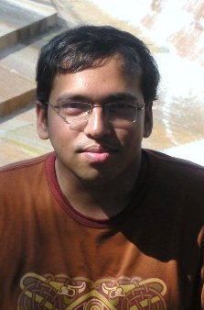
An Experiment in Developing Small Mobile Phone Applications: Comparing On-Phone to Off-Phone Development
Tuan A. Nguyen, Sarker T.A. Rumee, Christoph Csallner
(University of Texas at Arlington)
Nikolai Tillmann (Microsoft Research)
Monday, July 16
This material is based upon work supported by the National Science Foundation under Grants No. 1017305 and 1117369. Any opinions, findings, and conclusions or recommendations expressed in this material are those of the author(s) and do not necessarily reflect the views of the National Science Foundation.

Slide 3
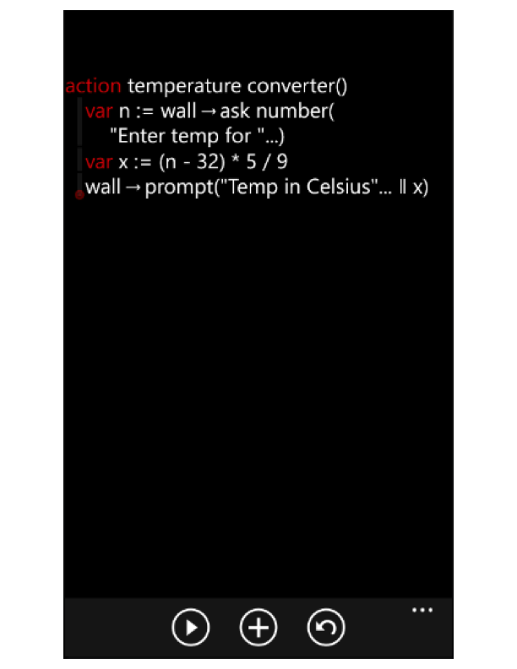
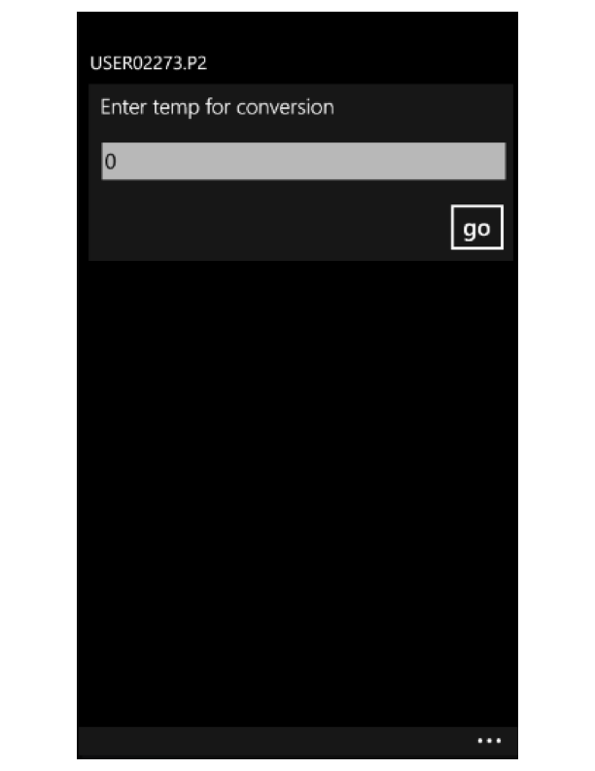
New Development Style: On-Phone
Semi-structured multi-touch IDE
Interpreter within IDE

Slide 4
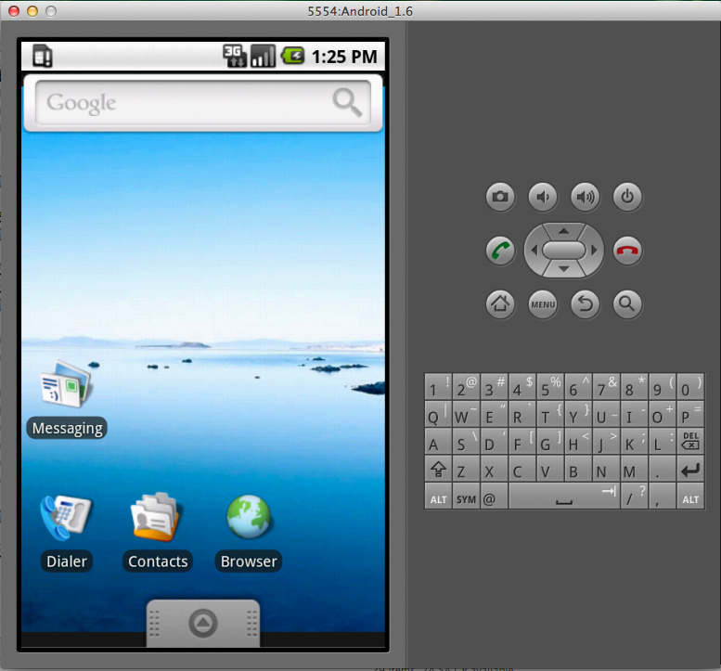
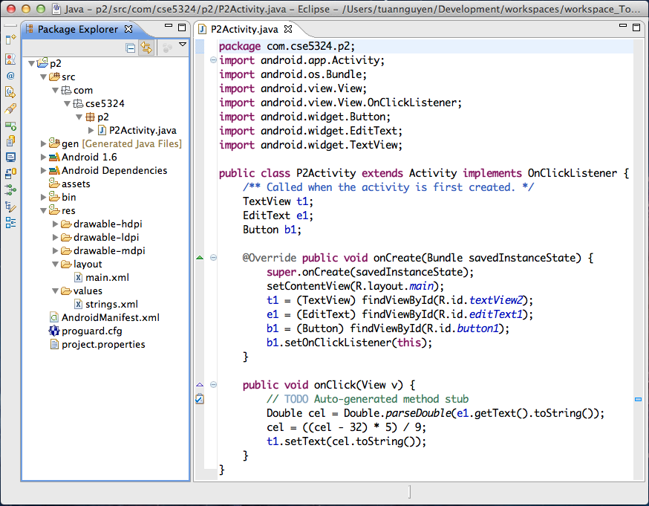
Traditional Development Style: Off-Phone
Android as an example, but Windows Phone, iOS, etc. work similarly
Standard IDE such as Eclipse, Visual Studio
Phone emulator

Slide 5
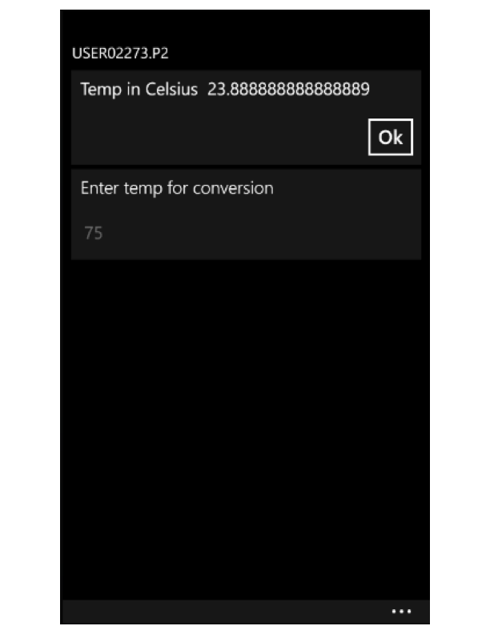
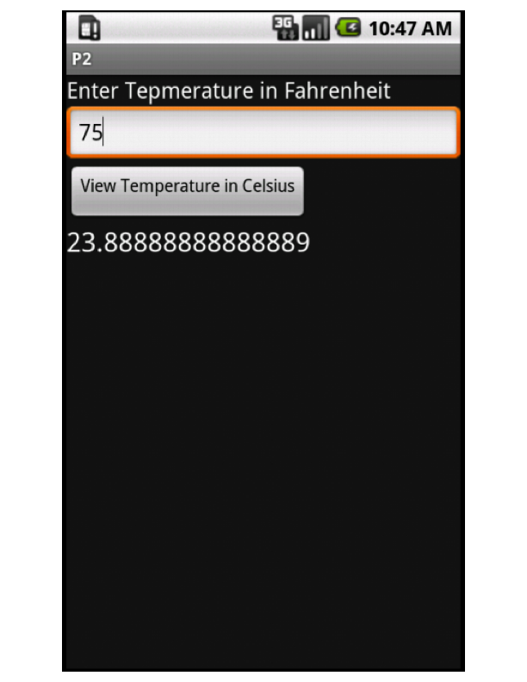
Resulting Apps May Look Very Similar
Example: Convert degrees Fahrenheit to degrees Celsius
TouchDevelop
Android

Slide 6
On-Phone vs. Traditional Off-Phone Development
Research questions (RQ), expectations (E), and hypotheses (H)
RQ1: How large are TouchDevelop apps?
E1: Tiny phone screen → expect most TouchDevelop apps to be small
H1: TouchDevelop Apps Are Small
RQ2: For given task: TouchDevelop-LOC vs. Android-LOC
E2: TouchDevelop specialized, assumes and hides details → expect TouchDevelop apps to be smaller
H2: TouchDevelop-LOC < Android-LOC
RQ3: Programmer productivity: TouchDevelop vs. Android
E3: Tiny phone screen, no keyboard, no mouse → expect TouchDevelop programmers to be less productive
H3: TouchDevelop-Productivity < Android-Productivity

Slide 7
RQ1: How Large Are TouchDevelop apps?
Count LOC of all TouchDevelop apps in TouchDevelop cloud
old versions of an
app (published by the app's original author under the same app name)
TouchDevelop
Cloud
All apps
(JSON)
Remove
Download
Keep
Current version of each app
Apps’ LOC
Count
Counting TouchDevelop LOC (and Android LOC)
Normalize TouchDevelop and Android apps
Count logical source statements (LSS) [“Software Size Measurement: A Framework for Counting Source Statements” by Park. Technical report, Software Engineering Institute, Sept. 1992.]
Do not count content of configuration files (XML, text, etc.)
Notes:
TODO: Add motivation on why we picked LSS over other metrics.
JavaNCSS ⁼⁼ http://www.kclee.de/clemens/java/javancss/
Android uses configuration files to define layout, styling, etc

Slide 8
RQ2 & RQ3: Experiment on Student Subjects
27 students of CSE 5324 software engineering class
25 MS CS + 1 MS CE + 1 MS SE, taught by Csallner, Rumee: TA
In this class students (expect to) work on big Android team project (team = 5 students)
Experiment conducted toward end of semester → students have some Android experience
10 Samsung Focus Windows 7 Phones from Microsoft
University lab with > 17 lab PCs
Randomly assigned subjects to:
One class period
10 min informed consent & phone loan forms + 60 min tasks + 10 min questionnaire
Stressed that participation does not influence grades, provided link to respective APIs
Individual development: Can consult samples, web, no other communication except with instructor/TAs
Thanks to Microsoft Research Connections
10 WP7 phones with pre-installed TouchDevelop v2.4.0.0 beta
17 lab PCs with pre-installed Eclipse + Android SDK v 1.6

Slide 9
Experiment Mechanics
Windows Phone subjects
Did not receive training in TouchDevelop
Received link to TouchDevelop website and 2-minute intro video
Did 5-minute phone setup
Setup wireless internet connection
Enter assigned fresh Windows Live ID
Download & install TouchDevelop
TouchDevelop comes with samples
Students not allowed to use another device
Simulate phone-only development
Developed apps published to cloud by TA
Android lab PC subjects
Had taught themselves Android for class project
Did 5-min PC setup
Download & install Android Development Tools
Create & start virtual device (emulator)
Wizard generates working “Hello World” program
E-mailed source of developed apps to TA
2 subjects failed to do that → Left with 15 Android subjects
Notes:
Prior training caveat: 10 weeks earlier we held a similar but non-IRB exercise (with different random assignment of subjects to phone/PC) to gain experience

Slide 10
Subjects Had Little Prior TouchDevelop Knowledge
Asked for hours spent before experiment on learning TouchDevelop (TD), Android (An), Eclipse (Ec)
Median #hours spent learning TouchDevelop = 0
Median #hours spent learning Android = 30
Median #hours spent learning Eclipse = 55

Slide 11
Prior LOC: TouchDevelop < Android < Java
Asked for LOC written before experiment in TouchDevelop (TD), Android (An), non-Android Java (J), C#
Median TouchDevelop LOC written before experiment = 0
Median Android LOC written before experiment = 250
Median non-Android Java LOC written before experiment = 1,000

Slide 12
Experiment Design: 11 Programming Tasks
(P1) Any "Hello World" program that prints "CSE 5324" on the screen.
(P2) A program that takes as input an integer number representing degrees Fahrenheit, converts it to degrees Celsius (using the Fahrenheit to Celsius conversion rule: deduct 32, multiply by 5, then divide by 9), and prints the resulting value.
(P3) A tip calculator that takes as input two integer numbers A, B from the user and prints the value of A*B/100.
(P4) A program that takes as input an integer number and prints "even" if it is an even number and "odd" if it is an odd number.
(P5) A program that takes as input a string and a character, prints "contains" if the string contains the character or else prints "not in there".
(P6) A program that takes as input a string and prints out the string with first character in uppercase.
(P7) A program that prints the system’s current time as text.
(P 8) A program that asks the user for a positive integer value n and prints odd numbers between 0 and n (including n if n is odd).
(P9) A program that takes as input a string that consists of numbers separated by commas. The program should output the numbers in increasing order.
(P10) A program that draws a circle on the screen.
(P11) A program that takes two strings as input and checks if they are equal.

Slide 13
RQ1: How Large Are TouchDevelop apps?

Slide 14
Result: TouchDevelop Apps Are Small
2,081 apps in the TouchDevelop cloud (17 Feb 2012)
Two largest apps of 1,742 and 1,675 LOC not shown
47% are ≤ 9 LOC
60% are ≤ 19 LOC
Notes:
90% (1,880) or more compile – according to haserrors flag via TouchDevelop cloud API

Slide 15
RQ2: For Given Task: TouchDevelop LOC vs. Android LOC

Slide 16
On Same Task: TD-LOC < Android-LOC
Correct solutions: TouchDevelop-LOC ≈ 4 Android-LOC
Correctness judged manually, width is proportional to #correct solutions we received

Slide 17
TouchDevelop App Has Less Code
Example: Convert degrees Fahrenheit to degrees Celsius
TouchDevelop
Android
Less general, focused on basic mobile device functions + Less configuration + Less code

Slide 18
RQ3: Programmer Productivity: TouchDevelop vs. Android

Slide 19
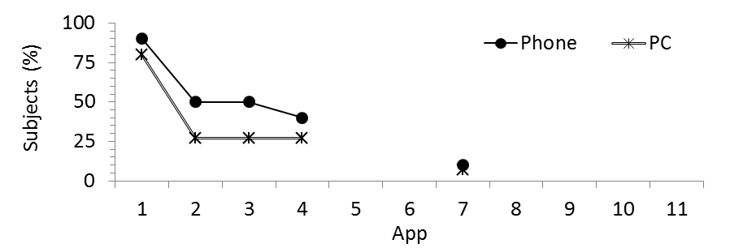
TouchDevelop-Productivity > Android-Productivity
TouchDevelop subjects on average started and finished more apps
System | Subjects | Apps / subject
 |  | Some code | Correct
TouchDevelop | 10 | 3.7 | 2.4
Android | 15 | 3.2 | 1.7

Slide 20
Why Were TD Subjects More Productive?
Possible explanations
TouchDevelop is more focused on tasks
Less configuration and setup in TouchDevelop
Modern language features: Type-inference
Convenient for small tasks
Semi-structured TouchDevelop IDE
Why traditional IDEs do not have this feature?
Traditional development may benefit from semi-structured IDEs

Slide 21
Threats to Validity
Our subjects are not a random sample
Study may not generalize well to novice or hobbyist programmers world wide
Subjects all UTA students
Subjects self-selected graduate software engineer course that has a large Android project
→ But subjects were not aware of this experiment
Hands-off administration of tasks
Did not instruct subjects on how to work on the given tasks
Time limits for each task may produce results that are easier to compare, but prevents subjects from switching back to earlier tasks and reusing later solutions in earlier tasks
Results may not generalize to larger programs
Limited mobile phone screen size and the limited amount of time
Designed all tasks to be simple, small, and solvable with both Android and TouchDevelop
Program size increases → TouchDevelop may need more scrolling & navigation → lower productivity

Slide 22
Conclusions & Future Work

Slide 23
Conclusions
Programmers so far have written small TouchDevelop apps
Experiment comparing on-phone to off-phone development
Small programming tasks
Student subjects
Subject training: Android > TouchDevelop
→ TouchDevelop LOC < Android LOC
→ TouchDevelop productivity > Android productivity

Slide 24
Future Work
Why were TouchDevelop subjects more productive?
How large is the impact of the semi-structured IDE vs. the other TouchDevelop components?
E.g.: Observe programmers on semi-structured IDE vs. on un-structured version of same IDE
What happens for larger programs?
Challenging to write large programs on small screen
Are TouchDevelop maintainers also more productive?
Observe subjects as they add/change a small feature in an third-party TouchDevelop app
Are TouchDevelop testers also more productive?
How do you debug and test code on a phone?

Slide 25
References
Technical paper ”An experiment in developing small mobile phone applications comparing on-phone to off-phone development” By Tuan A. Nguyen, Sarker T.A. Rumee, Christoph Csallner, and Nikolai Tillmann. In Proc. 1st International Workshop on User Evaluation for Software Engineering Researchers (USER), June 2012, pp. 9-12.
Corpus of TouchDevelop apps, Experiment tasks & resulting TouchDevelop & Android apps, Questionnaire, tools:
→ http://cseweb.uta.edu/~tuan/tdexp/

Slide 26
More Details

Slide 27
Background of This Experiment
Csallner’s programming experience mostly Java
Teaches project-based Software Engineering course
Team project, each team develops piece of software, covers major development phases
Current hot topic: Mobile app development skills
Pick Android as it is a major platform and matches instructor’s Java experience
TouchDevelop comes along
Radical new approach to mobile app development
What are the trade-offs?

Slide 28
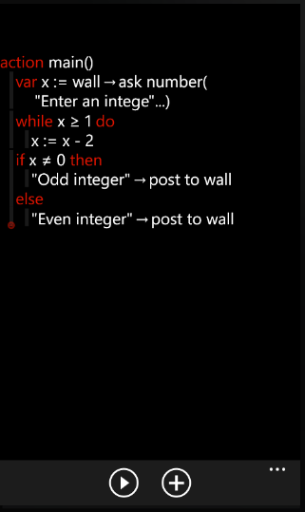
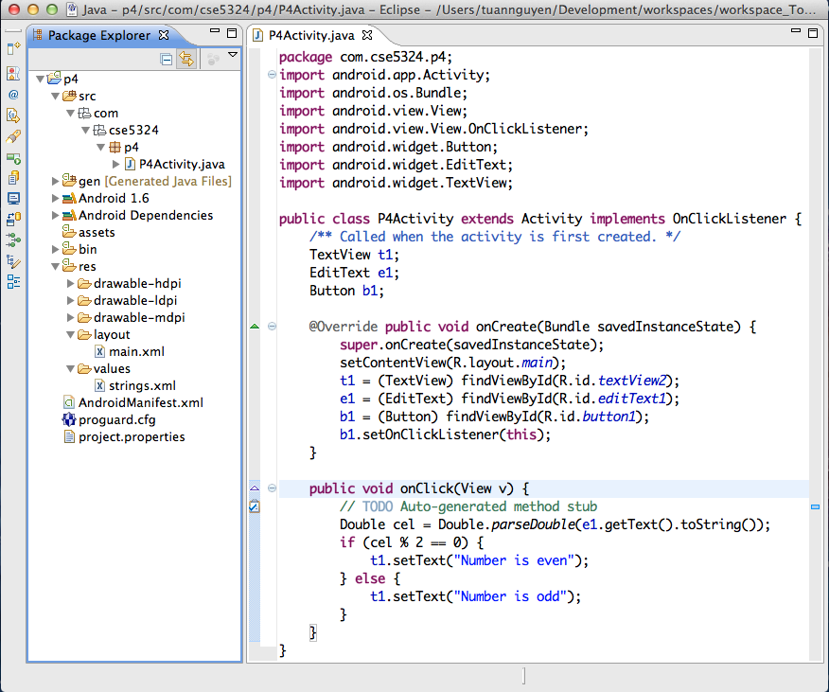
Counting LOC: Logical Source Statements
Example: Input an integer number and print "even" if it is an even number and "odd" if it is an odd number.
TouchDevelop LSS: 8
Android LSS: 25
1
1
2
2
3
4
5
3
6
7
4
8
5
9
6
10
7
11
8
12
13
14
15
16
17
18
19
20
21
22
23
24
25

Slide 29
Correct Apps Per Subject
Higher percentage of TouchDevelop subjects finish 1,2,3 apps
Higher percentage of Android subjects finish 4 apps

Slide 30
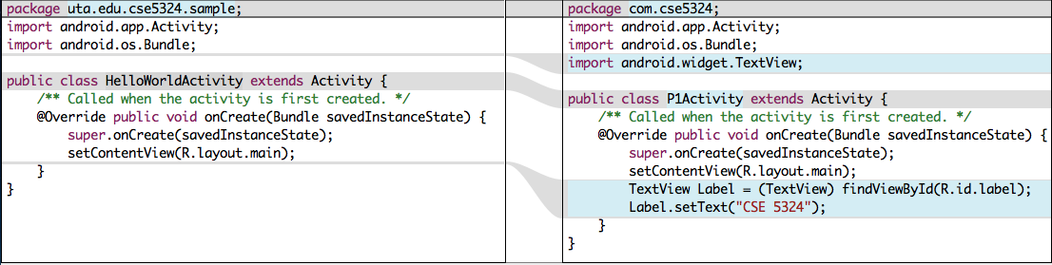
Subject Reusing Android Apps Between Tasks
“Hello world” template (left) vs. “Print CSE 5324” (right)
Lookup text view and change text to ``CSE 5324''
Could have implemented this change without changing code, just replace “Hello World” string in XML configuration file

Slide 31
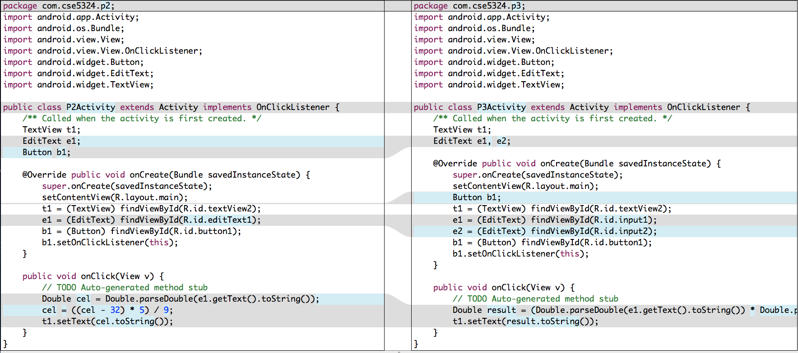
Subject Reusing Android Apps Between Tasks
°F to °C conversion (left) vs. Tip Calculator (right)
add e2 edit text box
Requires addition to XML configuration file (not shown)
Modify result expression

Slide 32
Prior Experience vs. Success in Experiment
Relation between app success and prior experience was much stronger for Android subjects

Slide 33
Post-Experiment Questionnaire
How many of the following have you done before this exercise?
Lines of code written, counting all programming languages: __________
(do not include plain html, but include JavaScript, C, C++, C#, Java, etc.)
Lines of (non-Android) Java code written: __________
Lines of C# code written: __________
Lines of Java for Android code written: __________
Lines of TouchDevelop code written: __________
Hours spent working with Eclipse (write Java code, etc..): __________
Hours spent learning TouchDevelop (watch video, read website, api, etc.): __________
Hours spent learning Android (watch video, read website, api, etc.): __________

Slide 34
Post-Experiment Questionnaire (2/3)
In completing this exercise, which problems did you encounter?
Preparing the IDE, emulator, etc.:
Developing particular apps:
Loading apps into the device:
Other (please elaborate):
In completing this exercise, which sources did you use (web sites, etc.)?
Samples that were part of the tool: Official API documentation:
Examples found on the web:
Other (please elaborate):

Slide 35
Post-Experiment Questionnaire (3/3)
Comparing these sources with other documentation you have used in the past, how useful were the sources you used in this experiment?
Samples that were part of the tool:
Official API documentation:
Examples found on the web:
Other (please elaborate):
Which aspects of this exercise did you particularly enjoy?
Please let us know any additional comments you may have.

Slide 36
Sources Used By Subjects During Experiment
TouchDevelop subjects mainly used code samples Android subjects: API sources and web sources
Source used | Android (%) | TouchDevelop (%)
Code samples | 13 | 80
API | 53 | 0
Web sources | 53 | 20
Other sources | 7 | 20

Slide 37

Acknowledgements and Credits
Microsoft Research Connections For providing Windows Phones for the duration of the semester
National Science Foundation
This material is based upon work supported by the National Science Foundation under Grants No. 1017305 and 1117369. Any opinions, findings, and conclusions or recommendations expressed in this material are those of the author(s) and do not necessarily reflect the views of the National Science Foundation.
Tuan (“Tony”) A. Nguyen
University of Texas Arlington
Sarker T.A. Rumee
University of Texas Arlington
Nikolai Tillmann
Microsoft Research Redmond

