Slide 1
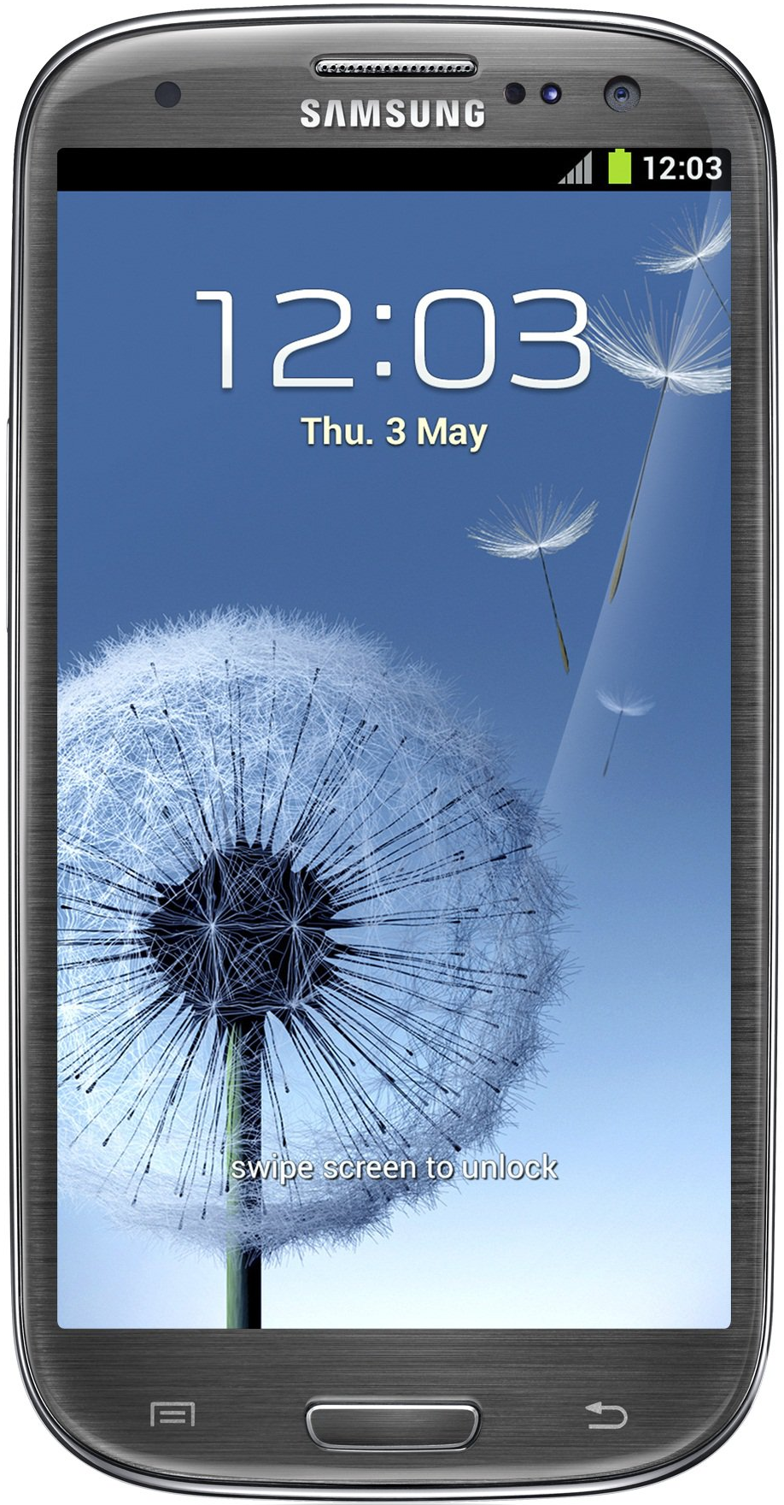
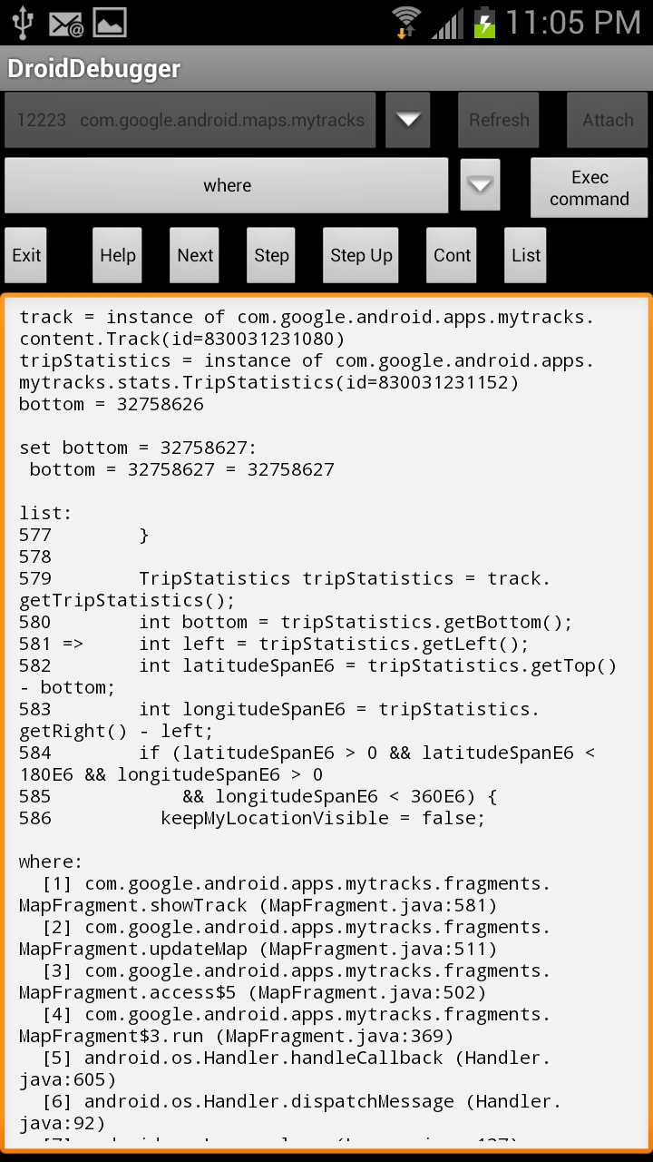
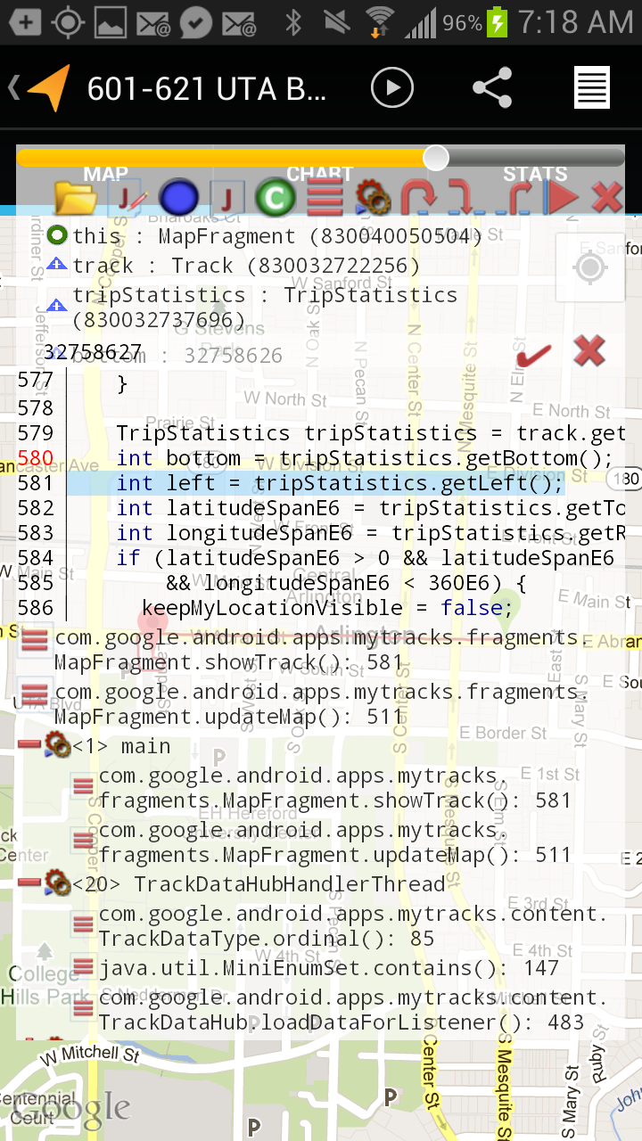

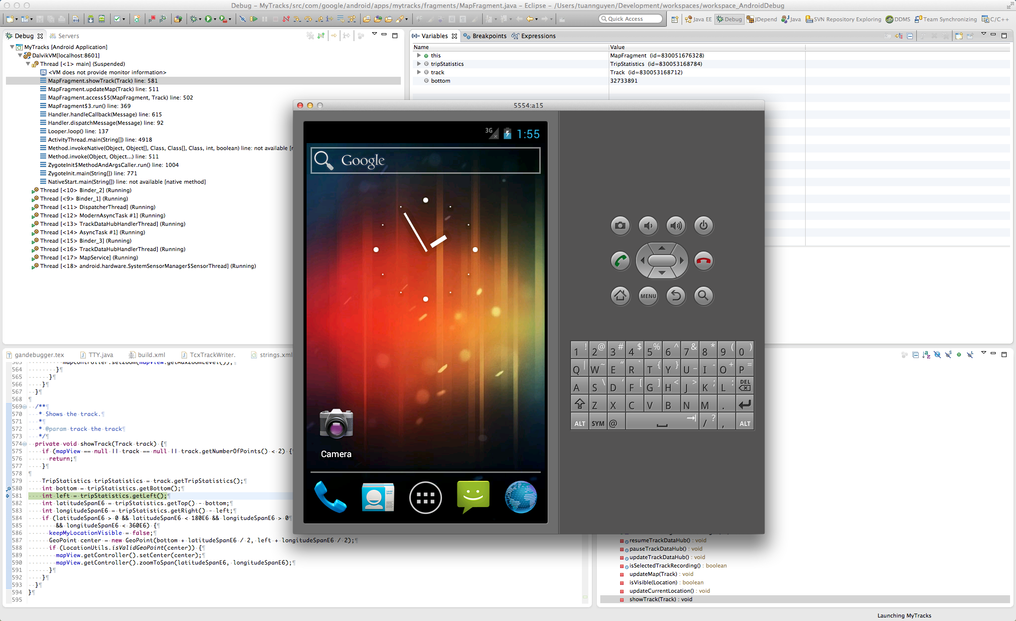
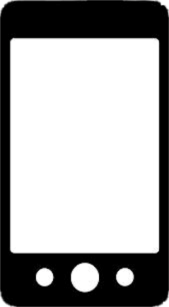





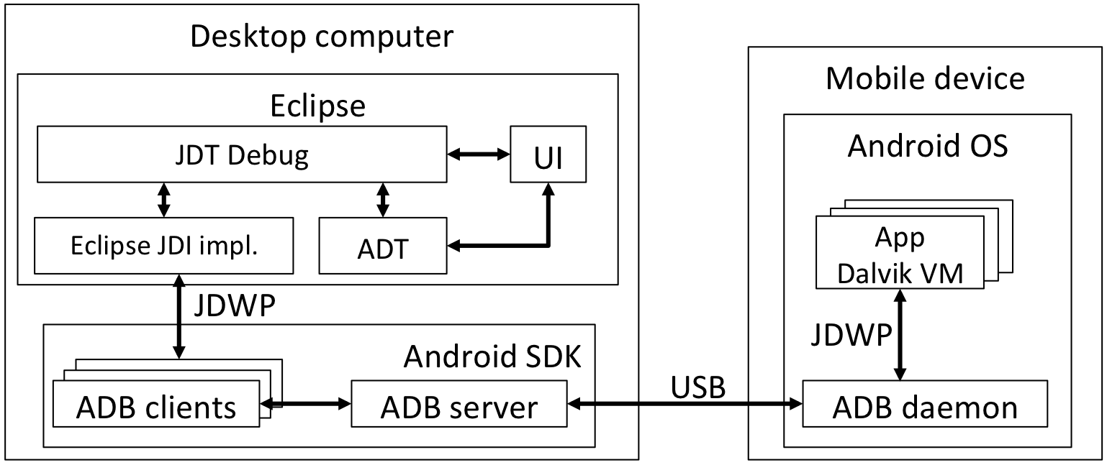
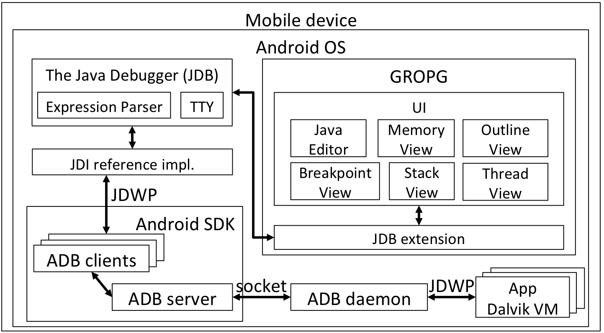
GROPG: A Graphical On-Phone Debugger
Introducing GROPG, the world’s first graphical on-phone app debugger
Test mobile phone app with a powerful graphical debugger
Tuan Anh Nguyen, tanguyen@mavs.uta.edu
Christoph Csallner
csallner@uta.edu
Nikolai Tillmann
nikolait@microsoft.com
Microsoft Research
Redmond, WA 98052
Computer Science and Engineering Department
University of Texas at Arlington
I just finished coding
my Android app ☺
(3) Text-based on-phone debugger
Less powerful than graphical debugger
Current options:
Debug pane handle and transparency slider
Control buttons
(2) Attach desktop debugger to a virtual device
Cannot emulate all phone features (e.g., GPS)
In-scope variables and reachable heap values
Write to memory
Source code with breakpoint
GROPG Features
(1) Attach desktop debugger to a phone
Need two devices;
Restricted movement
Load source code files
Set breakpoints
View and edit active breakpoints
Inspect & change in-scope memory values including heap
Step into, over, and out of instructions
Inspect threads and runtime stacks
View current source code location
Threads and invocation stacks
Observations
User interface of debuggee
It is hard to port an existing desktop debugger to mobile phones
Limited screen size on mobile devices
Increasing performance of mobile phones
J
GROPG Architecture
Preliminary results
# | DroidDebugger | T [s] | GROPG | T [s]
1 | Open source file in external tool | 21 | Open source file | 18
2 | Review code in external tool | 19 | Review code | 19
3 | Remember class, line for breakpoint | 5 | n/a | 0
4 | Switch back to debugger | 3 | n/a | 0
5 | Recall command syntax | 0 | n/a | 0
6 | Type: stop at com.google.android.apps. Mytracks.fragments.MapFragment:580 | 63 | Tap line | 1
7 | Tap Exec command | 1 | Tap button | 1
 | Total | 112 |  | 39
App | LOC | DroidDebugger |  |  | GROPG
 |  | App [MB] | Dbg [MB] | Time [min:s] | App [MB] | Dbg [MB] | Time [min:s]
F2C | 27 | 3 | 10 | 2:13 | 3 | 24 | 0:45
MyTracks | 21,563 | 19 | 11 | 3:35 | 19 | 26 | 0:52
Zing | 5,756 | 7 | 12 | 2:53 | 7 | 25 | 1:01
GROPG has a higher memory footprint [MB] but enables faster debugging [min:s].
Desktop-based Android debugger
attached to a phone
GROPG needs fewer steps for setting a breakpoint.

