Slide 1
GROPG: A Graphical On-Phone Debugger
Tuan Anh Nguyen
tanguyen@mavs.uta.edu
Christoph Csallner
csallner@uta.edu
Nikolai Tillmann nikolait@microsoft.com
Computer Science and Engineering Department
University of Texas at Arlington
Microsoft Research Redmond, WA

Slide 2
Debugger: Important tool
Debugging common during development and maintenance
Murphy’06 study: Java developers using Eclipse:
>90% of developers used built-in debugger to inspect memory values during program execution
Roehm’12 study: Professional developers use debuggers heavily for program comprehension
G. C. Murphy, M. Kersten, and L. Findlater, “How are Java software developers using the Eclipse IDE?” IEEE Software, vol. 23, no. 4, pp. 76–83, Jul. 2006.
T. Roehm, R. Tiarks, R. Koschke, and W. Maalej, “How do professional developers comprehend software?” in Proc. 34th ACM/IEEE International Conference on Software Engineering (ICSE). IEEE, Jun. 2012, pp. 255– 265.

Slide 3
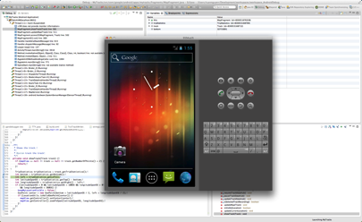



Debugging mobile phone applications today: 2 mainstream techniques
Common on: iOS, Android, Windows Phone, etc.
1
2
Attach desktop debugger to a phone
Need two physical devices
Pay for two physical devices
Real sensor readings: restricted movement
Attach desktop debugger to a virtual device
Cannot emulate all phone features (e.g., Accelerometer, Gyroscope, GPS)
Mainstream techniques ultimately require two physical devices

Slide 4
Example: Mainstream debugger architecture for Android
Android
Implemented in C, but almost all Android applications are written in Java
Consists of OS services, a Linux-based kernel, and the Dalvik virtual machine.
Dalvik virtual machine (VM)
Conceptually similar to a Java virtual machine
Implements two debug interfaces defined by the Java virtual machine:
Java Debug Interface (JDI) and Java Debug Wire Protocol (JDWP)
Desktop computer
Mobile device
Eclipse
JDT Debug
UI
Android OS
Eclipse JDI impl.
ADT
App
Dalvik VM
JDWP
Android SDK
JDWP
ADB clients
ADB server
USB
ADB daemon

Slide 5








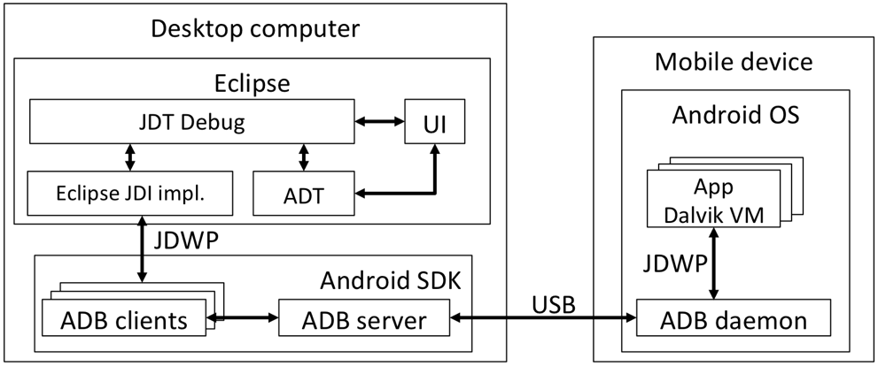
Challenges of building on-phone debuggers
Desktop
Developers can see during debugging several kinds of information on the screen
Desktop debuggers use UI elements optimized for keyboard short-cuts and mouse interaction
Mobile devices
Limited screen real estate: comparatively small mobile phone screen size
Mobile phones use touch and gesture interaction
Mobile evolving
Narrowing the performance gap with desktop computers: CPU, memory
Providing high- resolution touch-screens ➔ enable interactive debugging

Slide 6
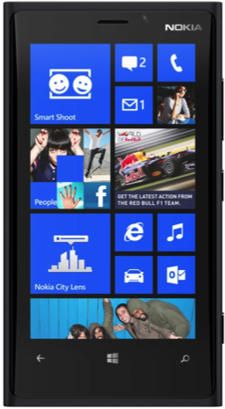
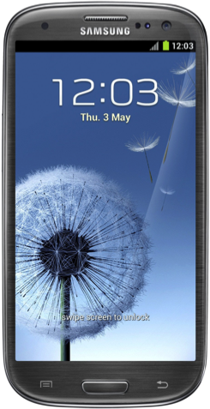
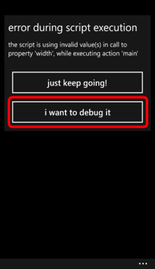
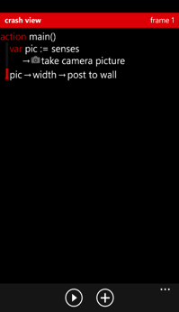
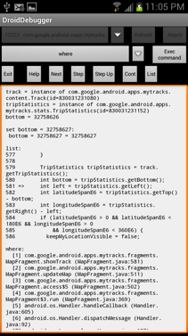

On-phone debuggers today
Pioneering techniques only require one device: a mobile phone
3
Well-known tradeoffs between desktop textual vs. graphical debuggers e.g., GDB vs. DDD
Text-based on-phone debugger: less powerful than graphical debugger; developers cannot:
- quickly navigate and manipulate the debuggee memory
- view the debuggee’s current source code location, memory values, call stack, and and debuggee UI side-by-side.
Goal: Improve mobile phone application debugging by adding powerful features to on-phone debuggers
TouchDevelop: lacks basic debugging features

Slide 7

GROPG: Graphical on-phone debugger
GROPG is built on the same ADB, JDWP, and JDI debugging infrastructure as the two-device debugger
The Java Debugger (JDB) is a simple command-line debugger included JDK
Mobile device
Android OS
The Java Debugger (JDB)
GROPG
Expression Parser
TTY
UI
Java Editor
Memory
View
Outline
View
JDI reference impl.
Breakpoint
View
Stack
View
Thread
View
JDWP
Android SDK
JDB extension
ADB clients
ADB server
socket
ADB daemon
JDWP
App
Dalvik VM

Slide 8
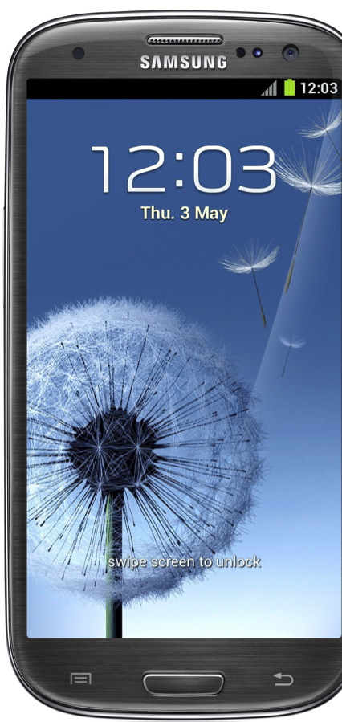
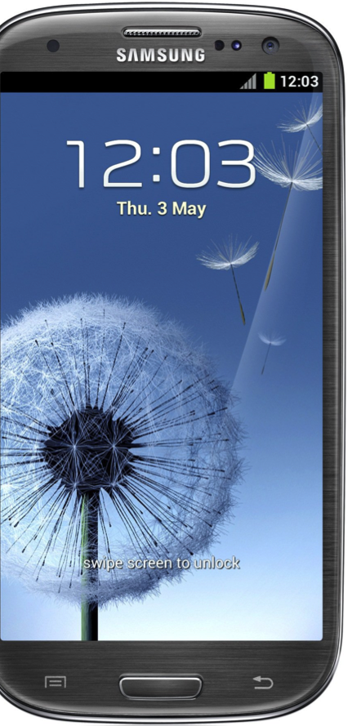
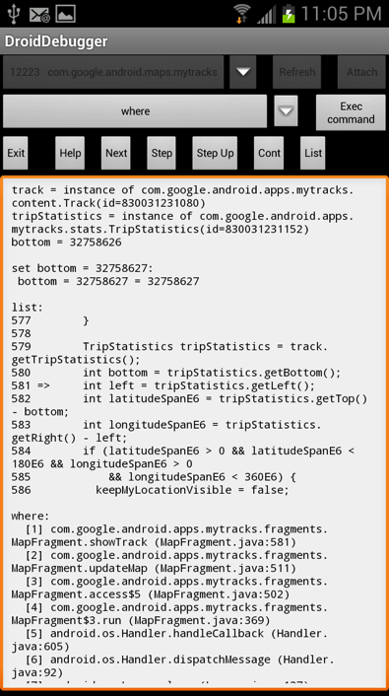
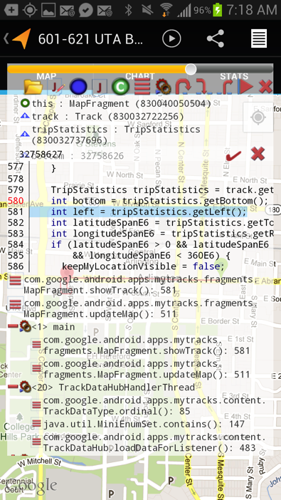
Debug pane handle and transparency slider
Control buttons
In-scope variables and reachable heap values
Write to memory
Source code with breakpoint
Threads and invocation stacks
User interface of debuggee

Slide 9

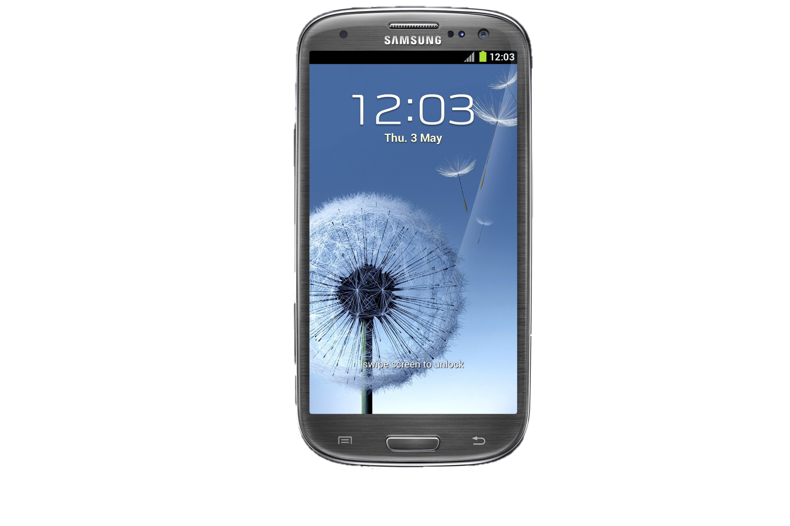

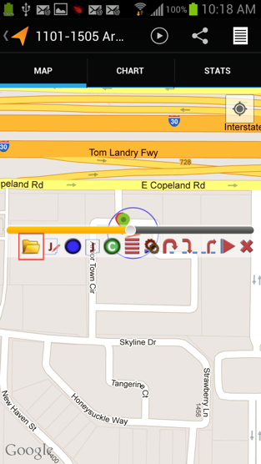
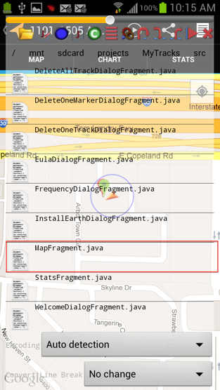
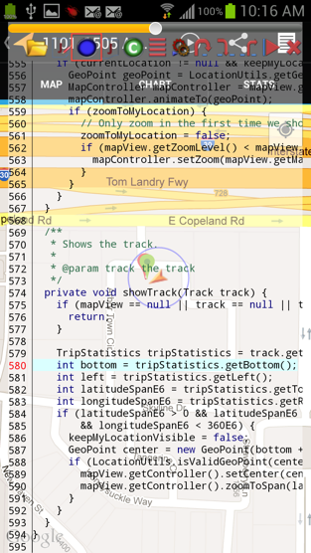

Setting a breakpoint
Tap on the line, then tap
Tap on the file to open
Tap to open a java source file
8

Slide 10
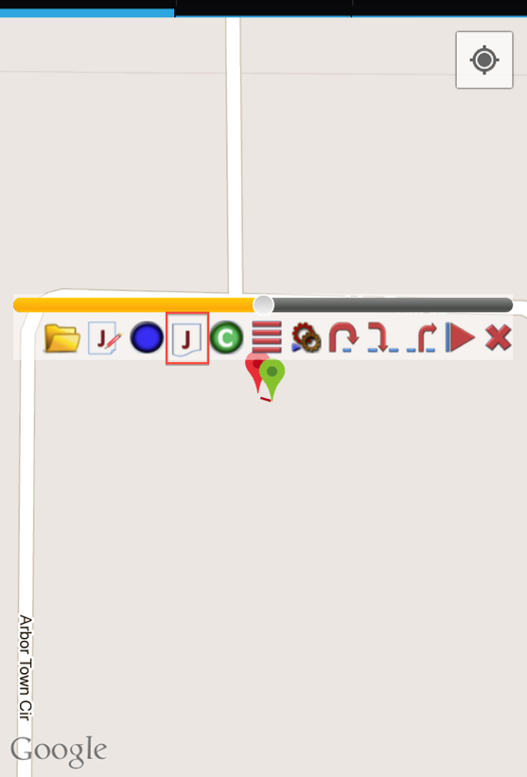
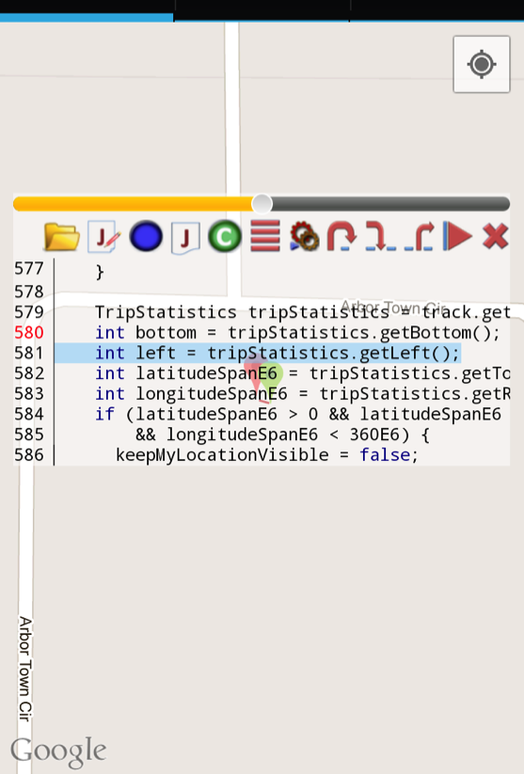
View current source code location
J
The current line is highlighted
Tap to view current source code location
J

Slide 11

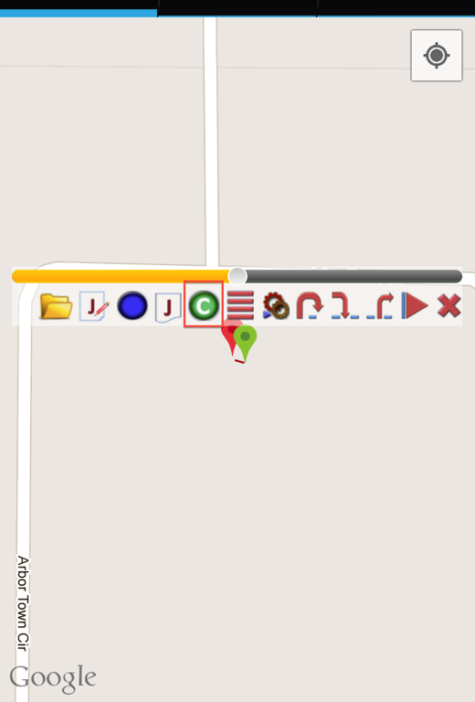
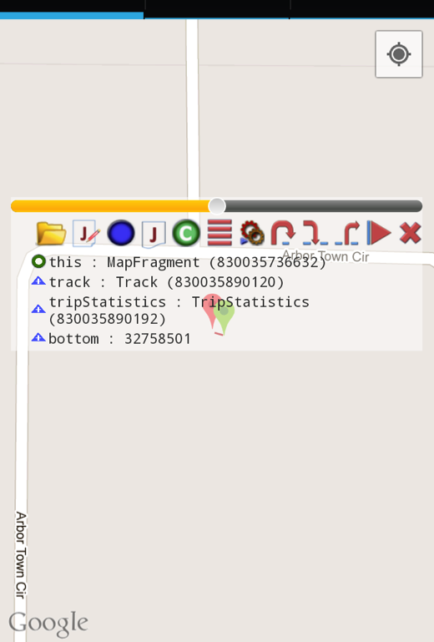
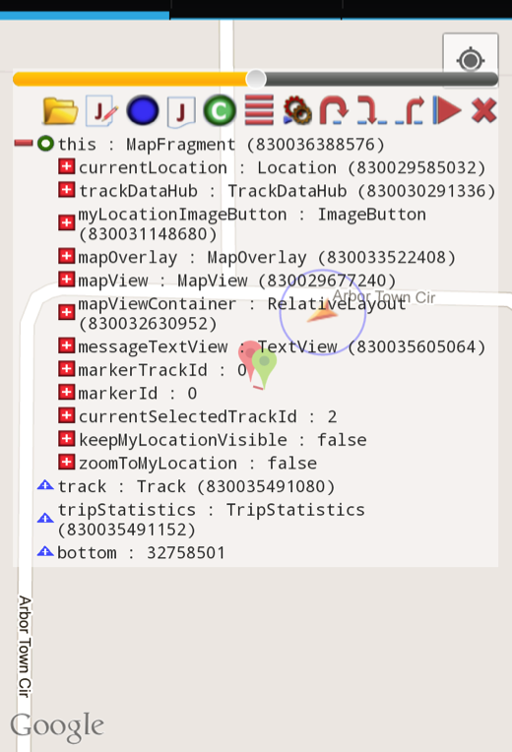

Inspect in-scope memory values
in-scope memory values
Tap to view in-scope memory values
Tap on a value to view its detail
Detail of this (MapFragment)

Slide 12
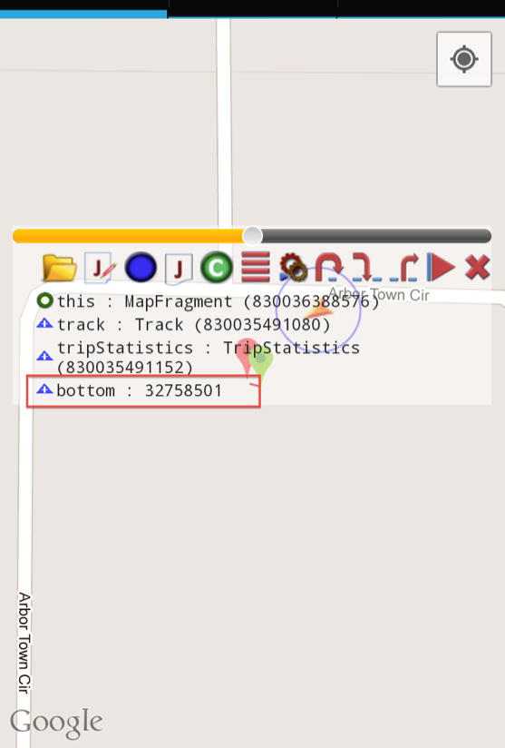
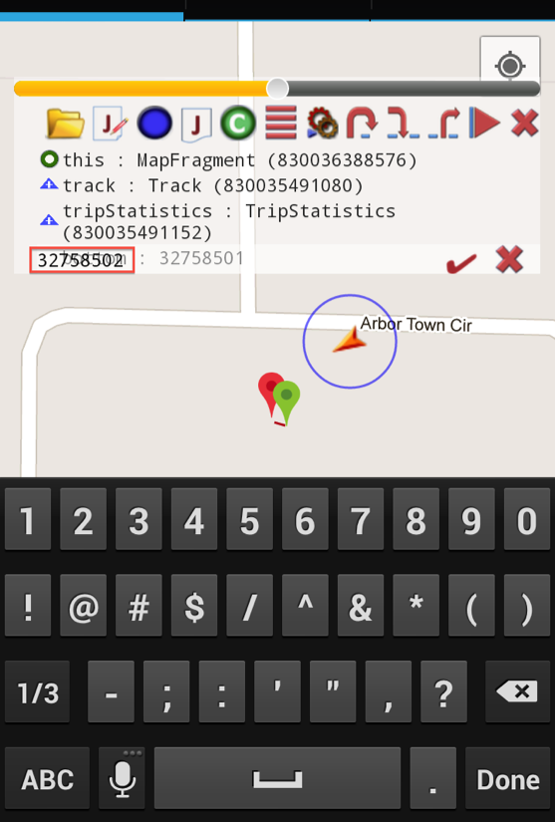
Change in-scope memory values
Tap a memory value
Tap ✔ to submit the change

Slide 13





Load source code files
Set breakpoints
View and edit active breakpoints
Inspect & change in-scope memory values including heap
Step into, over, and out of instructions
Inspect threads and runtime stacks
View current source code location
J

Slide 14
Preliminary experiments: Example debugging task
Start debugger and debuggee
Attach debugger to debuggee
Set one breakpoint
When debuggee reaches breakpoint: step to next instruction
Display memory values + method frame stack
Debuggee | LOC | DroidDebugger |  |  | GROPG
 |  | App [MB] | Debugger [MB] | Time [min:s] | App [MB] | Debugger [MB] | Time [min:s]
F2C | 27 | 3 | 10 | 2:13 | 3 | 24 | 45
My Tracks | 21,563 | 19 | 11 | 3:35 | 19 | 26 | 52
Zing | 5,756 | 7 | 12 | 2:53 | 7 | 25 | 1:01
GROPG has a higher memory footprint but enables faster debugging

Slide 15
Preliminary experiments
Step 3 of previous slide:
Setting a breakpoint, for My Tracks
GROPG needs fewer steps & less time for setting a breakpoint.
# | DroidDebugger | Time [s] | GROPG | Time [s]
(1) | Open source file in external tool | 21 | Open source file | 18
(2) | Review code in external tool | 19 | Review code | 19
(3) | Remember class, line for breakpoint | 5 | n/a | 0
(4) | Switch back to debugger | 3 | n/a | 0
(5) | Recall command syntax | 0 | n/a | 0
(6) | Type: stop at com.google.android.apps. Mytracks.fragments.MapFragment:580 | 63 | Tap line | 1
(7) | Tap Exec command | 1 | Tap button | 1
 | Total | 112 |  | 39

Slide 16


Status/Limitations
Works fully with Android version 2.3 to 4.2.1, do not need root
From 4.2.2 need root to work
Not support setting breakpoint in anonymous inner classes
Not show Android library source code during debugging
If an application is compiled for release mode, Android prevents it from being debugged
GROPG is open source, download sources from
http://cseweb.uta.edu/~tuan/GROPG/
Install GROPG via the Google App Store
https://play.google.com/store/apps/details?id=edu.uta.cse.gropg&hl=en

Slide 17
Future work
Integrate with on-phone coding which is similar to Tillmann’11 to create a full on-phone IDE
Address traditional debugging challenges on-phone:
  Cross-language Java and native code debugging of Lee’09
  Support for why-questions of Ko’04
N. Tillmann, M. Moskal, J. de Halleux, and M. Fahndrich, “Touchdevelop: Programming cloud-connected mobile devices via touchscreen,” in Proc. 10th SIGPLAN ONWARD. ACM, 2011, pp. 49–60.
B. Lee, M. Hirzel, R. Grimm, and K. S. McKinley, “Debug all your code:
portable mixed-environment debugging,” in Proc. 24th ACM SIGPLAN Conference on Object-Oriented Programming, Systems, Languages, and Applications (OOPSLA). ACM, Oct. 2009, pp. 207–226.
A. J. Ko and B. A. Myers, “Designing the Whyline: A debugging interface for asking questions about program behavior,” in Proc. ACM SIGCHI CHI. ACM, Apr. 2004, pp. 151–158.

Slide 18
References
G. C. Murphy, M. Kersten, and L. Findlater, “How are Java software developers using the Eclipse IDE?” IEEE Software, vol. 23, no. 4, pp. 76–83, Jul. 2006.
T. Roehm, R. Tiarks, R. Koschke, and W. Maalej, “How do professional developers comprehend software?” in Proc. 34th ACM/IEEE International Conference on Software Engineering (ICSE). IEEE, Jun. 2012, pp. 255– 265.
N. Tillmann, M. Moskal, J. de Halleux, and M. Fahndrich, “Touchdevelop: Programming cloud-connected mobile devices via touchscreen,” in Proc. 10th SIGPLAN ONWARD. ACM, 2011, pp. 49–60.
A. Zeller and D. Lütkehaus, “DDD - A free graphical front-end for Unix debuggers,” SIGPLAN Notices, vol. 31, no. 1, pp. 22–27, Jan. 1996.
N. Matloff and P. J. Salzman, The Art of Debugging with GDB, DDD,
and Eclipse. No Starch Press, Sep. 2008.
B. Lee, M. Hirzel, R. Grimm, and K. S. McKinley, “Debug all your code:
portable mixed-environment debugging,” in Proc. 24th ACM SIGPLAN Conference on Object-Oriented Programming, Systems, Languages, and Applications (OOPSLA). ACM, Oct. 2009, pp. 207–226.
A. J. Ko and B. A. Myers, “Designing the Whyline: A debugging interface for asking questions about program behavior,” in Proc. ACM SIGCHI CHI. ACM, Apr. 2004, pp. 151–158.

Slide 19
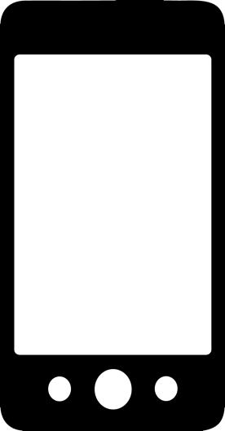
?

Slide 20
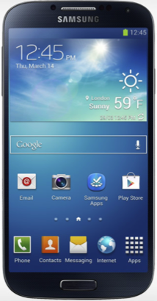
Challenges of building on-phone debuggers
CPU: Octa-core 1.6 Ghz
Memory: 2 GB
Pixel density: 441 ppi

