Slide 1
REMAUI: Reverse Engineering Mobile Application User Interfaces
Tuan Anh Nguyen
tanguyen@mavs.uta.edu
Christoph Csallner
csallner@uta.edu
Computer Science and Engineering Department
University of Texas at Arlington

Slide 2
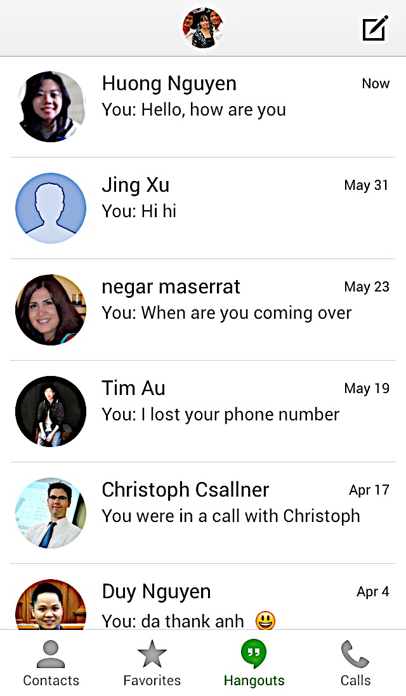
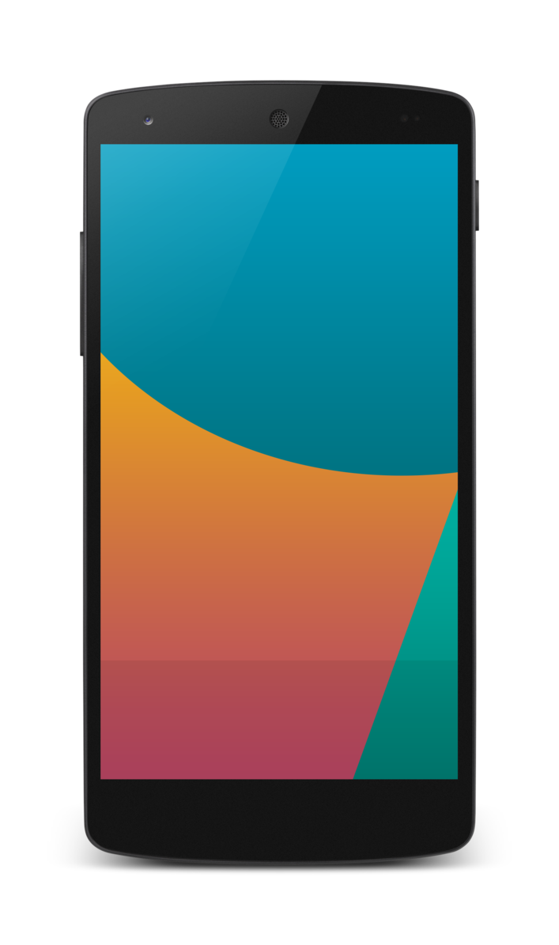
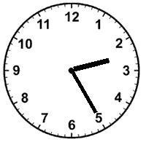
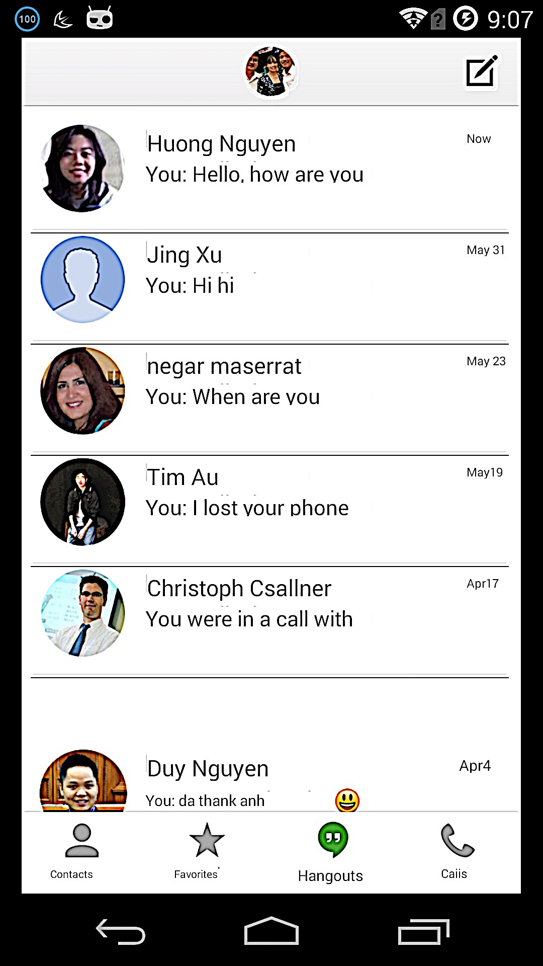
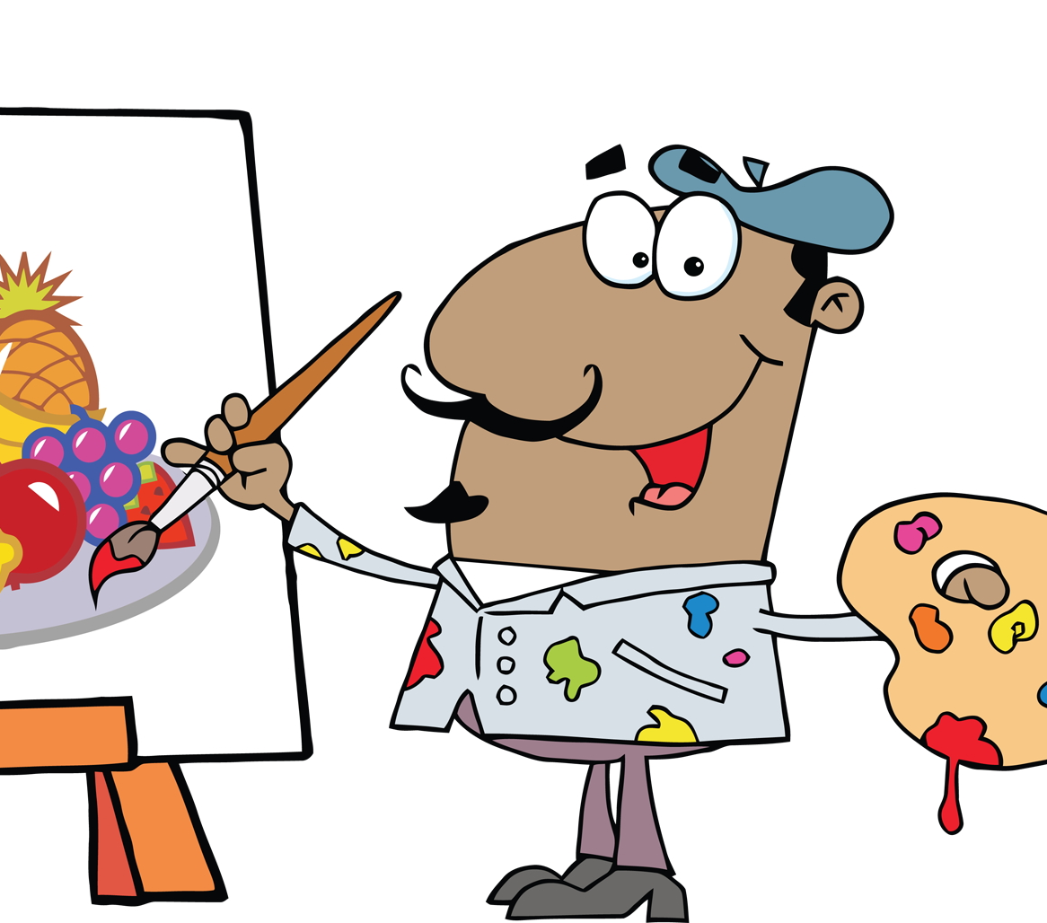

Mobile App Development:
Many Iterations of
Expert Graphic designers, artists, etc. → Non-programmers
Pixel-based bitmap: Conceptual drawing of user interface (UI) -- e.g., in Photoshop, screenshot, or pencil on paper
innovative & optimized user interface
Source code: Manually recreate artist’s UI bitmap as source code -- e.g., Android
Notes:
[] pronounce "manually" as MAN-ually (as in "man”)
[] why talk about feedback loop?
==> talk about recreation task instead
[-] do not "replace the developer" -- do easy work
Interactive GUI builders are complex
Programmers make many mistakes using GUI builders
14: need more workflow background:
-- designers
-- how do programmers fit it?

Slide 3
Goal: Automatically Infer App Source Code
Expert Graphic designers, artists, etc. → Non-programmers
Pixel-based bitmap: Conceptual drawing of user interface (UI) -- e.g., in Photoshop, screenshot, or pencil on paper
innovative & optimized user interface
Source code: Automatically recreate artist’s UI bitmap as source code -- e.g., Android
Notes:
Interactive GUI builders are complex
Programmers make many mistakes using GUI builders

Slide 4
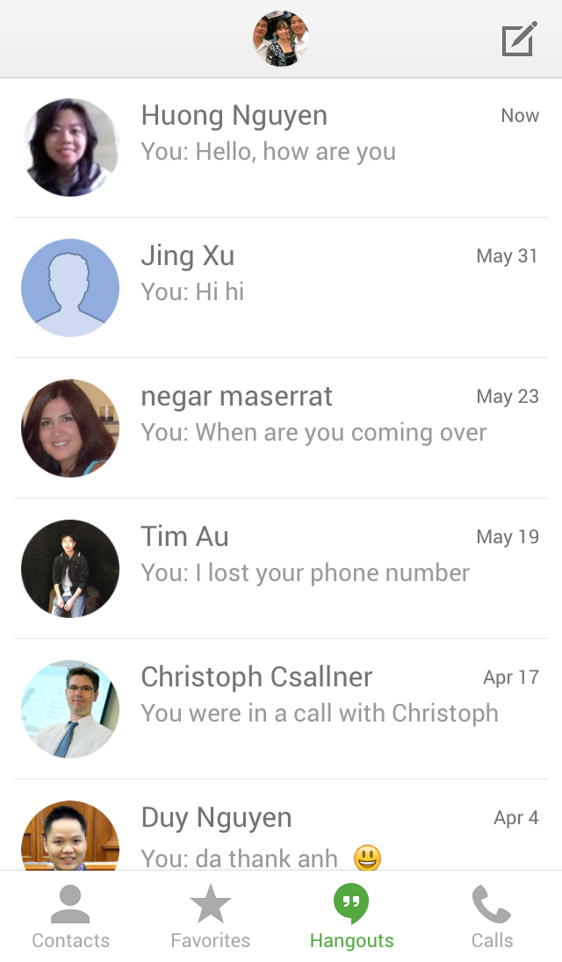
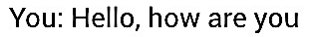
App UI ≠ Photoshop ≠ Pencil on paper
App UI = View Hierarchy, ideally flat & flexible
Container
(Root)
Container
Container
(List Item)
Container
(List)
…
…
Container
…
…
Container
Image
Text
Notes:
Entire screen:
Root
Chlir

Slide 5




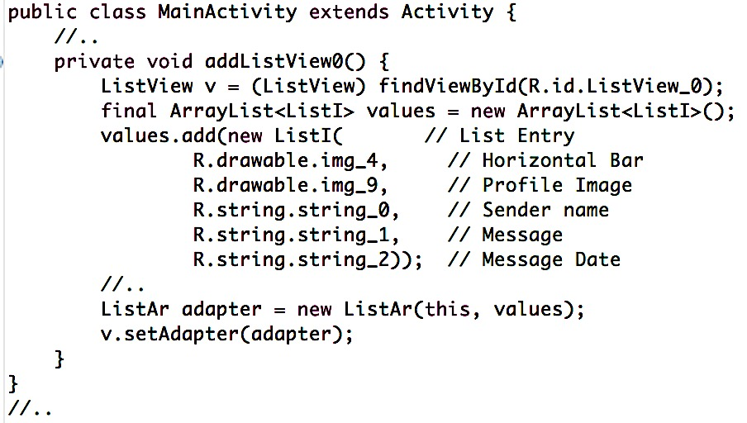
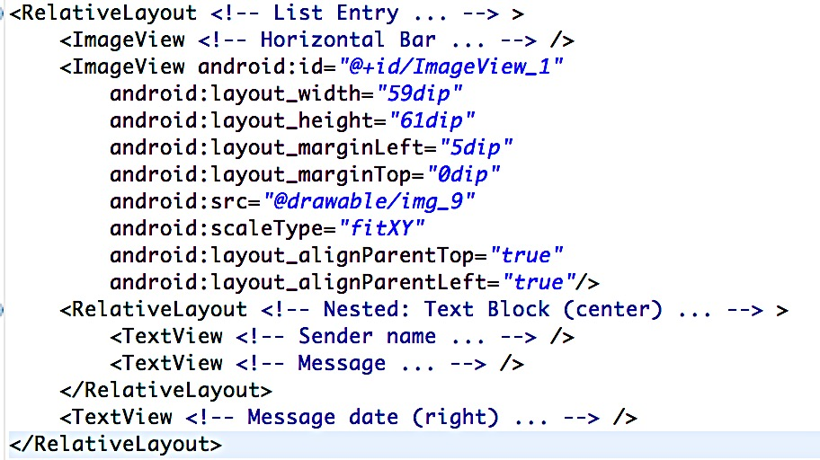
Background on View Hierarchy: Layout Containers & Layout Params
Linear Layout
Relative Layout
List / Grid
Container
Image
Text
Notes:
Different layouts:
Pick right one.

Slide 6


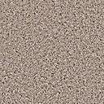









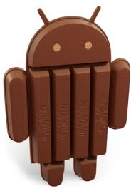
REMAUI Example:
iOS Screenshot → Running Android App
App Screenshot
(Google Hangout app on iOS)
UI View Hierarchy
Source Code and Resources
Images
Text
Huong Nguyen
Reverse eng.
Export
You: Hello, how are you
Now
Jing Xu
You: Hi hi
Source Code & Layout Definition
Compile
Deploy & Run
iOS
…
Image
Text
Container
List item
→ A reverse-engineering task: Infer general structure from single example screen

Slide 7
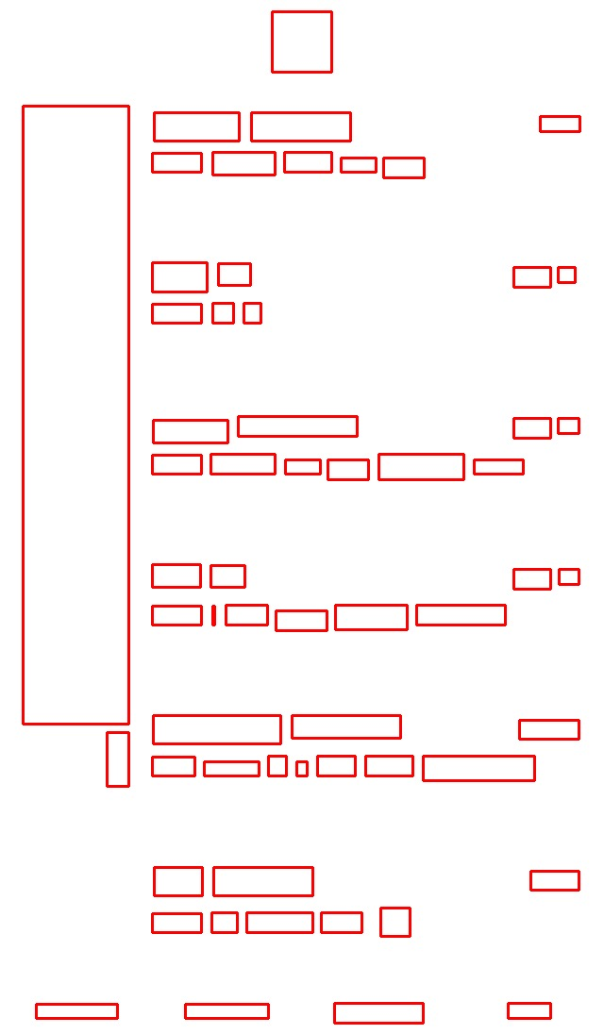
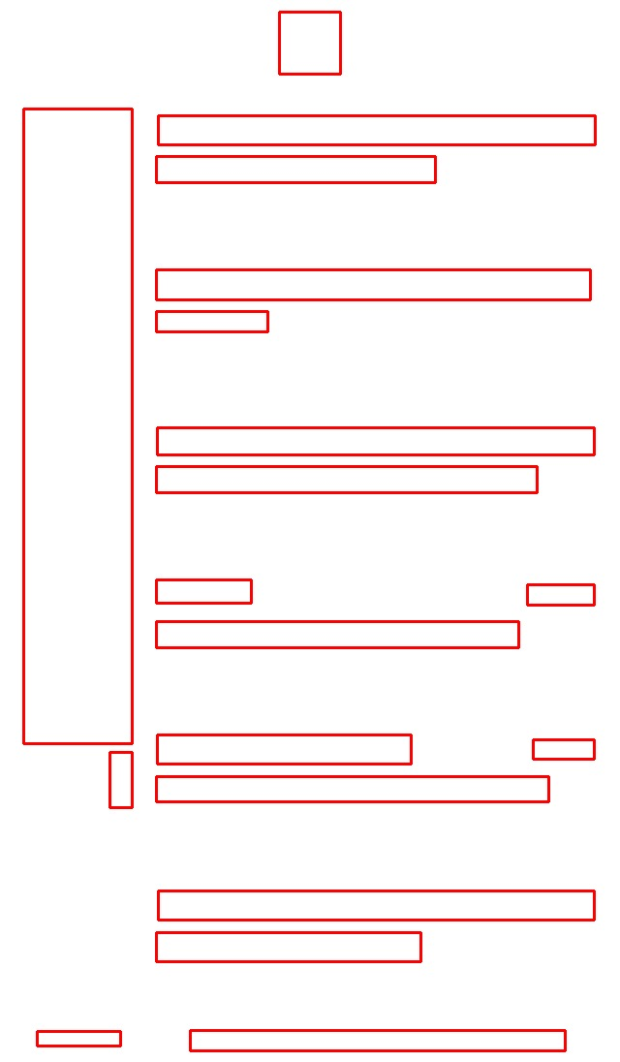
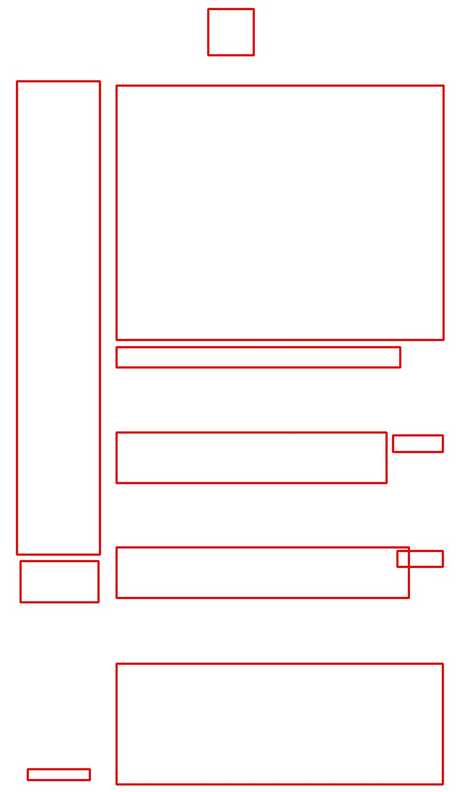
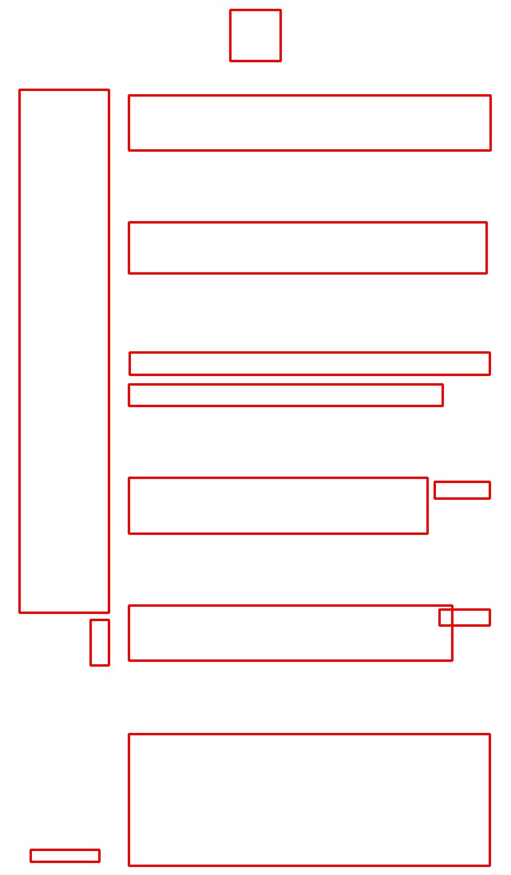
Optical Character Recognition Tool: Tesseract Similar to Commercial OCR Tools
OCR performance at various granularity levels
Word
Line
Block
Paragraph
?
OCR tools perform worse if text:
density is lower
arranged more freely
combined with images
Problems
Common in Apps
Notes:
Remove boxes:
OCR says "word box inside another word box" (full overlap) -- regardless of how big the boxes are ==> remove both word
Confidence value returned by OCR boxes
height at least 9 times larger than width
9 times (most English words are not very long)
“not clear what this means: what is "low confidence"?”
Confident: The OCR algorithm gives this confident level

Slide 8
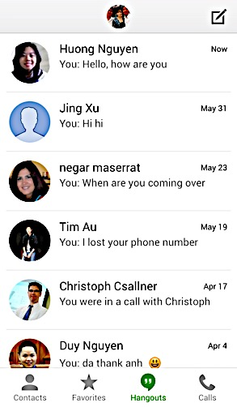
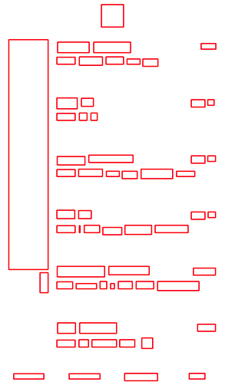
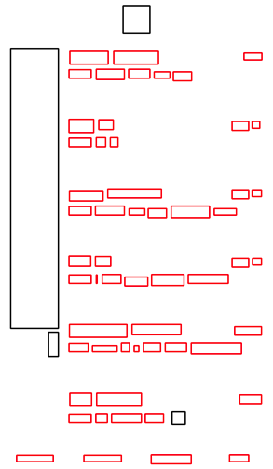
Step 1: Post-process OCR with Domain-specific Heuristics
Remove invalid words
OCR
Word
Attribute | Value
Text | “8”
Size | 63x64
Notes:
OCR is not confident about (rule 4),
have a zero dimension (rule 1),
have an odd shape (rule 2).
Remove boxes:
OCR says "word box inside another word box" (full overlap) -- regardless of how big the boxes are ==> remove both word
Confidence value returned by OCR boxes
height at least 9 times larger than width
9 times (most English words are not very long)
“not clear what this means: what is "low confidence"?”
Confident: The OCR algorithm gives this confident level

Slide 9
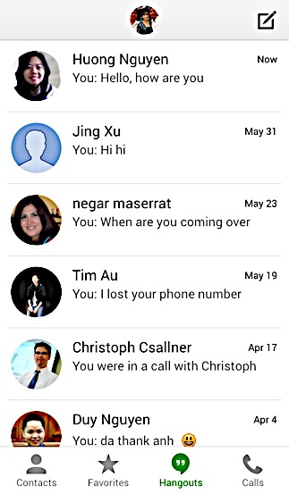
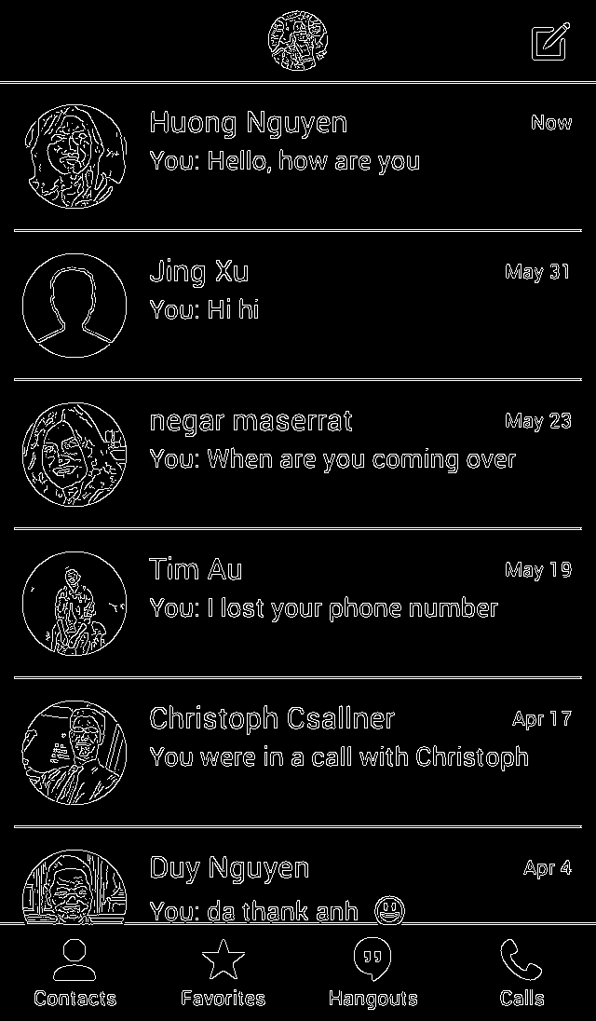
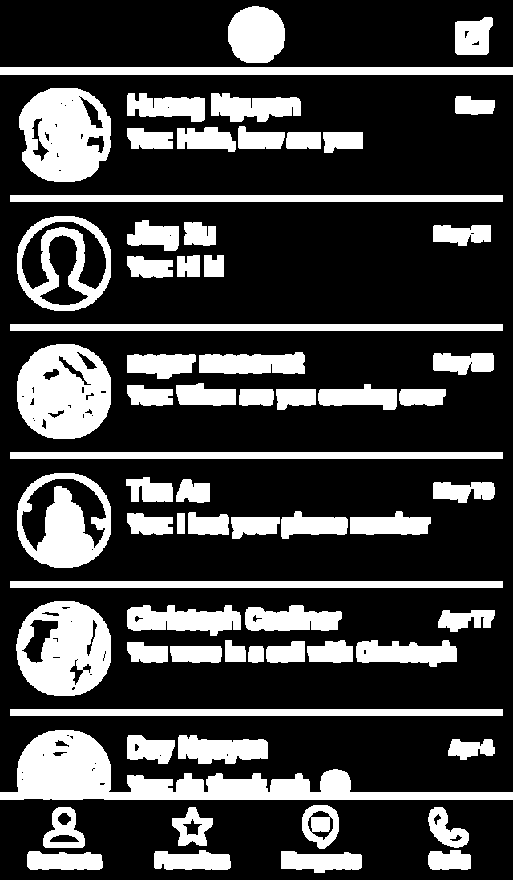
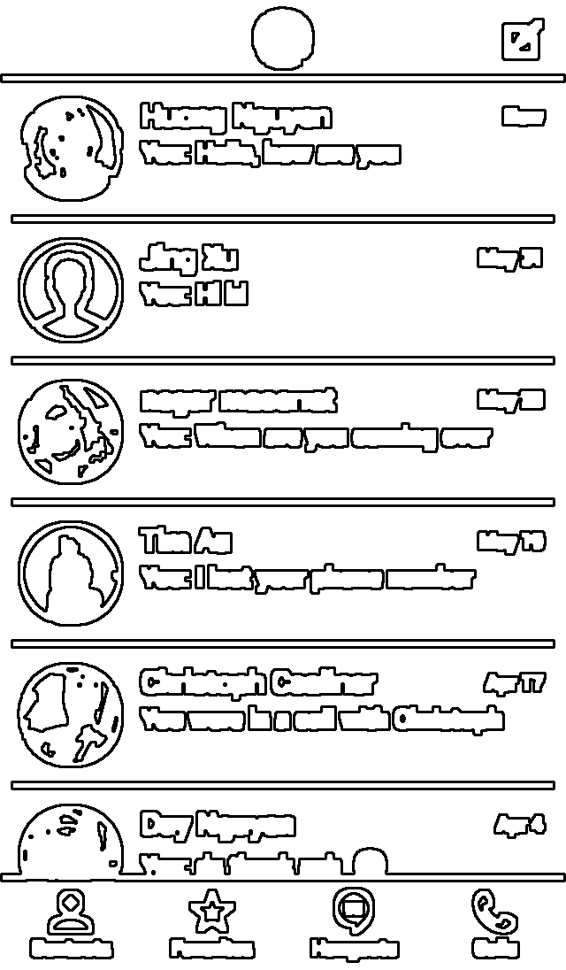
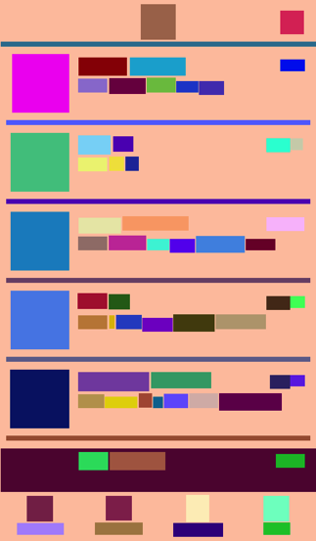
Step 2: Open-source Computer Vision Tool OpenCV
Different hierarchies & layouts → similar look
Compromise: minimal vs. flexible hierarchy
First identify atomic visual elements
Then capture nesting of visual elements
Original
Edges (via Canny)
Dilated Edges
Contours
Container Hierarchy
Separate elements
Pixels distance
Close Open Shape
Bounding Boxes
Notes:
Atomic we mean a visual element that reasonably should not be divided further

Slide 10
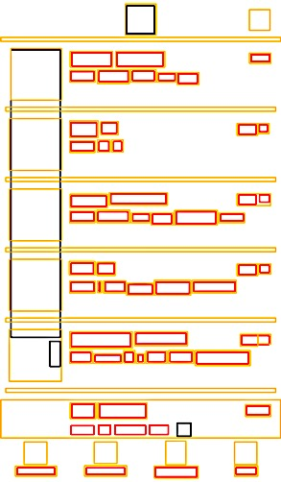
Step 3a: Eliminate OCR words that conflict with vision bounding boxes
Valid words
Invalid words
From Step 1: OCR: Word
Eliminate
OCR
Words
Vision boxes
From Step 2: Computer Vision: Tree hierarchy of boxes
Non-overlapped leaf vision box contains only 1 word, word size < 0.2 box size
Container Hierarchy
One word per box = Valid words

Slide 11
Step 3a: Eliminate OCR words that conflict with vision bounding boxes
One word per box = Valid words

Slide 12

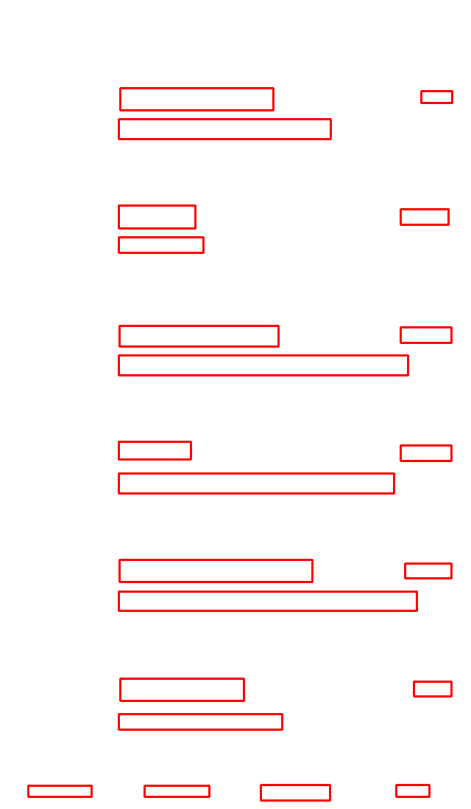
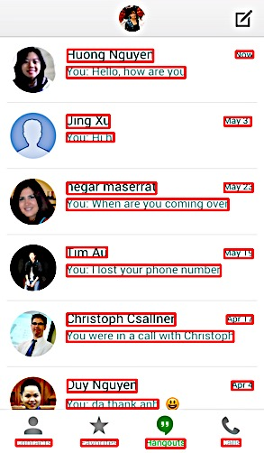
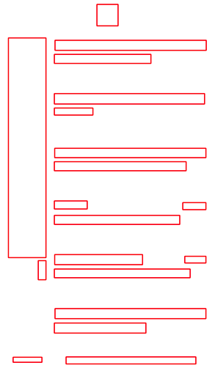
Step 3b: Divide lines into text boxes
One word per box = Valid words
Run OCR
Divide lines
Distance between words <= their height
One box per text box
From OCR: One box per line
Valid text boxes
Notes:
Pass block boundary back to OCR, run OCR on block boundary
==> better OCR results than before.
pronounce clearly "sleep" vs. "split"

Slide 13
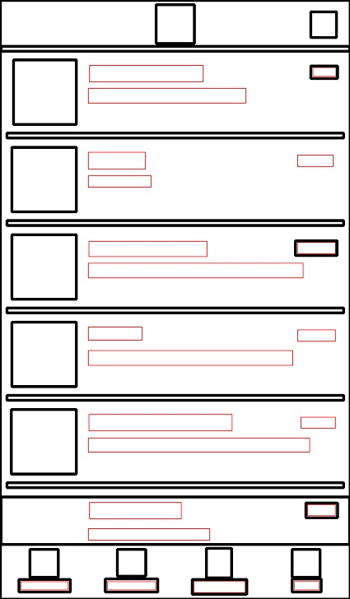
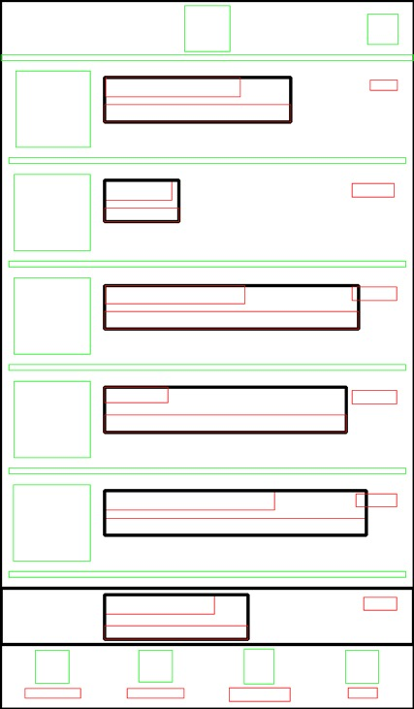

Step 3c: Add text boxes to view hierarchy
Text boxes
Vision boxes no children → Images
Vision boxes
Aligned and close text boxes → Container
Create UI elements
Adding textboxes
One box per text box
Create view hierarchy
Image View
Text view
Container view
Vision box hierarchy
Notes:
need more detailed description of all the steps (incl. this slide)
generally it is a long sequence of "we do this, we do that, we do .."
but it is never clear WHY we do the various steps: need to add this info

Slide 14
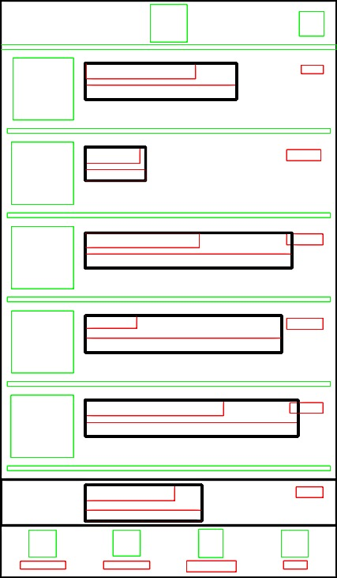
Step 4: Identify lists
Identify different view sub-trees
Create bounding-box around identical sub-trees
Other elements captured in bounding-box belong to item but are optional
Repeat for all list items
Identify identical view sub-trees
View sub-tree identical among list items
View sub-tree identical among list items
View sub-tree that differs among list items

Slide 15

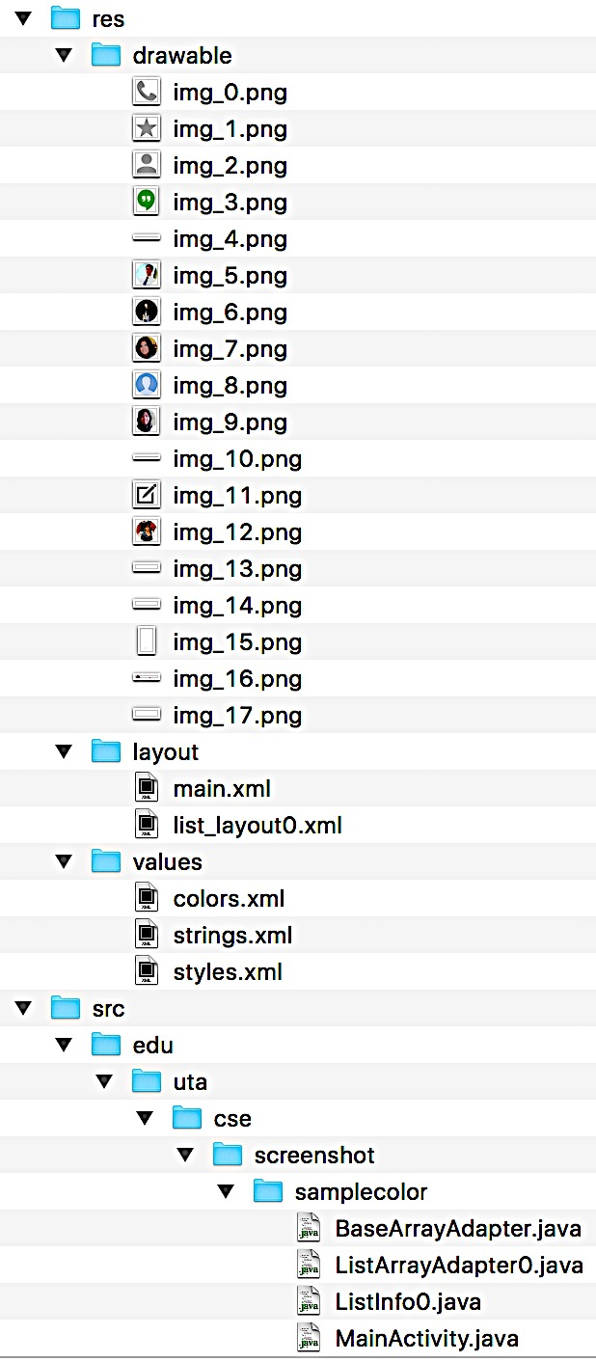
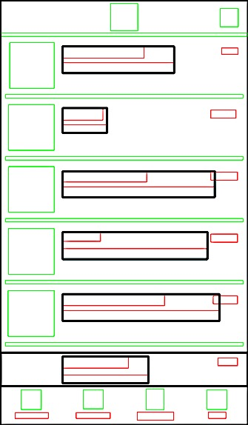
Step 5: Export images, text, layout, source code → Ready to compile
Crop and extract identified images, once for repeated images
Text value and its style
List item layout definition
Main layout definition
Container background color: dominant color after extracting images
Java code to fill lists with identified content
1
4
3
5
2
6
Notes:
not clear where OCR is coming from
-- why do we need it?
-- what does it do for us?
-- how do we use it exactly?

Slide 16
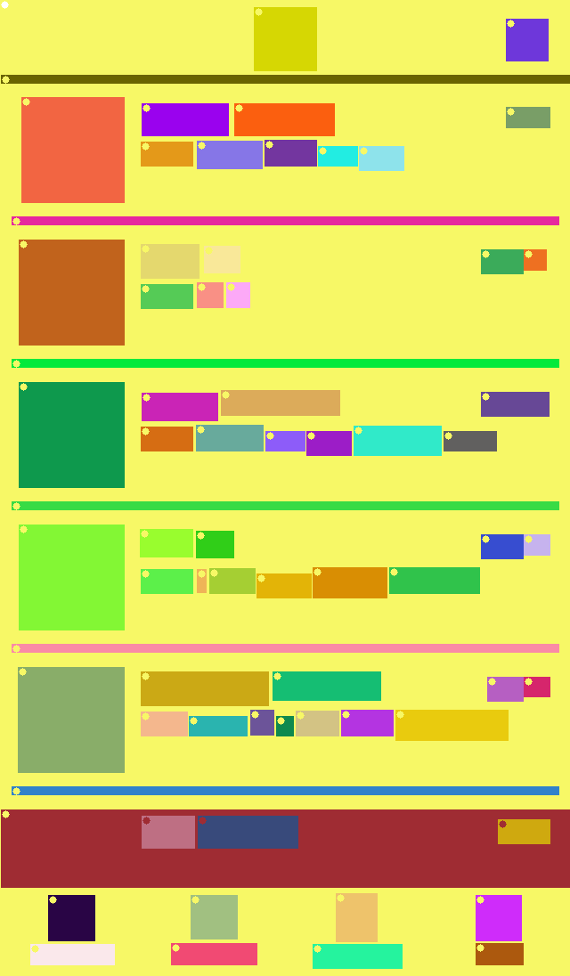
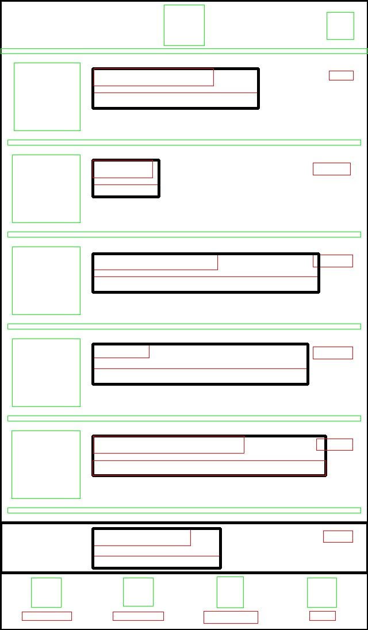


Summary of REMAUI processing steps
Computer Vision (2)
Merge (3)
Identify lists (4)
Compile,
Deploy
& Run (6)
(1)
OCR
(5)
Export
Input: UI bitmap
Images, Text, Source Code
Output: Generated app with inferred UI
Box: Word
Box: Line
Notes:
REMAUI thus uses vision and character recognition techniques to reason about the screen bitmap.
REMAUI groups
related pixels into text or images,
lines of text into text boxes,
related items into containers,
and repeated elements into list elements.

Slide 17
488 Subjects in 5 Groups
66 third-party non-game iOS applications
Top-100 free apps (minus games) in Apple App Store [*]
Group A: Every screen we could reach: 302 screenshots
Group B: Apps’ main screen with different data contents
46 third-party non-game Android applications
Top-100 free apps (minus games) in Google Play [+]
Group C: Main screen of 46 non-game apps
Group D: Main screen of 58 iOS 7 applications outside top-100 from Google and Apple
Group E: Pencil on paper sketches of main screenshots of the alphabetically first 16 of the top 100 iOS applications
[*] as of August 12, 2014
[+] as of November 9, 2014
Notes:
Non-game: e-commerce, email, maps, media players, productivity tools, translation software, and social media

Slide 18
Evaluation
Research Questions
Expectations
REMAUI Runtime?
Pixel-by-Pixel Similarity?
UI Hierarchy (Structure) Similarity?
Not interactive
Does not work well for all applications
Generated UI structure somewhat similar to original app’s UI structure
Run app from A—D on phone
Capture app’s UI hierarchy and screenshot simultaneously
Provide only screenshot to REMAUI
cycript
 | Device | OS | Configuration
A, B, D | iPhone 5 | iOS 7.1.2 | 1 GB RAM
C | Google Nexus 5 | Android 4.4.4 | 2 GB RAM
REMAUI | MacBook Pro | OSX 10.10.2 | 16 GB RAM, 2.6 GHz Core i7
adb shell uiautomator dump
Jailbreak
Rooted
Notes:
missing why we use applications (and not random screenshots from the web)
100 top apps (non-game)

Slide 19
RQ1: REMAUI Runtime Max: 52s, Average: 9s
Processing steps
1. OCR
2. computer vision
3a. merging OCR text with vision boxes
3b. splitting text lines
3c. creating the view hierarchy
4 identifying lists
5 export
Total runtime.
Expensive steps: Computer vision or OCR
Runtime of REMAUI’s seven main processing steps on the 488 subjects, shown by group, from left (A) to right (E).

Slide 20
RQ2: High Pixel-by-Pixel Similarity
Picture similarity metrics
Mean absolute error (MAE)
Mean squared error (MSE)
Normalized pixel-by-pixel screenshot similarity between REMAUI input and generated application on the 488 subjects, shown by group A–E from left to right. Higher values are better.

Slide 21
RQ3: UI Hierarchy (Structure) Similarity
Original Image
An Example
Precision p =
REMAUI Generated
Recall r =

Slide 22
RQ3: Moderate UI Hierarchy (Structure) Similarity
Image, text, and overall UI element precision (p) and recall (r) for groups B (left) and C (right). Higher values are better.
Notes:
Text is showed as text.
Image is showed as image.

Slide 23
RQ3: Reasons for Only Moderate UI Hierarchy Similarity
Input screenshot
UI hierarchy of original app
Number = Depth of UI hierarchy nesting (e.g., 9)
UI hierarchy of REMAUI-generated app
Metric not fully captures how REMAUI reproduced text or images
Pixel-by-pixel similarity was high
REMAUI computes tight bounding boxes
A corresponding original text or image view contains much additional white-space

Slide 24
Questions
?

Slide 25
Need and Industrial Relevance
≥ 90% of US pop. (≥ 16 years) uses mobile phone
> 50% of phones are smart-phones: Android, iOS
Smart-phones used for traditional PC tasks
Email, music, video, news, social, etc.
> 1M mobile apps alone for Android
Automating app development → Save $$$
Sources:
Nielsen, Feb 2013:
http://www.nielsen.com/us/en/insights/reports/2013/mobile-consumer-report-february-2013.html
http://www.appbrain.com/stats/number-of-android-apps

Slide 26
Levenshtein distance (edit distance)
Text box strings between original and generated applications.
A higher text recall than the pixel-based recall
Group | # Texts (K) | Average (Characters)
 |  | Original text | Generated text | Edit distance
C | 2.4 | 18.8 | 14.6 | 4.7
B | 2.9 | 14.6 | 15.0 | 2.9
Notes:
So on average it took only 4.7 single-character additions, removals, or substitutions to convert a string in the generated application back to the corresponding string in the original application

Slide 27
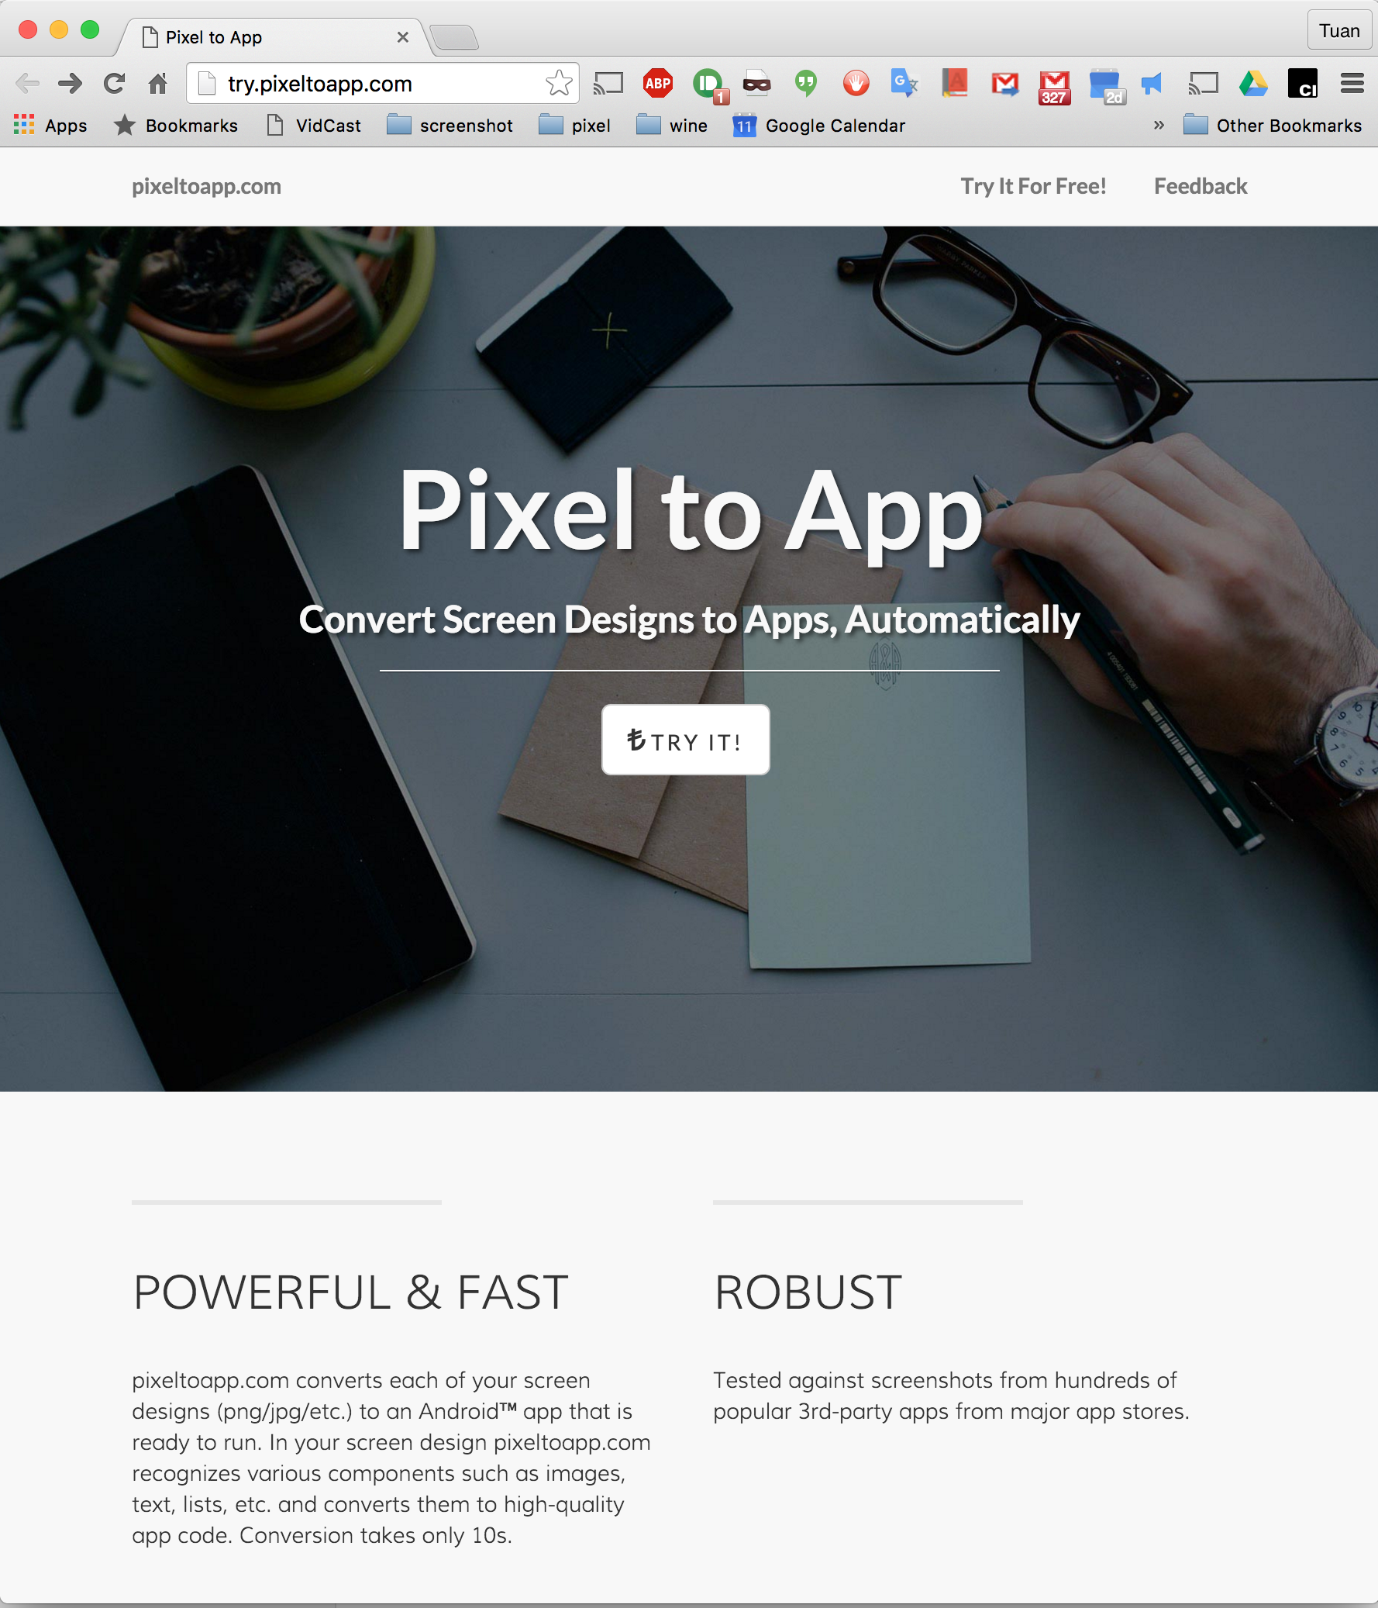

Slide 28
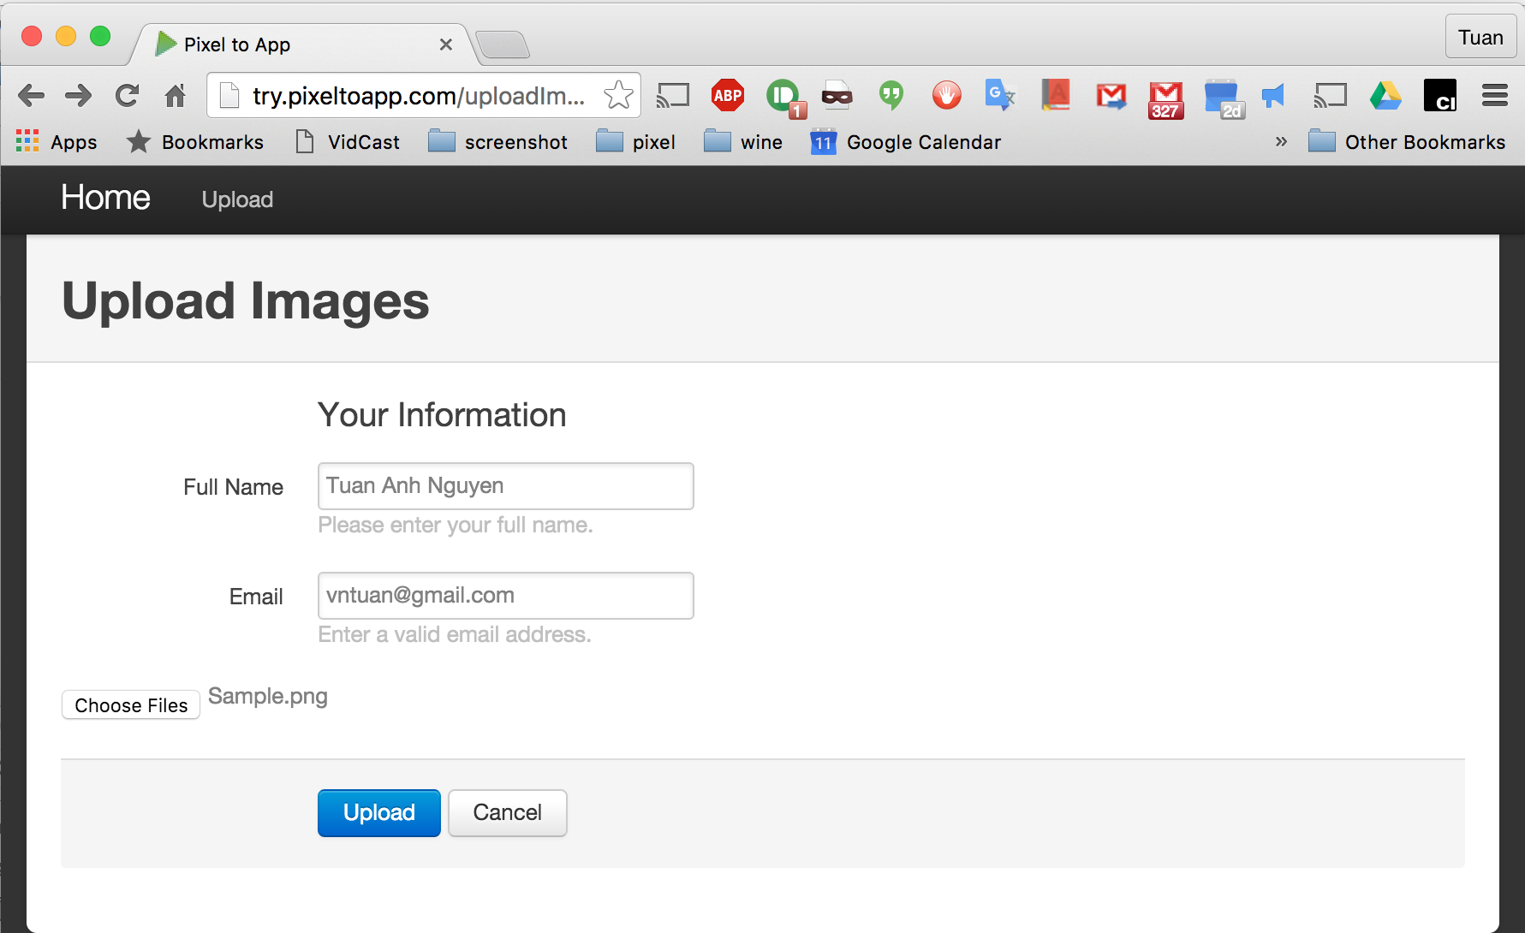

Slide 29
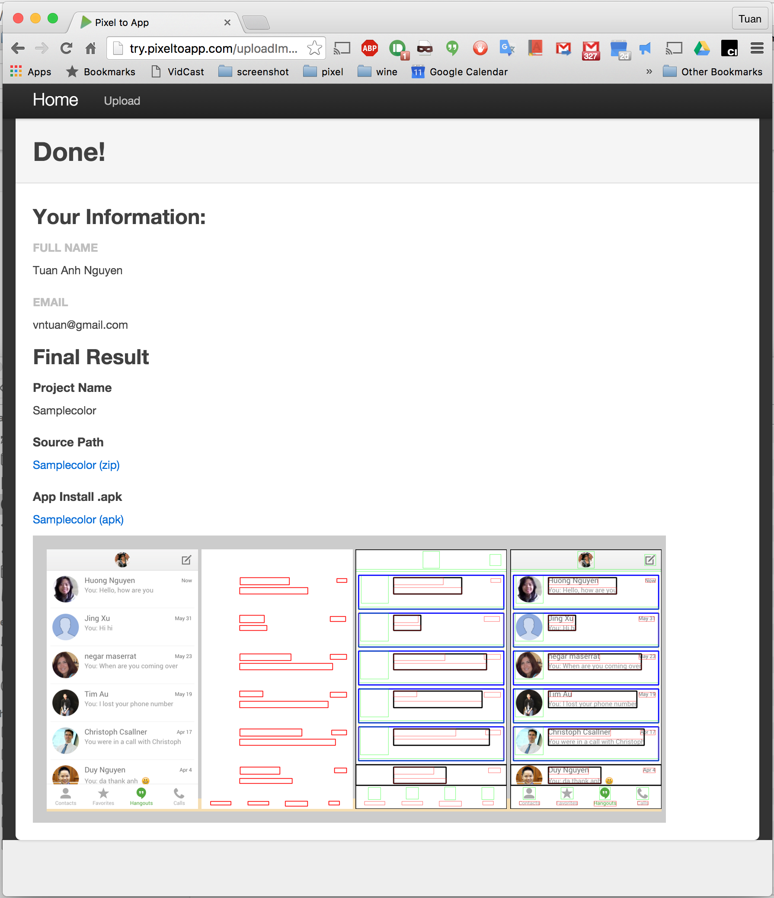

Slide 30
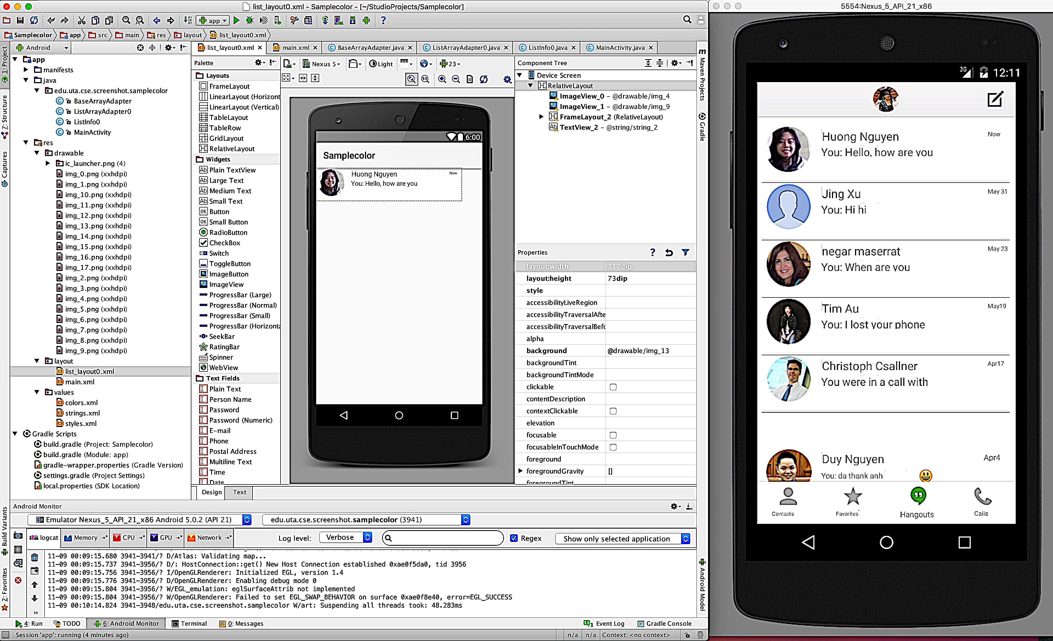

Slide 31
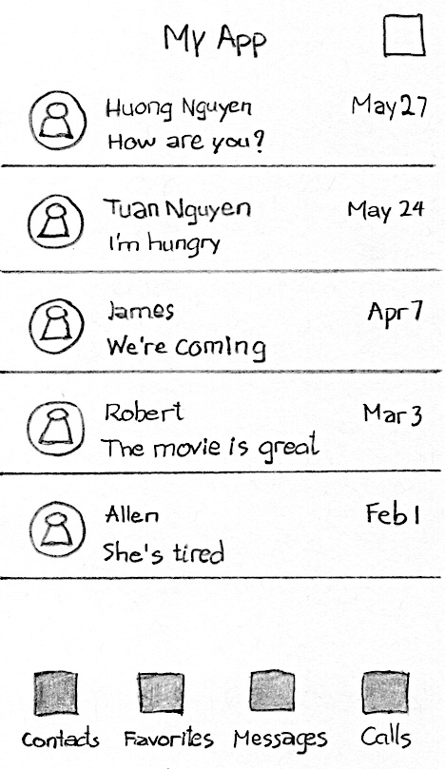

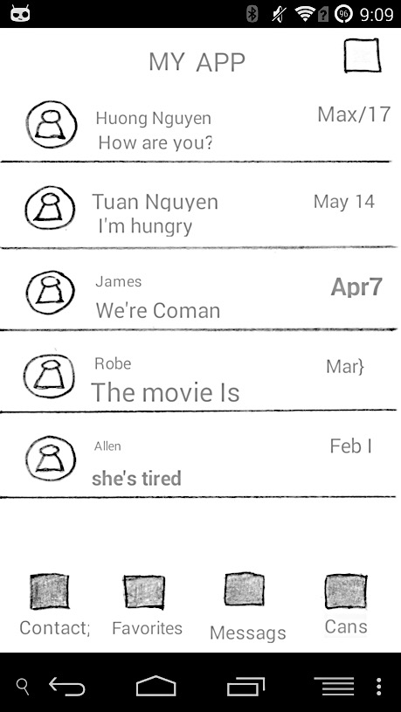



Forward engineering a mobile phone application : Pencil on Paper
Concept: Pencil on Paper
UI View Hierarchy
Source Code and Resources
Images
Text
Huong Nguyen
Reverse eng.
Export
How are you?
Generate
Max/17
Tuan Nguyen
Source Code & Layout Definition
Compile
Deploy & Run
iOS
…
Image
Text
Container
List item

